Slide 1


OnePlan Training:
Admin Training

Slide 2
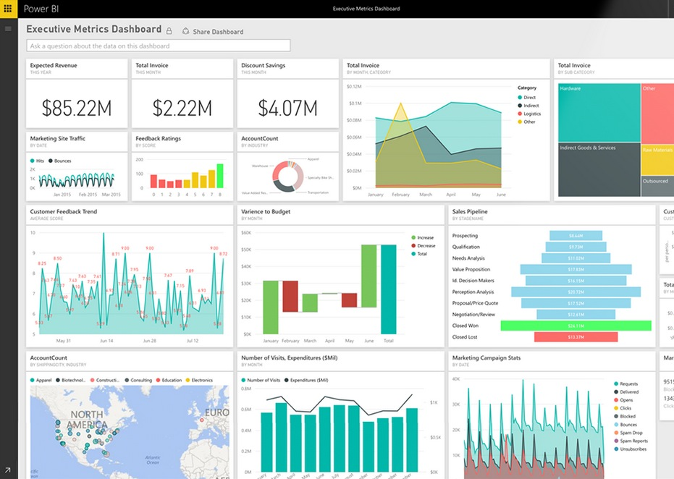


Today’s Agenda
Reorganize Projects
Resource Center
Add and Edit Generic Resources
Users Permission Global Settings
Project Level Permission Settings
Edit Users’ permission group (Entra)
Reports
Q&A

Slide 3
Things You May Be Asked To Do
“I created a project under the wrong program. Please move it.”
“Can we please add a few more Generic Resources into OnePlan for our BU so we can assign to these roles?”
“I don’t yet see Charlie Brown in the Resource Center. Can we add him in OnePlan so he then gets synced to Workday?”
“I created a project by accident. Please delete it!”
“I have a new member of my team. Please add them to my Contributor’s group so they can edit projects.”
“Can you please add a column to my schedule view?”
What else might you be asked?
Notes:
Perhaps update if they’re not using “Project”

Slide 4
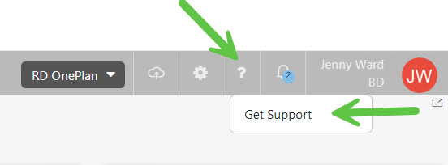
Support site
You can find all the information include in this training in support site
How to Log in Support Site: How to Login BD OnePlan Support Website? – OnePlan Support provided by PPM Works

Slide 5
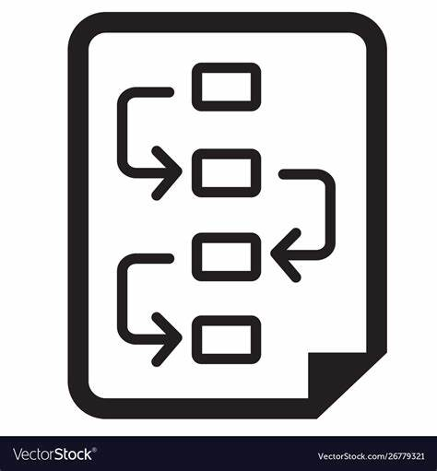
Reorganize Projects

Slide 6
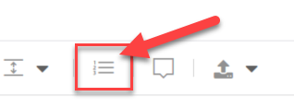
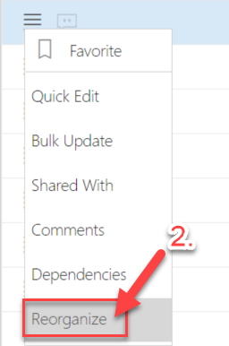
Reorganize Portfolio View
Option 1: Select Reorder icon on the top banner in Portfolio page.
Option 2: Click the hamburger menu next to the project name and select Reorganize
Notes:
Perhaps update if they’re not using “Project”

Slide 7
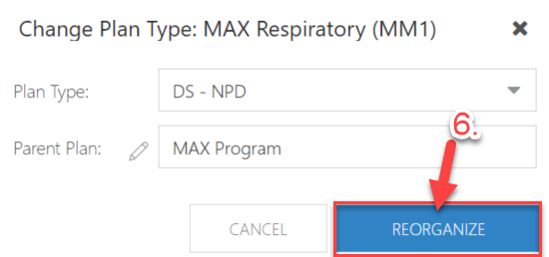
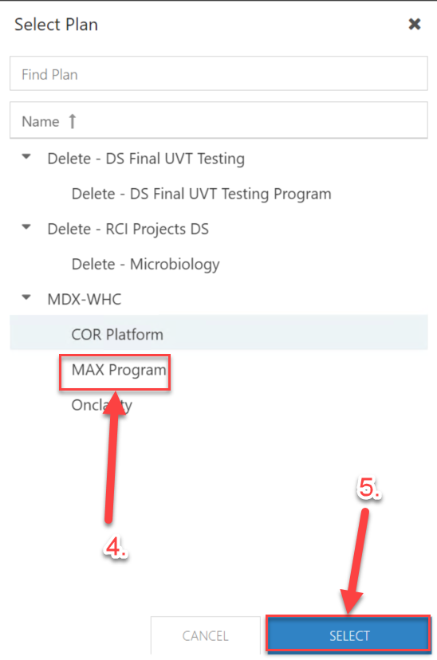
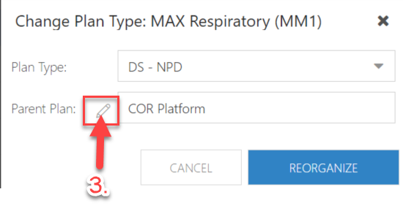
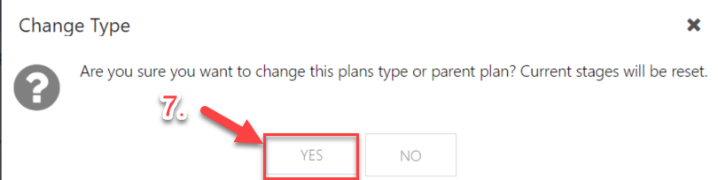
Reorganize Portfolio View
Click the hamburger menu next to the project name and select Reorganize
Notes:
Perhaps update if they’re not using “Project”

Slide 8
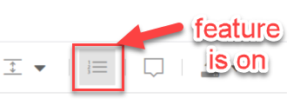
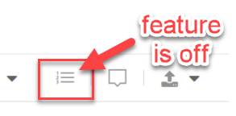
Tips:
When you using the reorder icon, if you want to move a project to a new program(here we use the example above: MAX Program, which is a new platform that with no project under it), you should ensure the program(MAX Program) has at least one project under it. The reason why you cannot move the project under a new program is that there is nothing under the new program, and OnePlan think you are going to move the project(as a program) under the new program which not match with what the hierarchy structure is.
When you create a new Program level, use the hamburger menu (reorganize feature) to move one project under the Program level.
Then you can use reorder icon on the top banner to move other projects which you want to include in that Program.
NOTE: Remember to click Reorder icon again after you finish changing the portfolio structures.
Notes:
Perhaps update if they’re not using “Project”

Slide 9

Resource Center

Slide 10

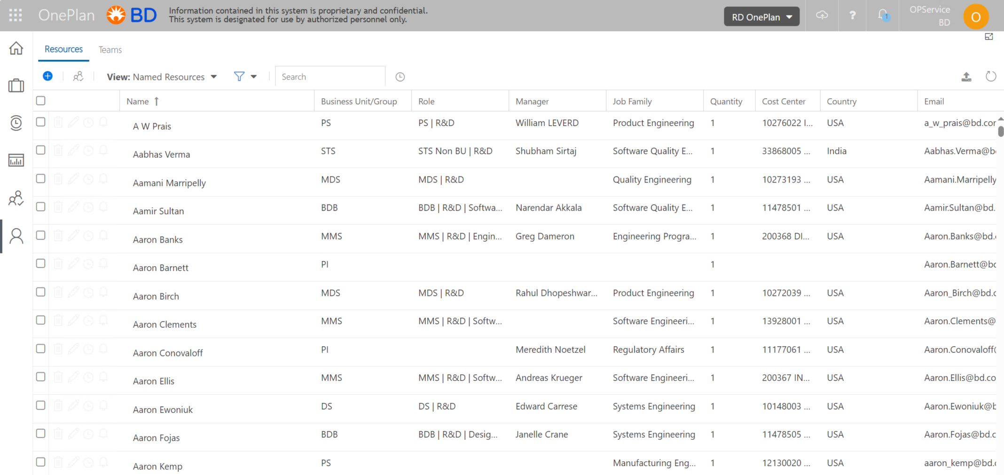
Accessing Resource Center
From the left navigation bar, select Resource Center icon.
Notes:
Perhaps update if they’re not using “Project”

Slide 11
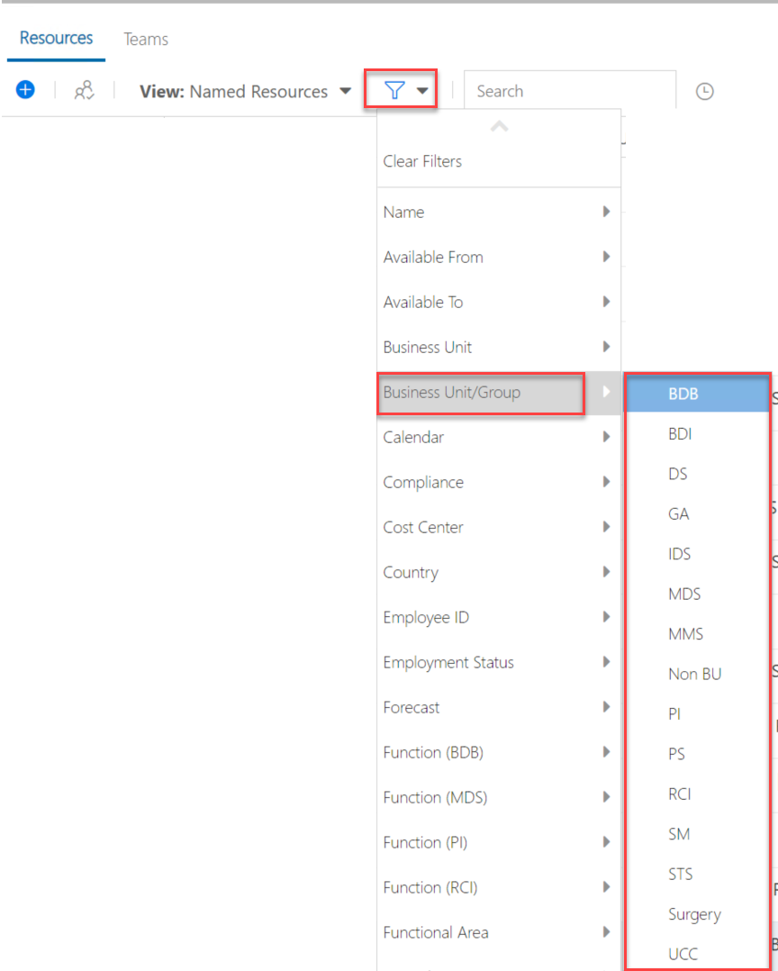
Filter to Own BU
From the top menu, click filter and select “Business Unit/Group”
Notes:
Perhaps update if they’re not using “Project”

Slide 12
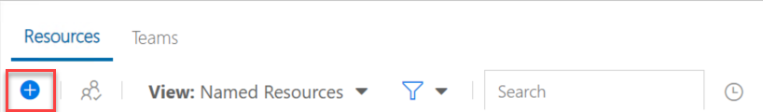
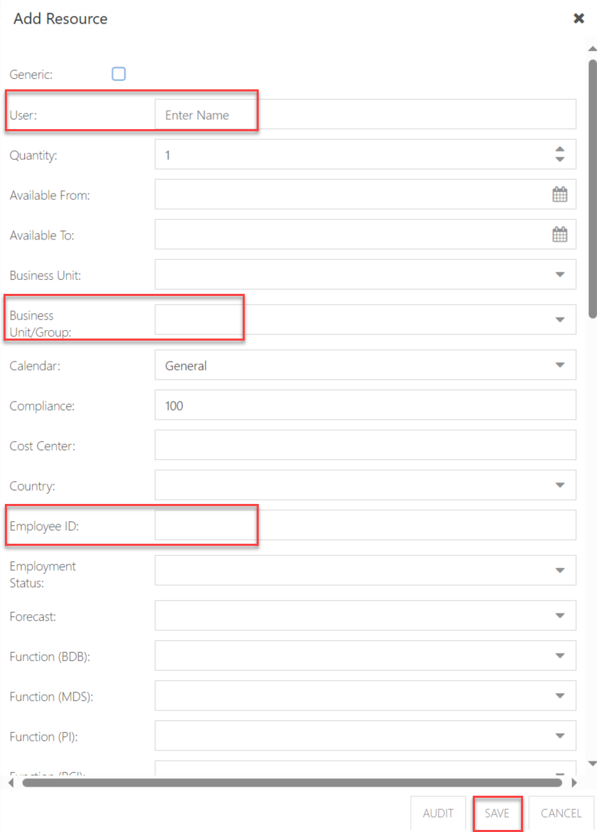
Add New Named Resources
Click “+” from top left corner
Fill in following fields
Save the information
Few fields MUST fill in:
User: Fill in Resource Name, make sure the resource with correct email address
Business Unit/Group: Select the BU name
Employee ID: Fill in Resource’s Employee Id (optional)
Manual Add: Select -> Generic no Sync
NOTE: The Rest of the information for the Named Resources will update after Workdays daily refresh.
Notes:
Perhaps update if they’re not using “Project”

Slide 13
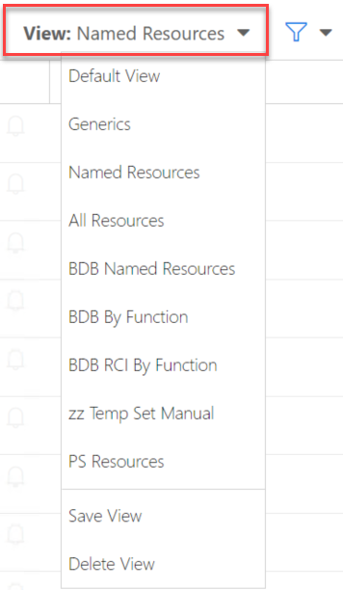
Change view to Generics
From the top menu, click View, switch to the view you want to be in
Notes:
Perhaps update if they’re not using “Project”

Slide 14
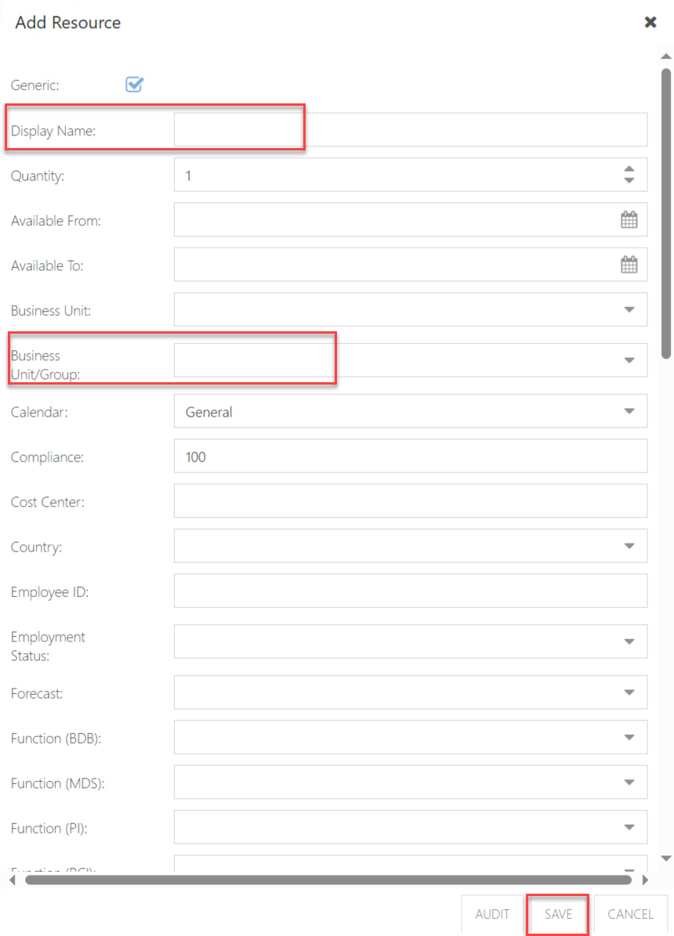
Create New Generic Resources Manually
Click “+” from top left corner
Click and select “Generic”, and fill in following fields
Save the information
Few fields MUST fill in:
Display Name: Based on the structure already set up in OnePlan (e.g. BU | R&D | ____ ), type in the Generic’s name
Business Unit/Group: Select your own BU
Manual Add: Select -> Generic no Sync
Notes:
Perhaps update if they’re not using “Project”

Slide 15
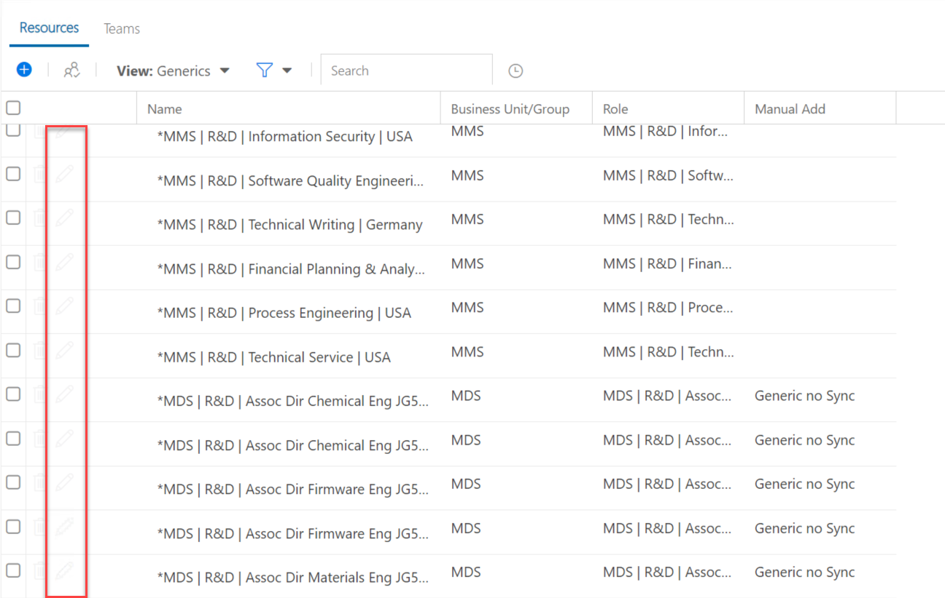
Edit Generic Resources Manually
Click “Pen” icon next to the Generic Resources you want to edit
Edit the information
Save the information
Not able to edit
NOTE: Only the Generic Resources which field “Manual Add – Generic no Sync” are able to edit
Able to edit
Notes:
Perhaps update if they’re not using “Project”

Slide 16

Reports

Slide 17
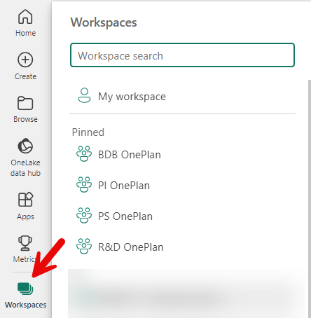
Accessing Reports
We are in the process of creating workspaces for each team.
Each of these is accessible via
powerbi.Microsoft.com
We will be setting permission on these
Workspaces to users in your Entra groups
(our next topic!)
Please advise us if all your groups should
have access
Notes:
Perhaps update if they’re not using “Project”

Slide 18

Entra Group

Slide 19
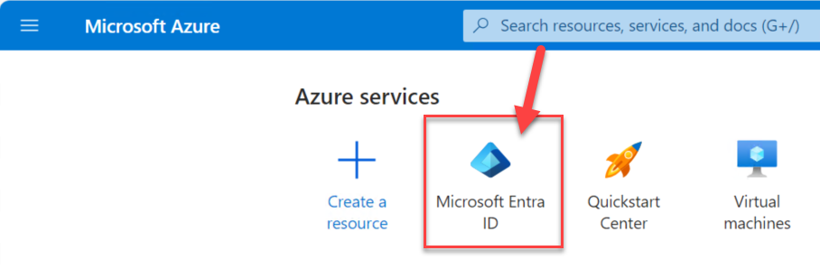
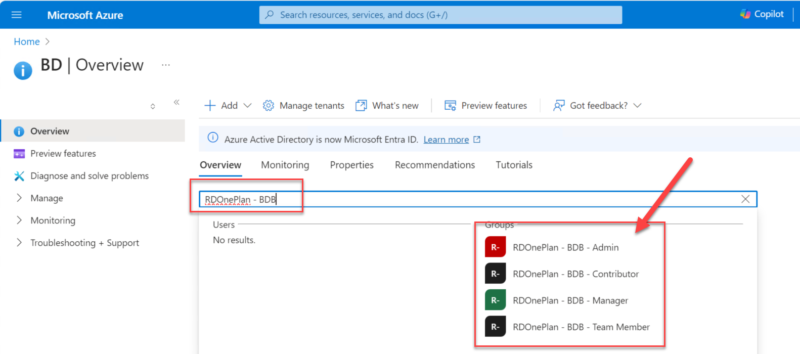
Accessing to Microsoft Portal
Home - Microsoft Azure
Search for your groups
RDOnePlan – BU –
Admin/Contributor/
Manager/Team
Member
Notes:
Perhaps update if they’re not using “Project”

Slide 20
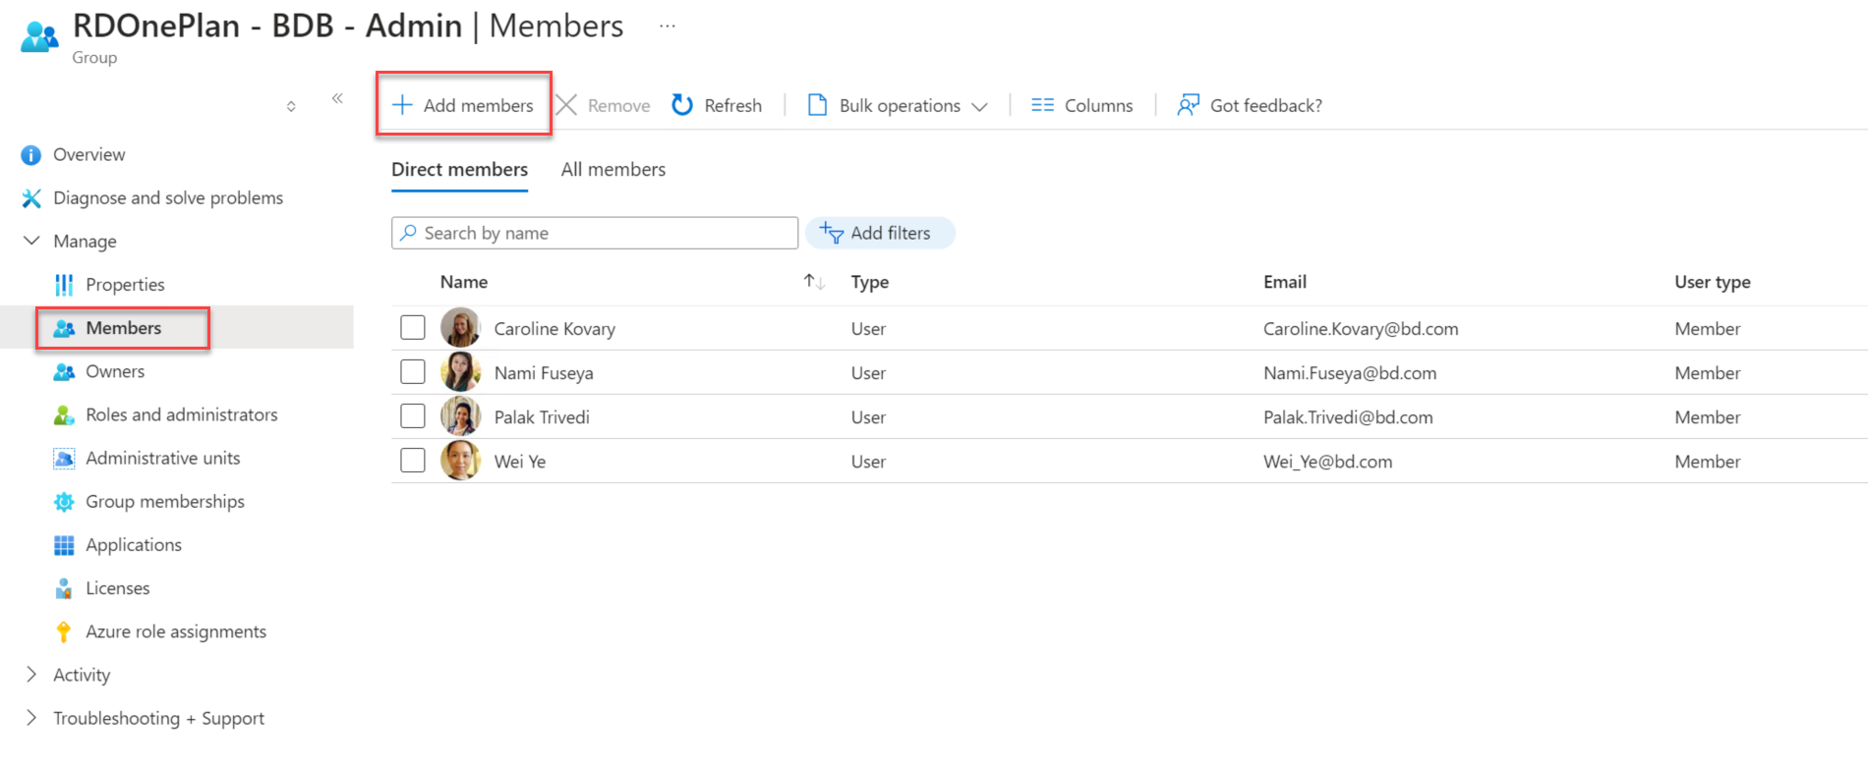
Add Users in the Groups
Notes:
Perhaps update if they’re not using “Project”

Slide 21
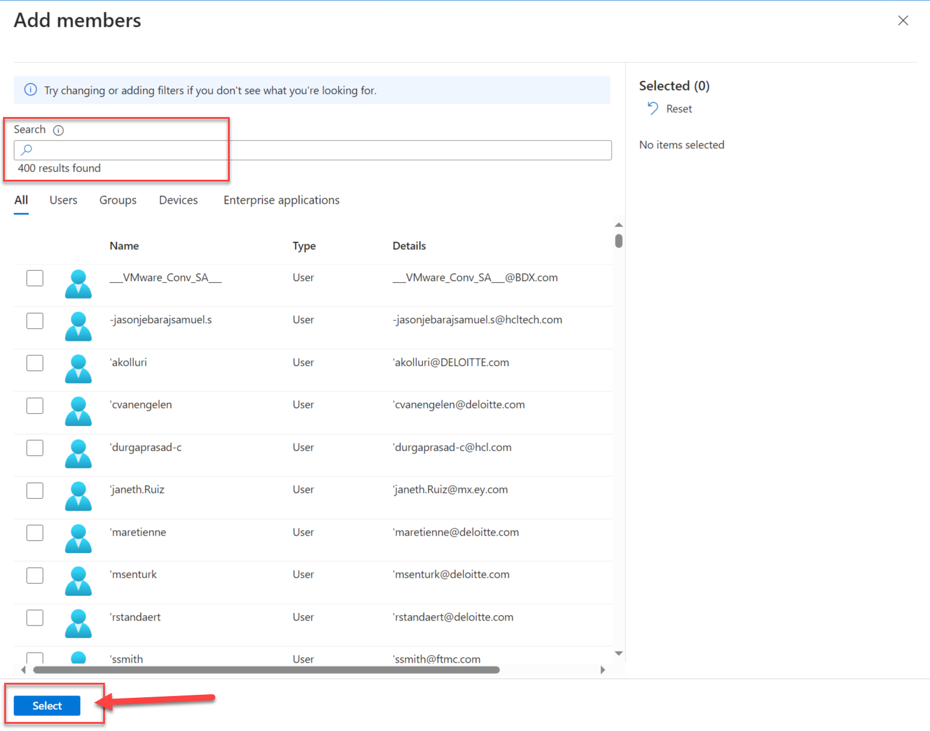
Add Users in the Groups
You can do a large group of users at a time!
NOTE: Remember to Click Select
Notes:
Perhaps update if they’re not using “Project”

Slide 22

Global Permission Settings

Slide 23
Global Permission Settings
Permission Level | Home |  | My Work | My Portfolio |  |  |  | Resource Plan |  | Financial Plan | Resource Plan VIew | Resource Center
 | Recent | Plans Shared With Me |  | Create Plan | Delete Plan | Audit | Share With | Assign Resources | Delete Resources |  | Pre filter to BU | Add Resources | Edit Permission
BU - Admin | Yes | Yes | Yes | Yes | Cannot delete Plan, Need to submit ticket | Can see the audit of the project if you are the contributor/owner | Can share plan if you are the owner of the plan | Yes | Yes | Yes | Yes | Yes | Edit in Azure
BU - Manager | Yes | Yes | Yes | Yes | Cannot delete Plan, Need to submit ticket | Can see the audit of the project if you are the contributor/owner | Can share plan if you are the owner of the plan | Yes | Yes | Yes | Yes | No | No
BU - Contributor | Yes | Yes | Yes | Yes | Cannot delete Plan, Need to submit ticket | Can see the audit of the project if you are the contributor/owner | Can share plan if you are the owner of the plan | Yes | Yes | Yes | No | No | No
BU | Permission | Global Permissions | OnePlan Connector | Plan Permission | Able to Access
BDB, GA, MDS, MMS, PI, PS, SM, Surgery, UCC | Admin | Create/Manage global views, Access the Resource Center/Add Resources, Access the Portfolio Resource Plan | Yes | Add Plan | Home, My Work, My Portfolio, Resource Plan, Resource Center
RCI, STS, DS | Admin | Create/Manage global views, Access the Resource Center/Add Resources, Access the Portfolio Resource Plan | Yes | Add Plan | Home, My Work, My Portfolio, Resource Plan, Resource Center, Timesheet
BDB, GA, MDS, MMS, PI, PS, SM, Surgery, UCC | Manager | Create/Manage global views, Access the Resource Center/Add Resources, Access the Portfolio Resource Plan | Yes, but only if an Owner on Plan | Add Plan | Home, My Work, My Portfolio, Resource Plan
RCI, STS. DS | Manager | Create/Manage global views, Access the Resource Center/Add Resources, Access the Portfolio Resource Plan | Yes, but only if an Owner on Plan | Add Plan | Home, My Work, My Portfolio, Resource Plan, Timesheet
BDB, GA, MDS, MMS, PI, PS, SM, Surgery, UCC | Contributor | Edit Plans on which users have Contribute or above; Add Plans on which Users have Contribute or above on parent plan | Yes, but only if an Owner on Plan | Add Plan | Home, My Work, My Portfolio
RCI, STS, DS | Contributor | Edit Plans on which users have Contribute or above; Add Plans on which Users have Contribute or above on parent plan | Yes, but only if an Owner on Plan | Add Plan | Home, My Work, My Portfolio, Timesheet
Notes:
Perhaps update if they’re not using “Project”

Slide 24
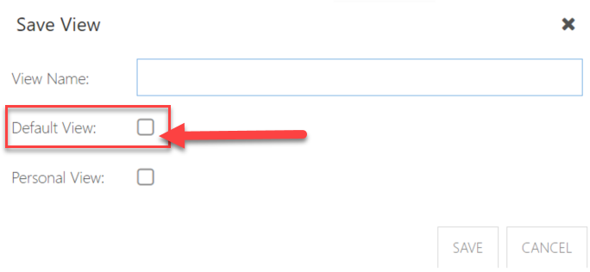
Permission to Save Views
For Contributor:
  Only able to save Personal view for:
    Portfolio view
    Resource Plan view
    Work Plan view
    Schedule Template
For Admin & Manager:
  Able to save Global view for:
    Portfolio view
    Resource Plan view
    Work Plan view
    Schedule Template
NOTE: For BU Internal Training, need to make sure everyone know they should not save a view as DEFAULT!
Notes:
Perhaps update if they’re not using “Project”

Slide 25
Plan Level Permission Settings
Plan is an inclusive term that means all the portfolios, programs, platfomrs, and projects in OnePlan

Slide 26
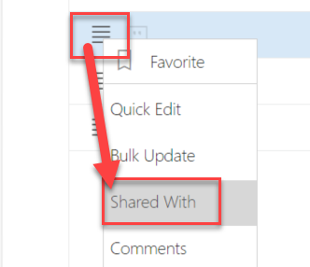
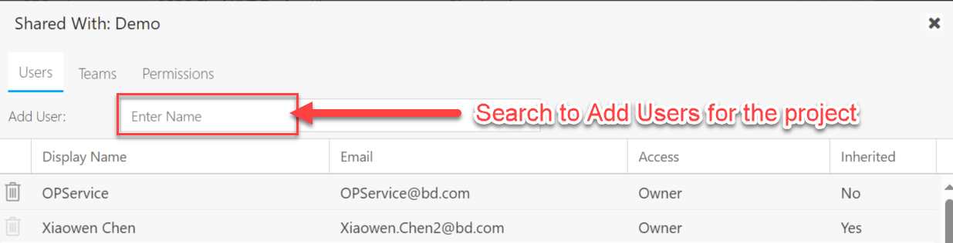
Share a Project
Share a project using hamburger menu next to project name and select Shared With
Change users plan level permission here
Notes:
Perhaps update if they’re not using “Project”

Slide 27
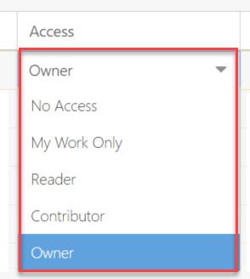
Plan Level Permission
No Access: The user will not have access to the plan, and will not see assigned work items in My Work. The user can be assigned to tasks by the Plan Manager.
My Work Only: The user will not have access to the plan. The user will see all assigned work items in their My Work area.
Reader: The user has read-only access to the plan. The user will see all assigned work items in their My Work area.
Contributor: The user has edit access to the plan. The user cannot delete or archive the plan.
Owner: The user has full edit rights to the plan. Even still, the user can NOT delete or archive the plan. We do not use the Archive feature, so please submit a ticket with Plan Id, Name, and explanation to request a plan be deleted.
Notes:
Perhaps update if they’re not using “Project”

Slide 28
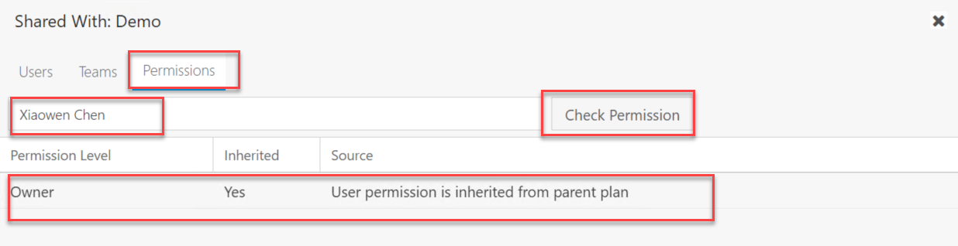
Search for Users’ Permission
If there are hundreds of resources within a portfolio or a program, it will be difficult to check the plan level permission for a resource
Click Permissions and search for Resource name
Notes:
Perhaps update if they’re not using “Project”

Slide 29

Question & Answer

Slide 30
Final Points
Muscle memory will develop. Don’t be hard on yourself as you learn - remember it will take time to get used to where to click!
OnePlan rolls out new updates about every 6 weeks. This means you’ll see improvements all the time, including responses to our enhancement requests.
If you have an idea, share it with us, and we can submit to OnePlan.
The help guide is always available if you need it.

Slide 31
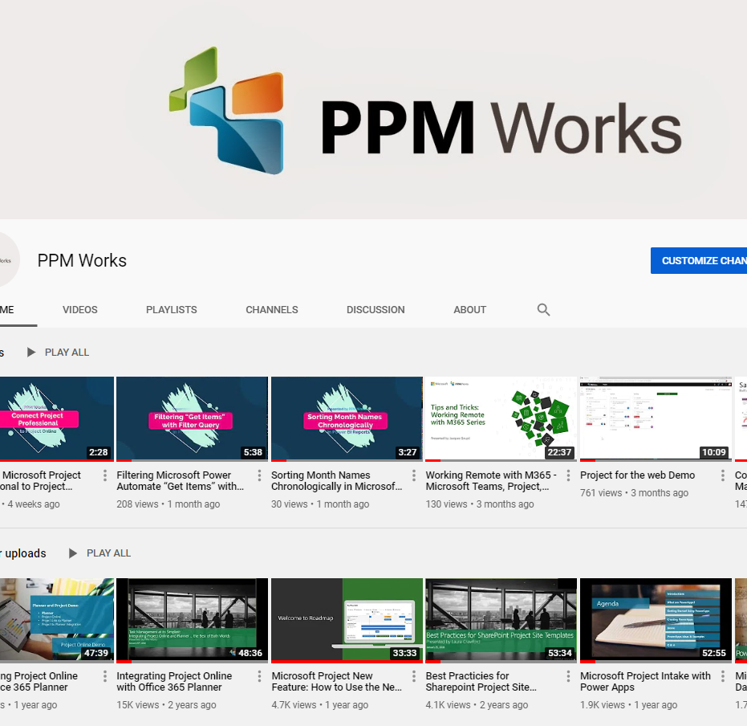
Subscribe to our YouTube Channel
Stay on top of the latest tips and tricks and new features by subscribing to PPM Work’s YouTube Channel. Learn from our latest videos and earn free PDU’s.
https://www.youtube.com/c/ppmworks

