Slide 1


OnePlan Work Plan Training:
Schedule
RAID
Lessons Learned
My Work

Slide 2
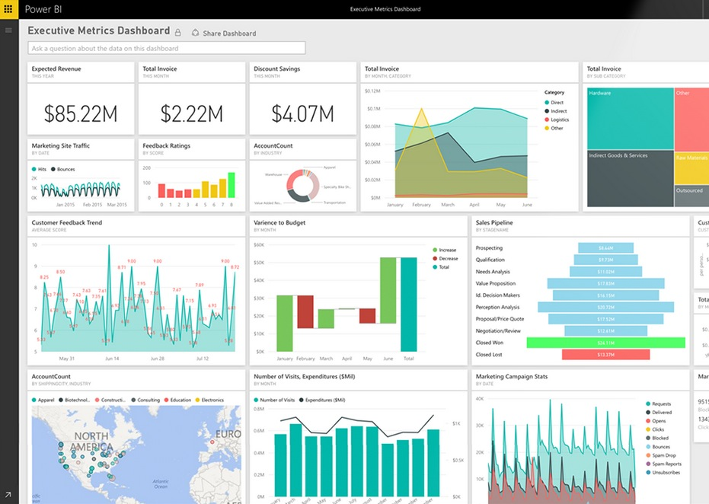


Previously Covered
What is OnePlan?
Navigation, Icons
Ways to Access Projects
Project Details Page
Hierarchy

Slide 3
Today’s Agenda
Access to Work Plan
Schedule
RAID
Lesson Learned
My Work
Q&A

Slide 4
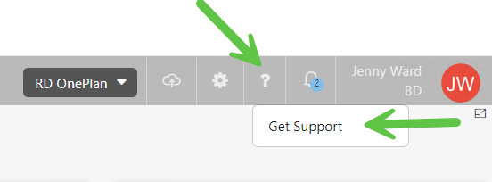
Support site
You can find all the information included in this training on the support site, accessible from the OnePlan menu, or
bd.ppmworks.com.

Slide 5

Schedule

Slide 6
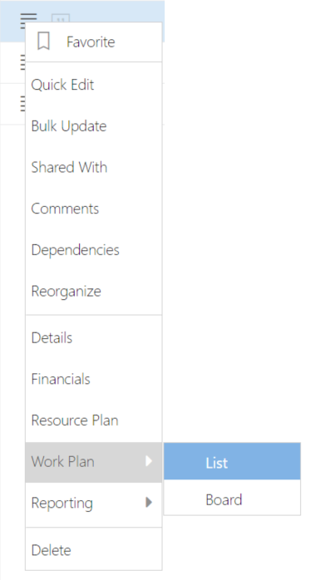
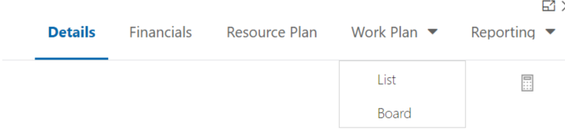
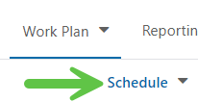
Accessing the Project Work Plan
Option 1: From My Portfolio, use the “hamburger” menu on the left side of your project in the list, and select “Work Plan” – “List”
Option 2: Get into Project Detail page, and click “Work Plan” on the top panel – “List”
Ensure you are on the “Schedule” work type
1
1
2
2
Notes:
Perhaps update if they’re not using “Project”

Slide 7
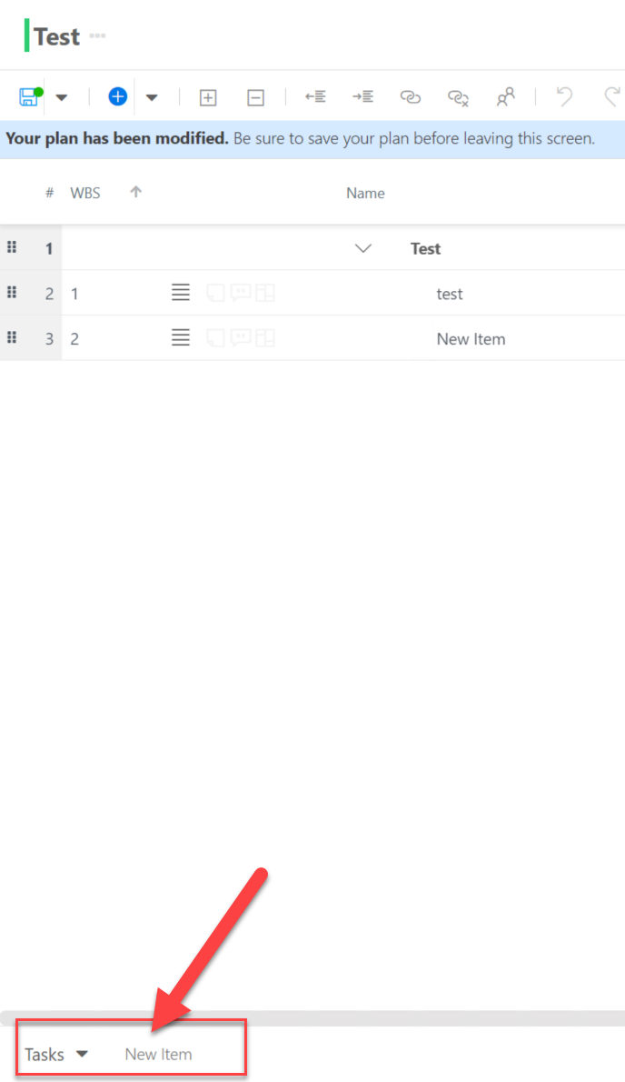
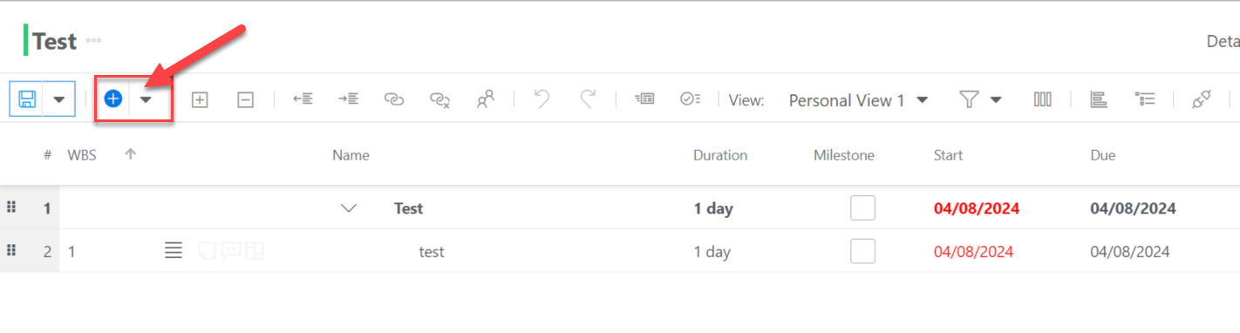
Add Task
Option 1: Click “+” icon to add a new work item.
Option 2: Enter task name from the left bottom corner, and press enter to add a new task
Notes:
Perhaps update if they’re not using “Project”

Slide 8
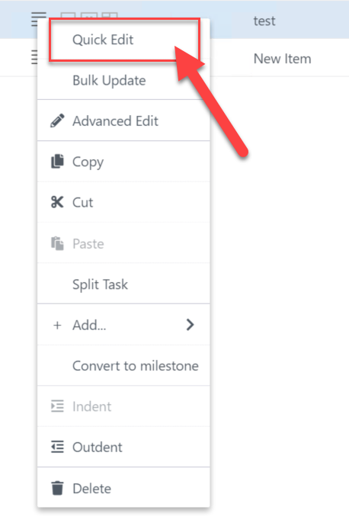
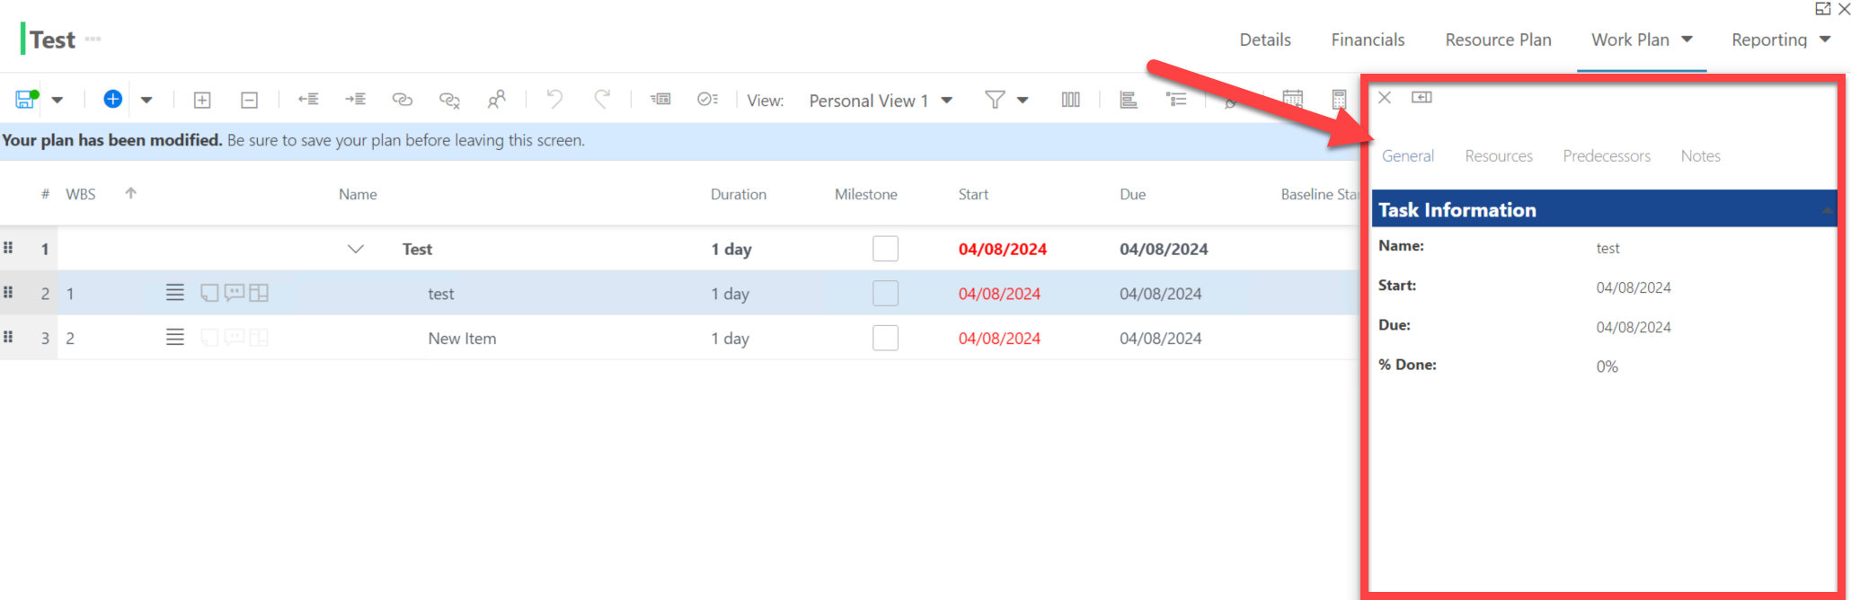
Check Tasks Details
Click the “hamburger” menu next to the task you want to edit, select Quick Edit
Quick Edit detail page shows on the right side of the screen
Note that the Task Quick Edit panel will only show the most basic task fields
Notes:
Perhaps update if they’re not using “Project”

Slide 9
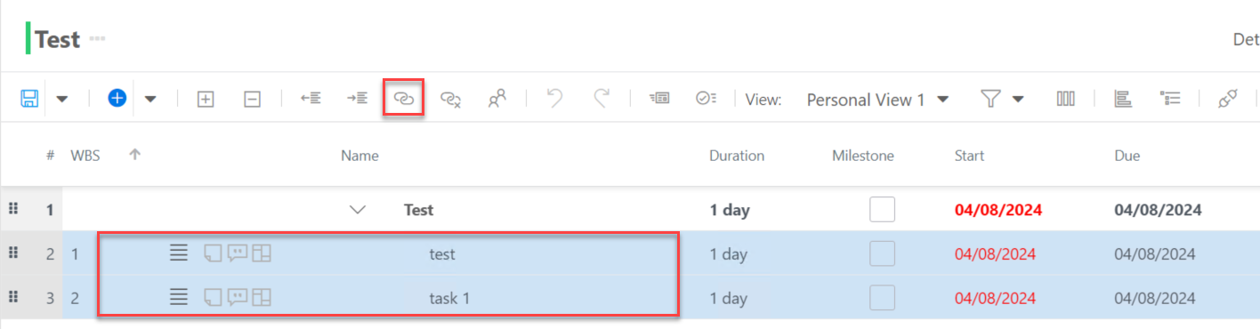
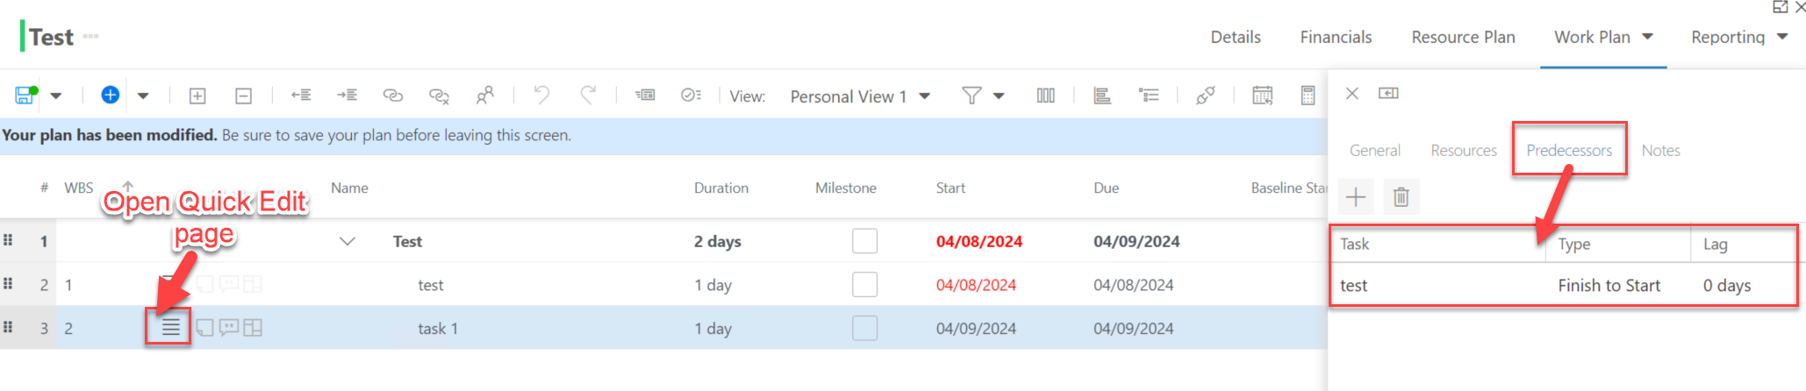
Link and Unlink Tasks
Hold down the CTRL key to select two tasks. The selected task will highlight in blue.
Click the Link icon. The second task becomes the dependent task.
NOTE: Selecting the task is easiest from the left hand side of the screen.
Notes:
Perhaps update if they’re not using “Project”

Slide 10
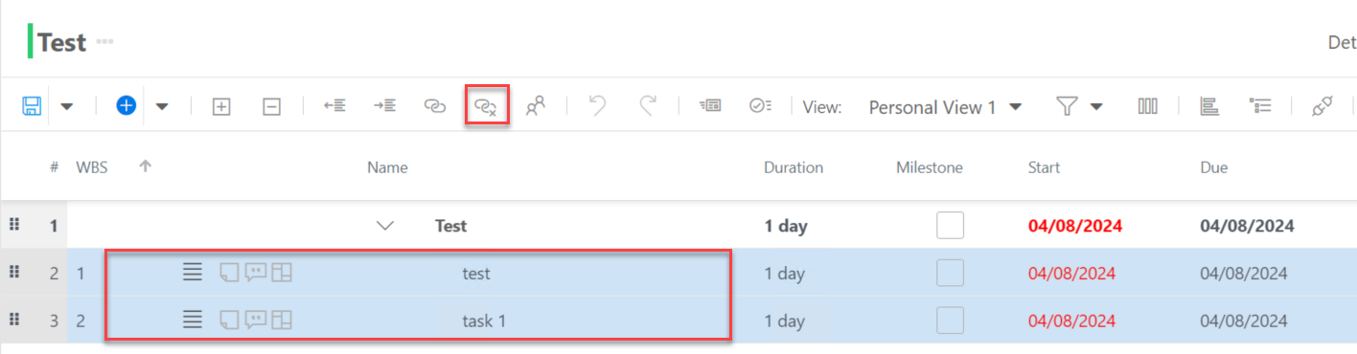
Link and Unlink Tasks
Hold down the CTRL key to select two tasks. The selected task will highlight in blue.
Click the Unlink icon.
Notes:
Perhaps update if they’re not using “Project”

Slide 11
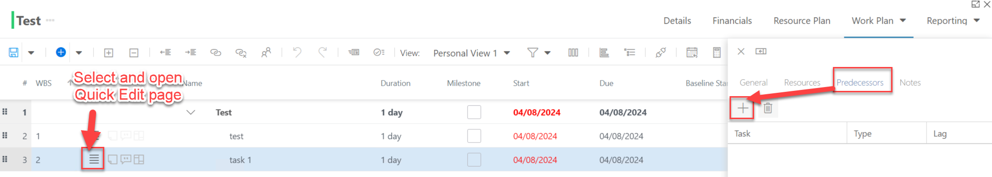
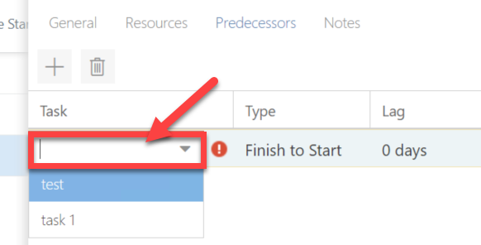
Link and Unlink Tasks
If using the Link icon, the relationship is automatically Finish-to-Start relationship with 0 lag days.
If you want to specify different link type or lag time, select the parent item and open the Quick Edit window. Go to the Predecessors tab to make your changes.
Notes:
Perhaps update if they’re not using “Project”

Slide 12
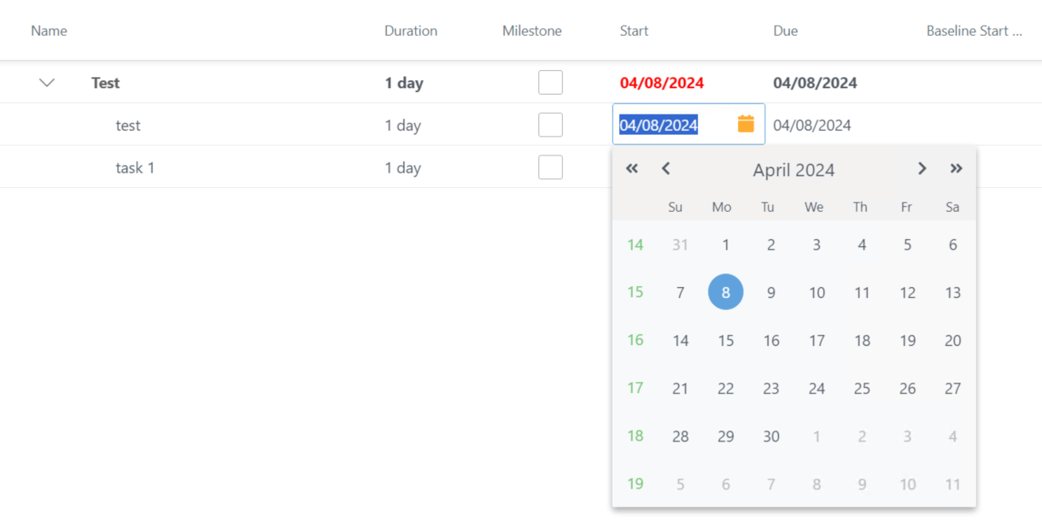
Edit Task Dates
Edit Start, Due, and all other date fields by clicking directly on the field to change the date; If you’re looking to change only the due date, our recommendation is to extend the duration of the task
NOTE:
If tasks are linked, the second task will change the start date regarding the change of first task’s dates.
Notes:
Perhaps update if they’re not using “Project”

Slide 13
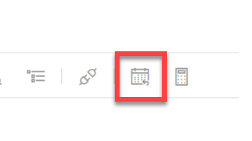
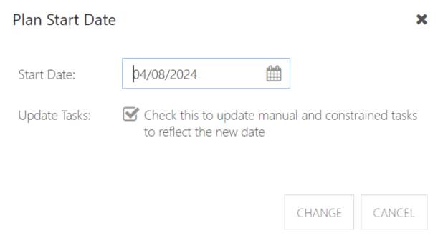
Edit Project Start Date to Previous Date
You will receive a warning if you try to start a schedule task prior to the start date of the plan.
To resolve, click Plan Start Date icon to push back the project start date to the past.
Notes:
Perhaps update if they’re not using “Project”

Slide 14
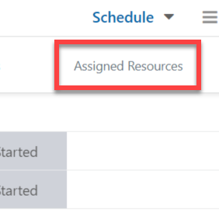
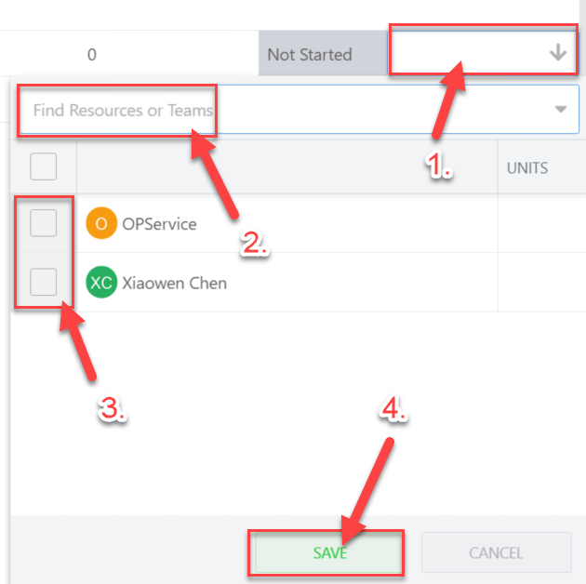
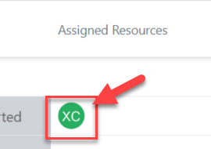
Assign Resources to a Task
Drag the scroll bar in the bottom of the page to the right until you see Assigned Resource field
Click the empty field and search for the resource you want to assign
Select the resource and Save the change
Assigning resources in this way will result in
these tasks showing in their “My Work” view.
Notes:
Perhaps update if they’re not using “Project”

Slide 15
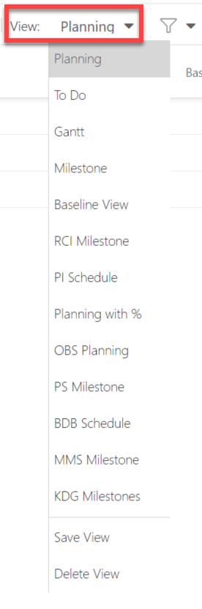
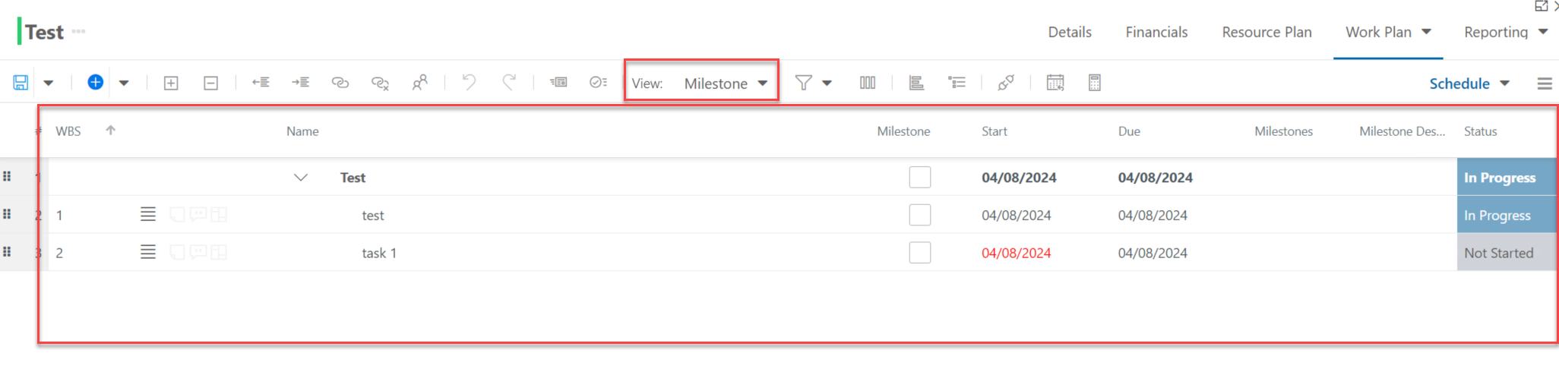
Change View
Click View icon and select the view you want to switch to
For example, we want to switch the view to Milestone view
You will notice many views have been created, and we can add more per your needs.
Notes:
Perhaps update if they’re not using “Project”

Slide 16
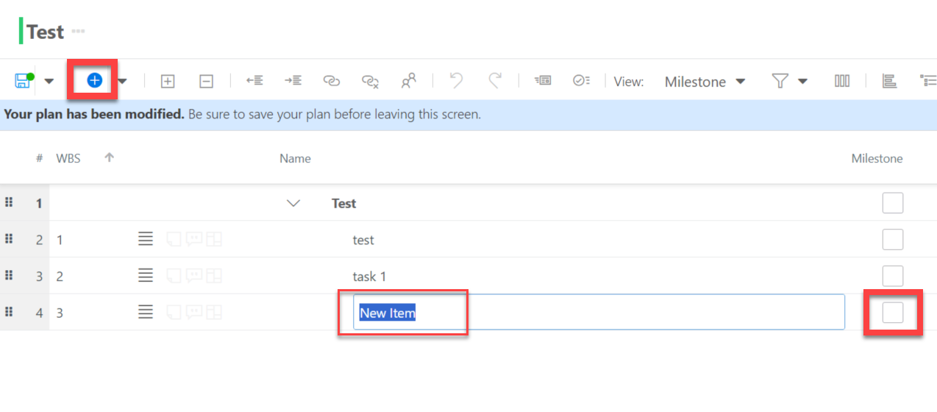
Create Milestones
Create a new item by click “+”
Edit new task name and select as Milestone
Note that tasks with 0 effort or duration will automatically be set to a milestone
Notes:
Perhaps update if they’re not using “Project”

Slide 17
Save Changes in the Work Plan
Save the editing by clicking Save button
When you make any changes to the Work Plan, you will receive a notification at the top of the screen notifying you to save your changes:
NOTE: If you navigate away from the Work Plan List view without saving, your changes will be lost. It is best practice to save often as you update your work plan.
Notes:
Perhaps update if they’re not using “Project”

Slide 18

Save Changes in the Work Plan
Let’s say it again:
Save changes by clicking the Save button
This applies in all work types’ grid views
If you accidentally close your browser tab, that’s it. Your work is lost!
Notes:
Perhaps update if they’re not using “Project”

Slide 19
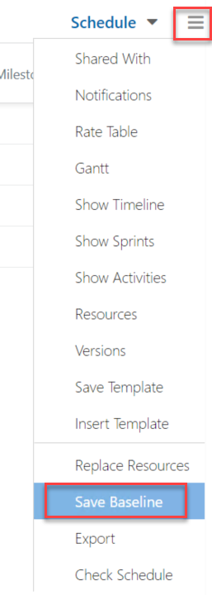
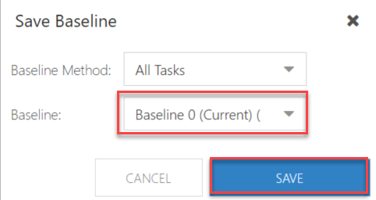

Save Baselines
Click the “hamburger” menu from the top right corner
Select Save Baseline
Baseline 0 will always be your current baseline, and the baseline that will show in reports.
NOTE: Baseline 0 (Current) is the current baseline, which will change over time. So, we need to save the schedule one more time to Baseline (1).
Baseline(1) should ALWAYS have the original projection.
Notes:
Perhaps update if they’re not using “Project”

Slide 20
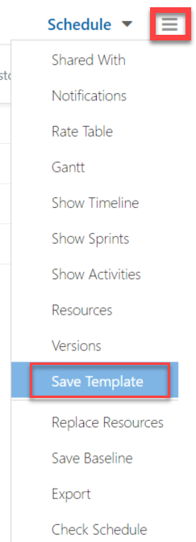
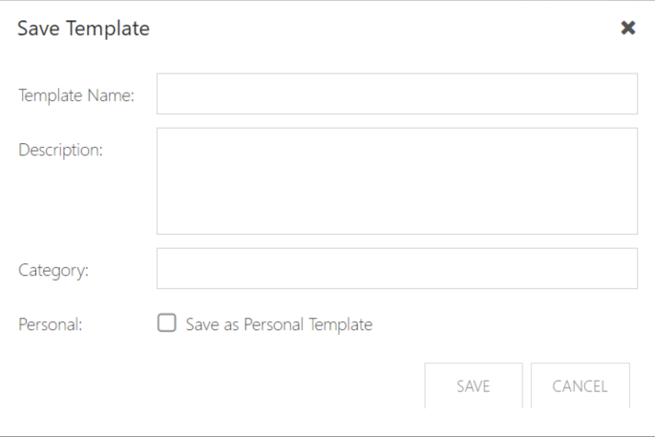
Save Schedule Template*
* Note this capability is restricted to BU Admins
Click the “hamburger” menu from the top right corner
Select Save Template
Notes:
Perhaps update if they’re not using “Project”

Slide 21
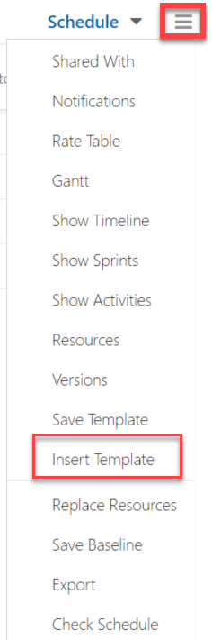
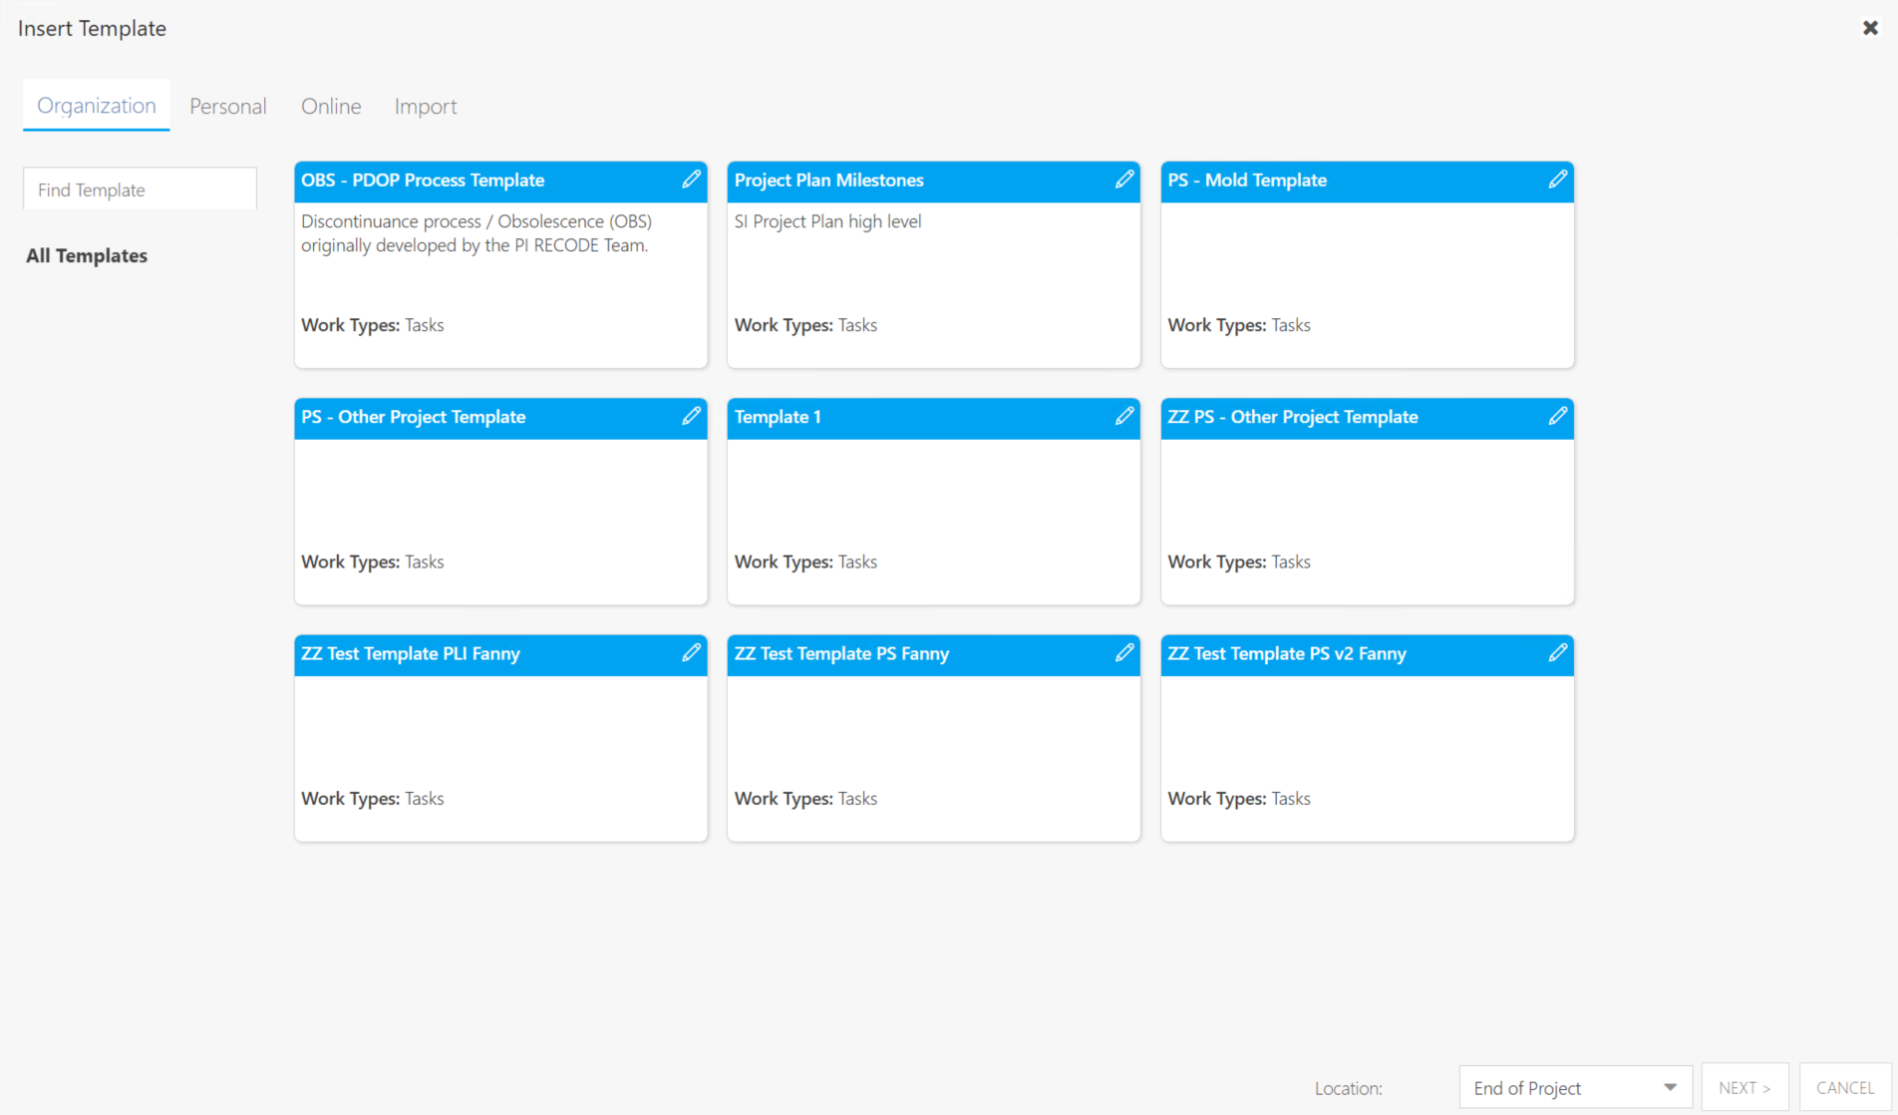
Use Saved Schedule Template
Click the “hamburger” menu from the top right corner
Select Insert Template
Notes:
Perhaps update if they’re not using “Project”

Slide 22
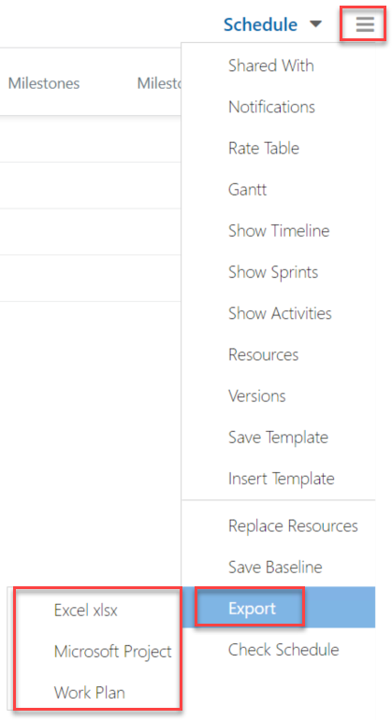
Export Schedule
Click the “hamburger” menu from the top right corner
Select Export
You can export schedule as Excel or Microsoft Project
Notes:
Perhaps update if they’re not using “Project”

Slide 23
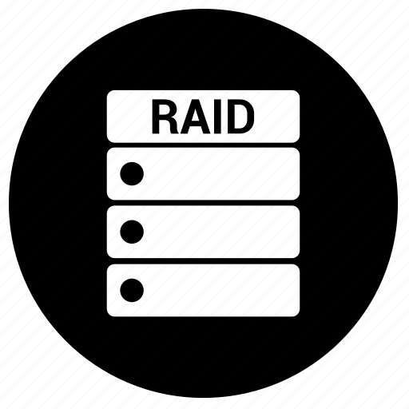
RAID

Slide 24
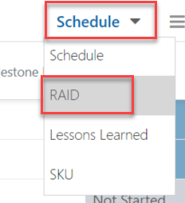
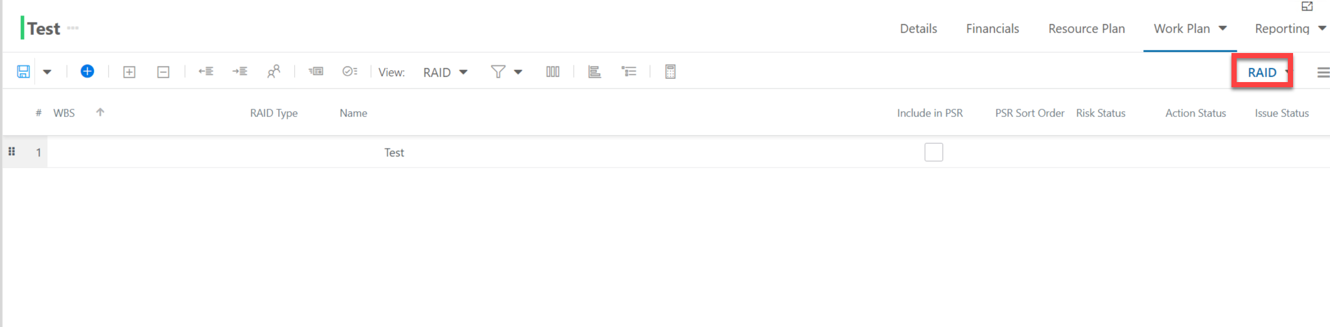
Accessing RAID view
Click Work Types view and select RAID
Notes:
Perhaps update if they’re not using “Project”

Slide 25
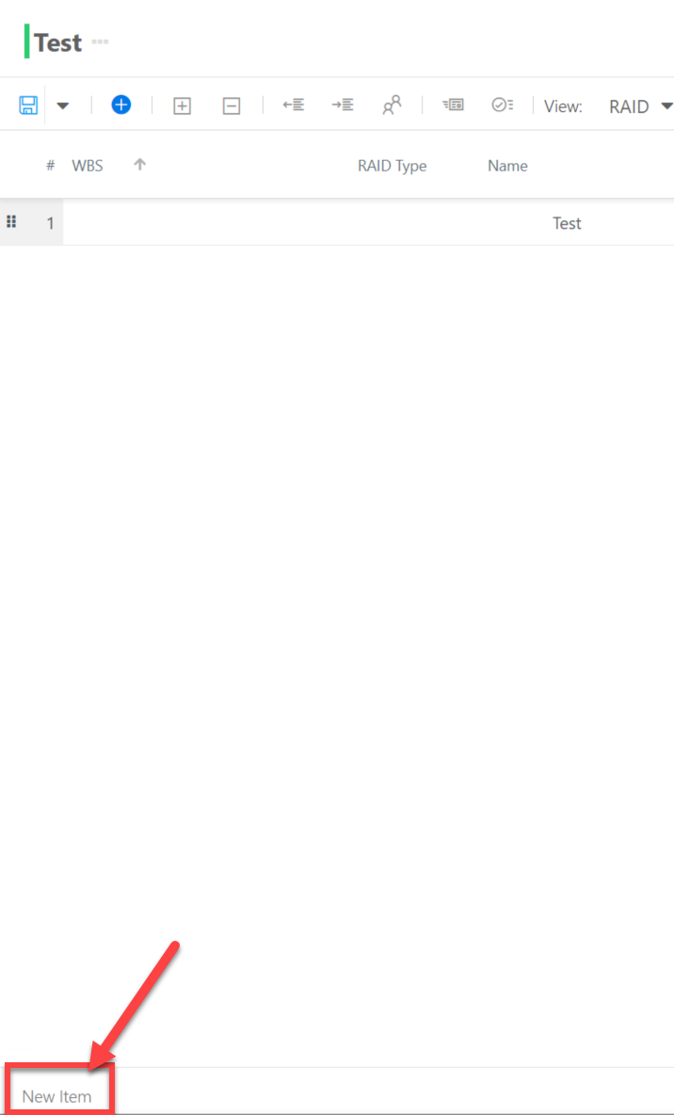
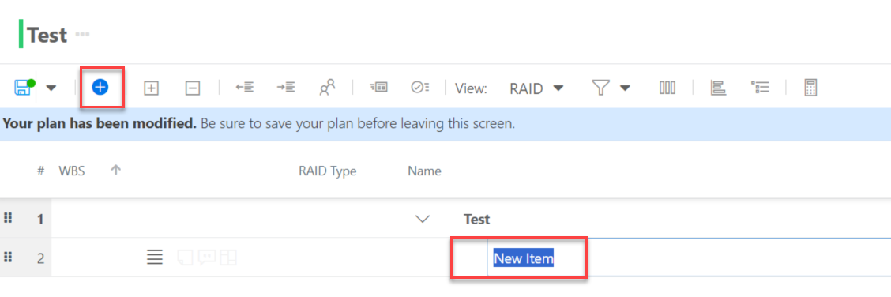
Add New RAID item
Option 1: Click “+” icon to add a new item.
Option 2: Enter New Item name from the left bottom corner, and press enter to add a new RAID item
Notes:
Perhaps update if they’re not using “Project”

Slide 26
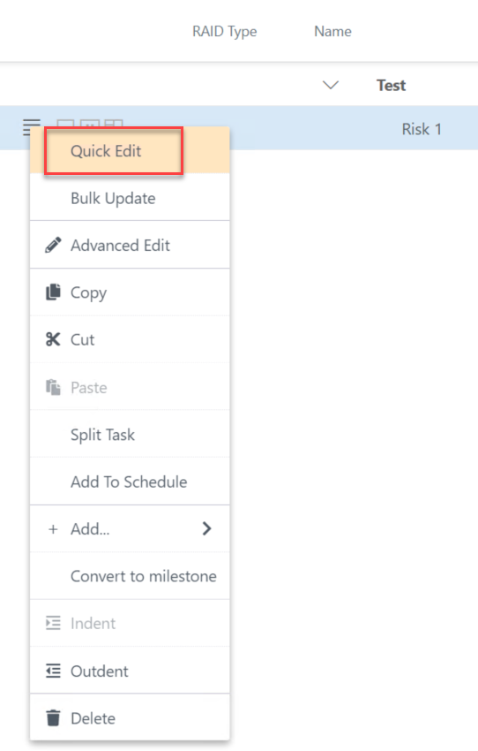
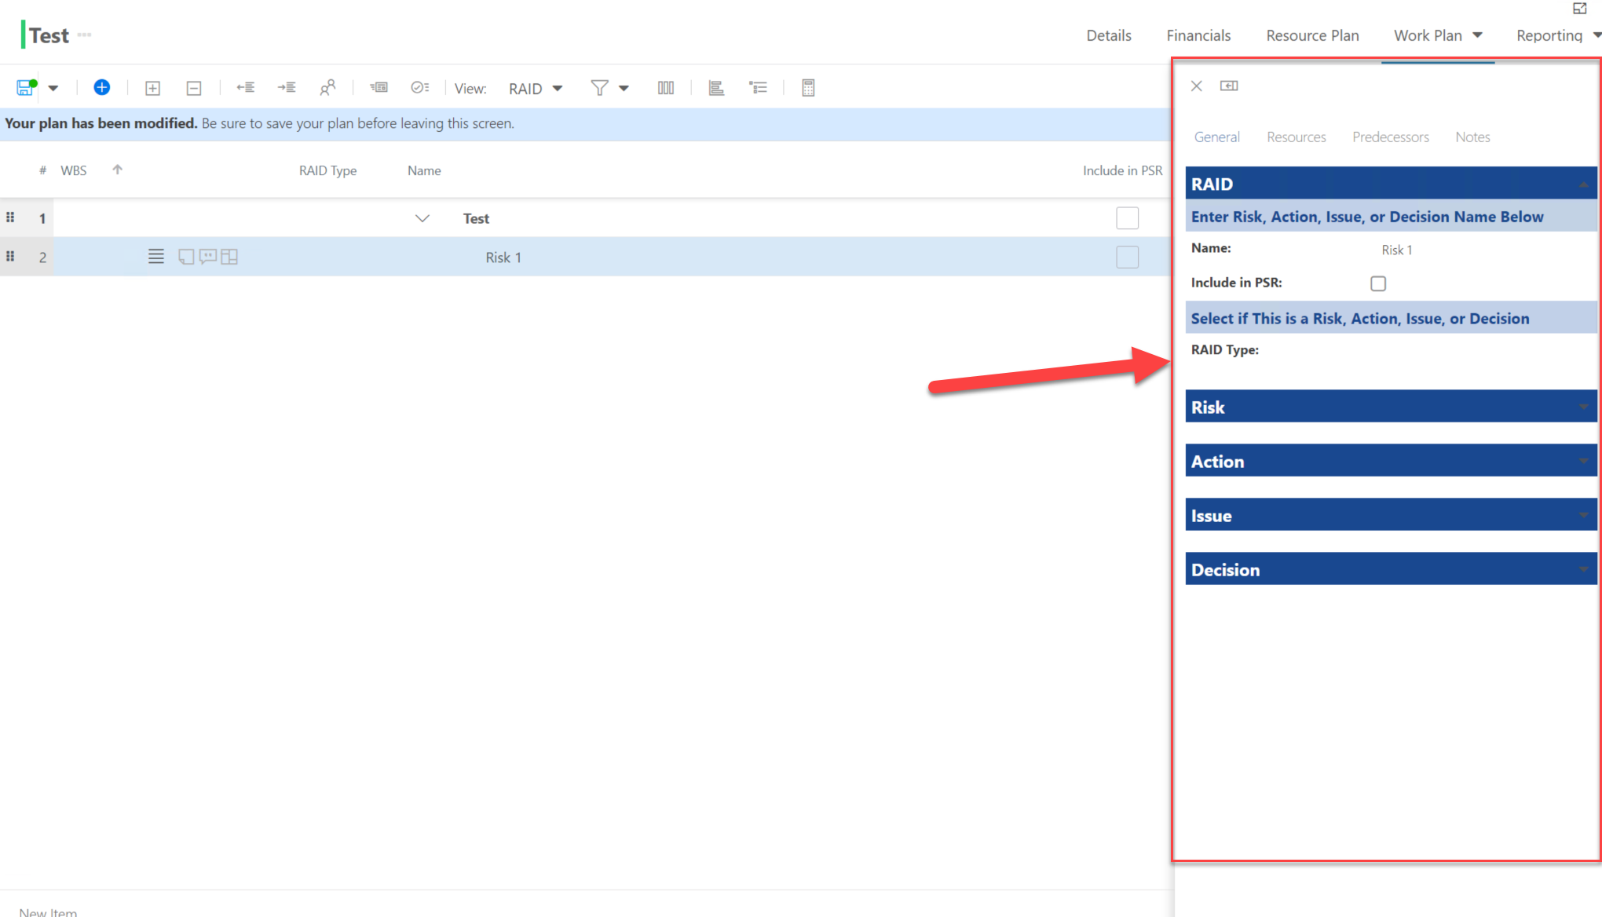
Check RAID Details
Click the hamburger menu next to the task you want to edit, select Quick Edit
Quick Edit detail page shows on the right side of the screen
Notes:
Perhaps update if they’re not using “Project”

Slide 27
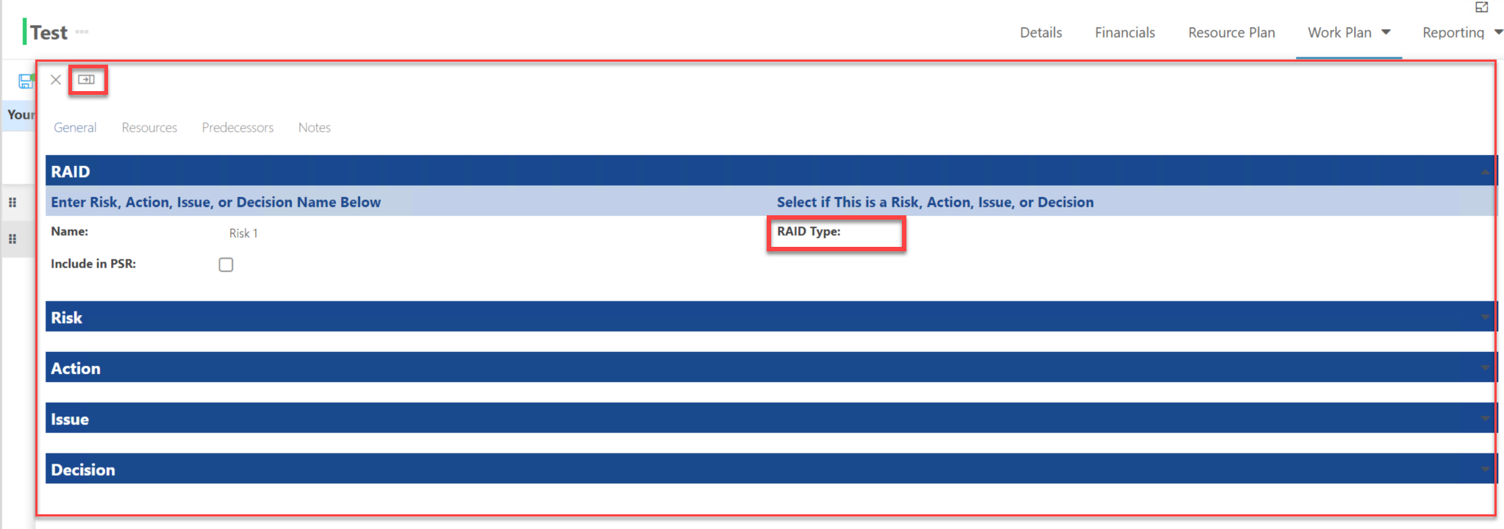
Check RAID Details
Click Expand icon to make detail page wider to view
Select RAID Type, and expand the page if you need to fill in information
Notes:
Perhaps update if they’re not using “Project”

Slide 28

Lessons Learned

Slide 29
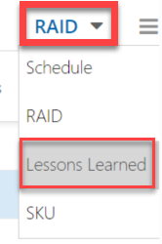
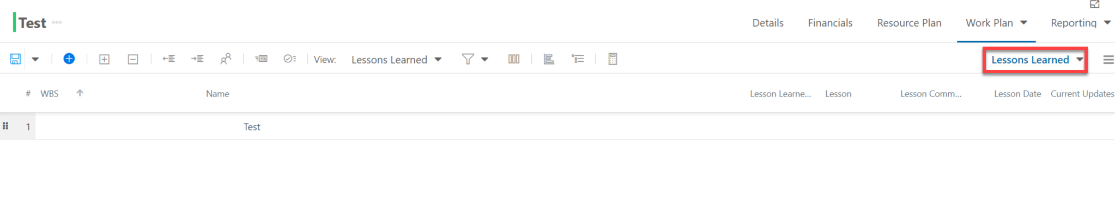
Accessing Lessons Learned view
Click Work Types view and select Lessons Learned
Notes:
Perhaps update if they’re not using “Project”

Slide 30
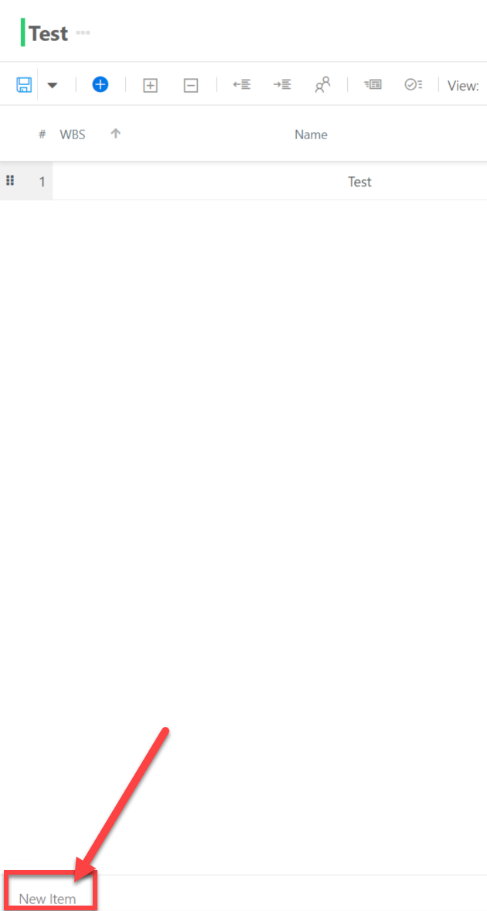
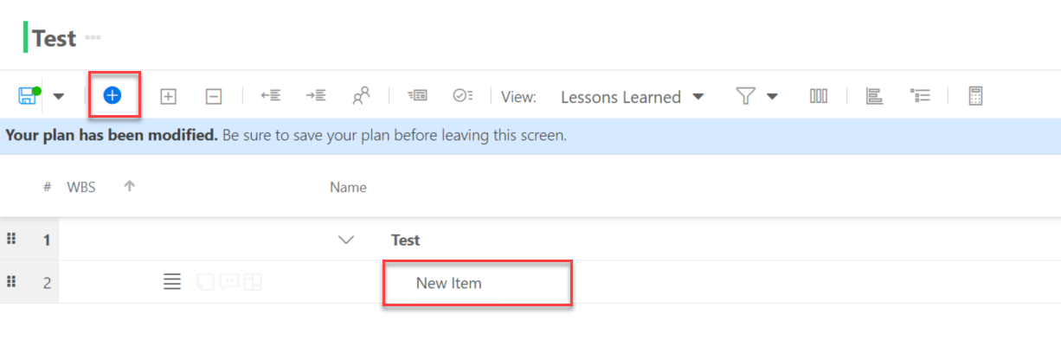
Add New Lessons Learned item
Option 1: Click “+” icon to add a new item.
Option 2: Enter New Item name from the left bottom corner, and press enter to add a new item for Lessons Learned
Notes:
Perhaps update if they’re not using “Project”

Slide 31
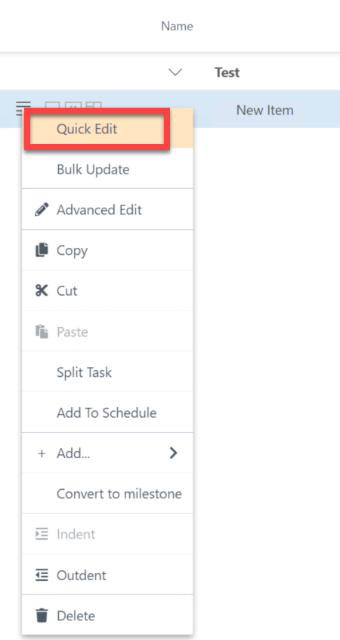
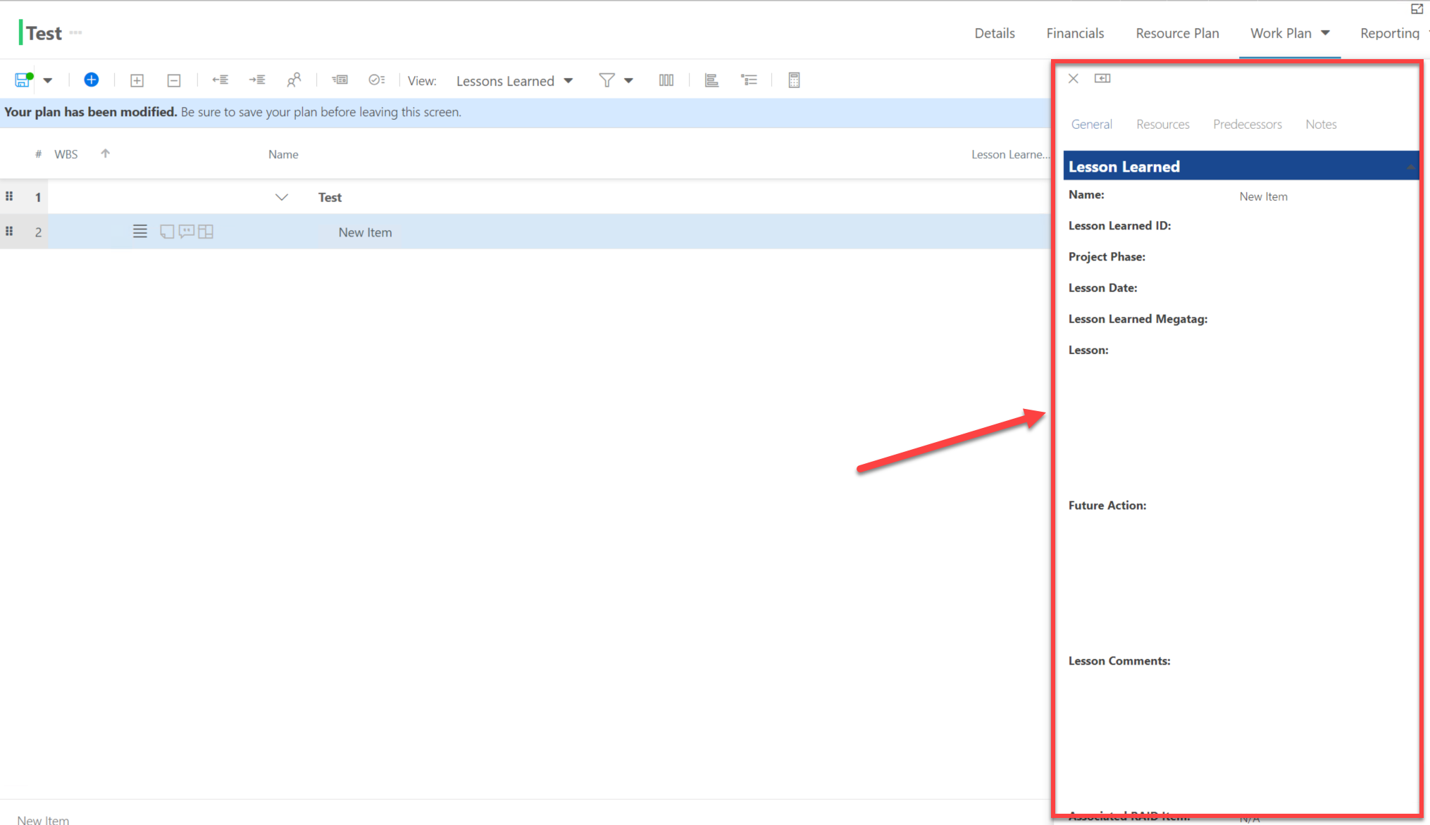
Check Lessons Learned Details
Click the hamburger menu next to the task you want to edit, select Quick Edit
Quick Edit detail page shows on the right side of the screen
Notes:
Perhaps update if they’re not using “Project”

Slide 32
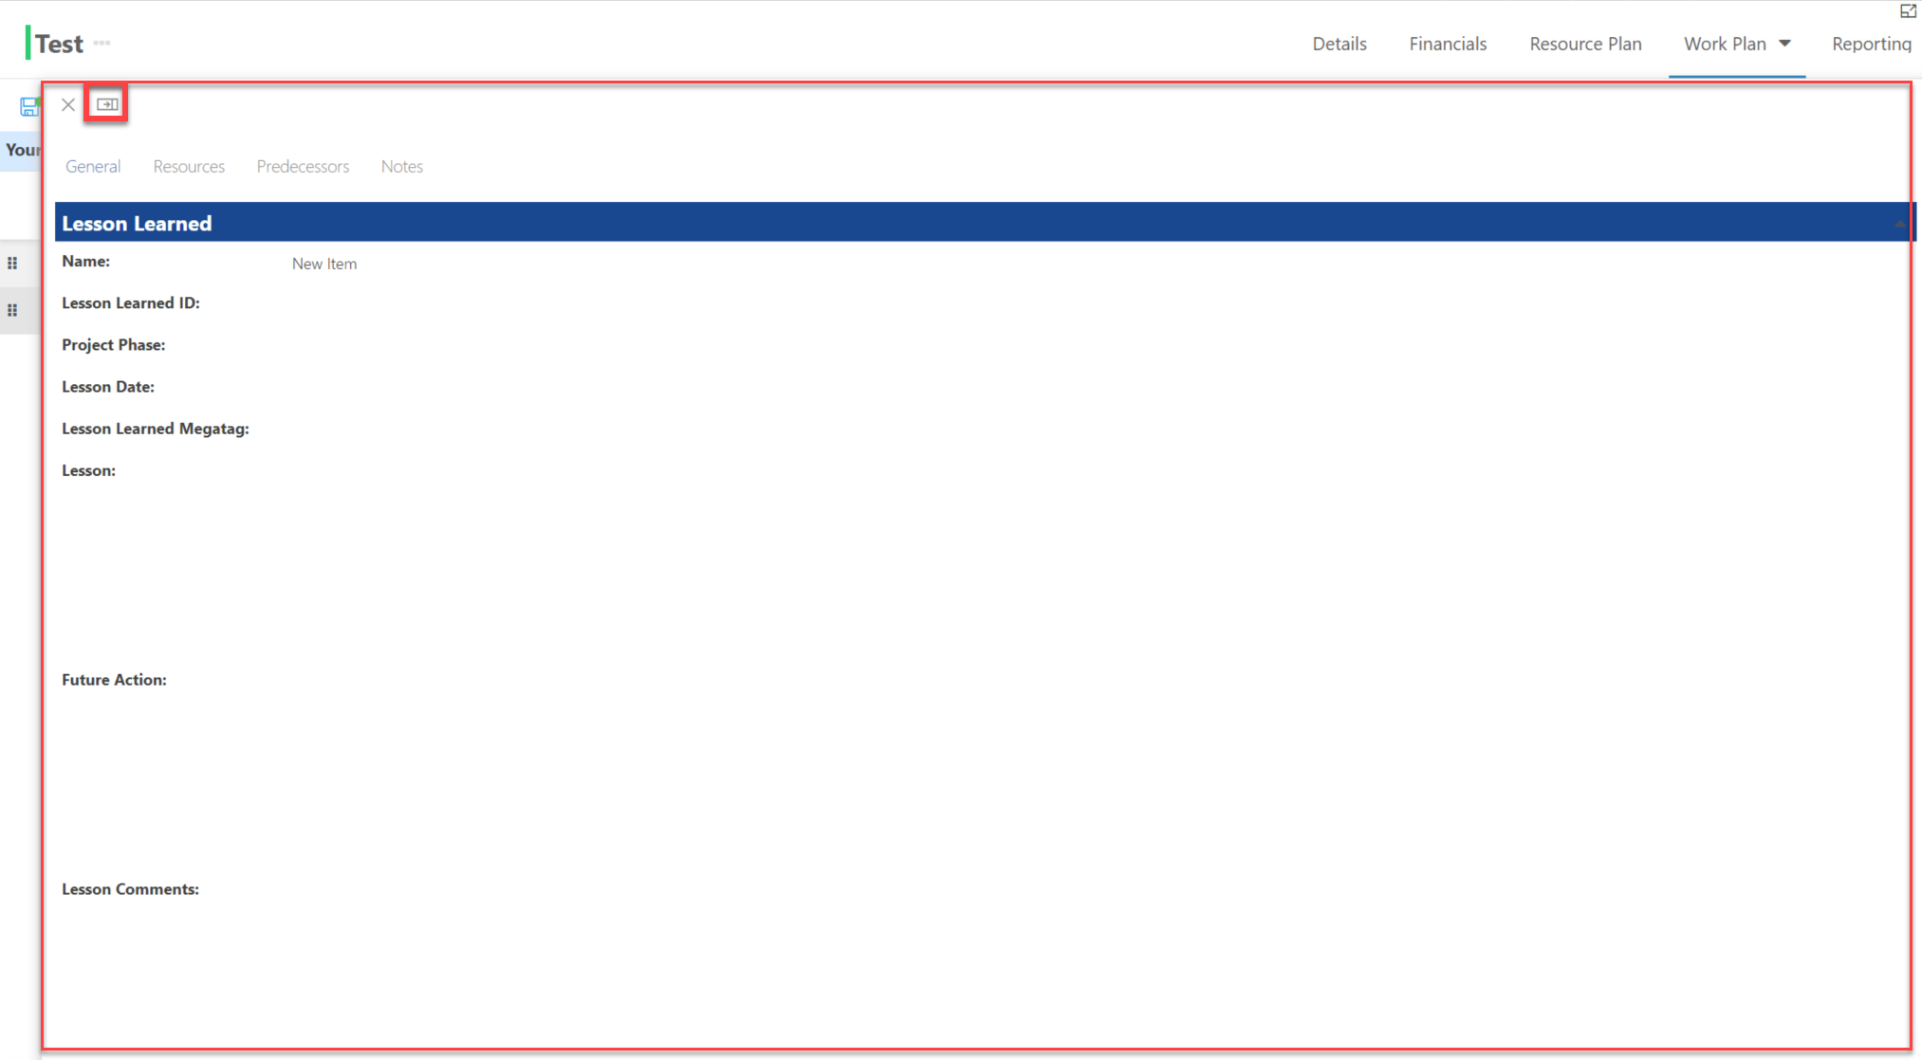
Check Lessons Learned Details
Click Expand icon to make detail page wider to view
Notes:
Perhaps update if they’re not using “Project”

Slide 33

My Work

Slide 34

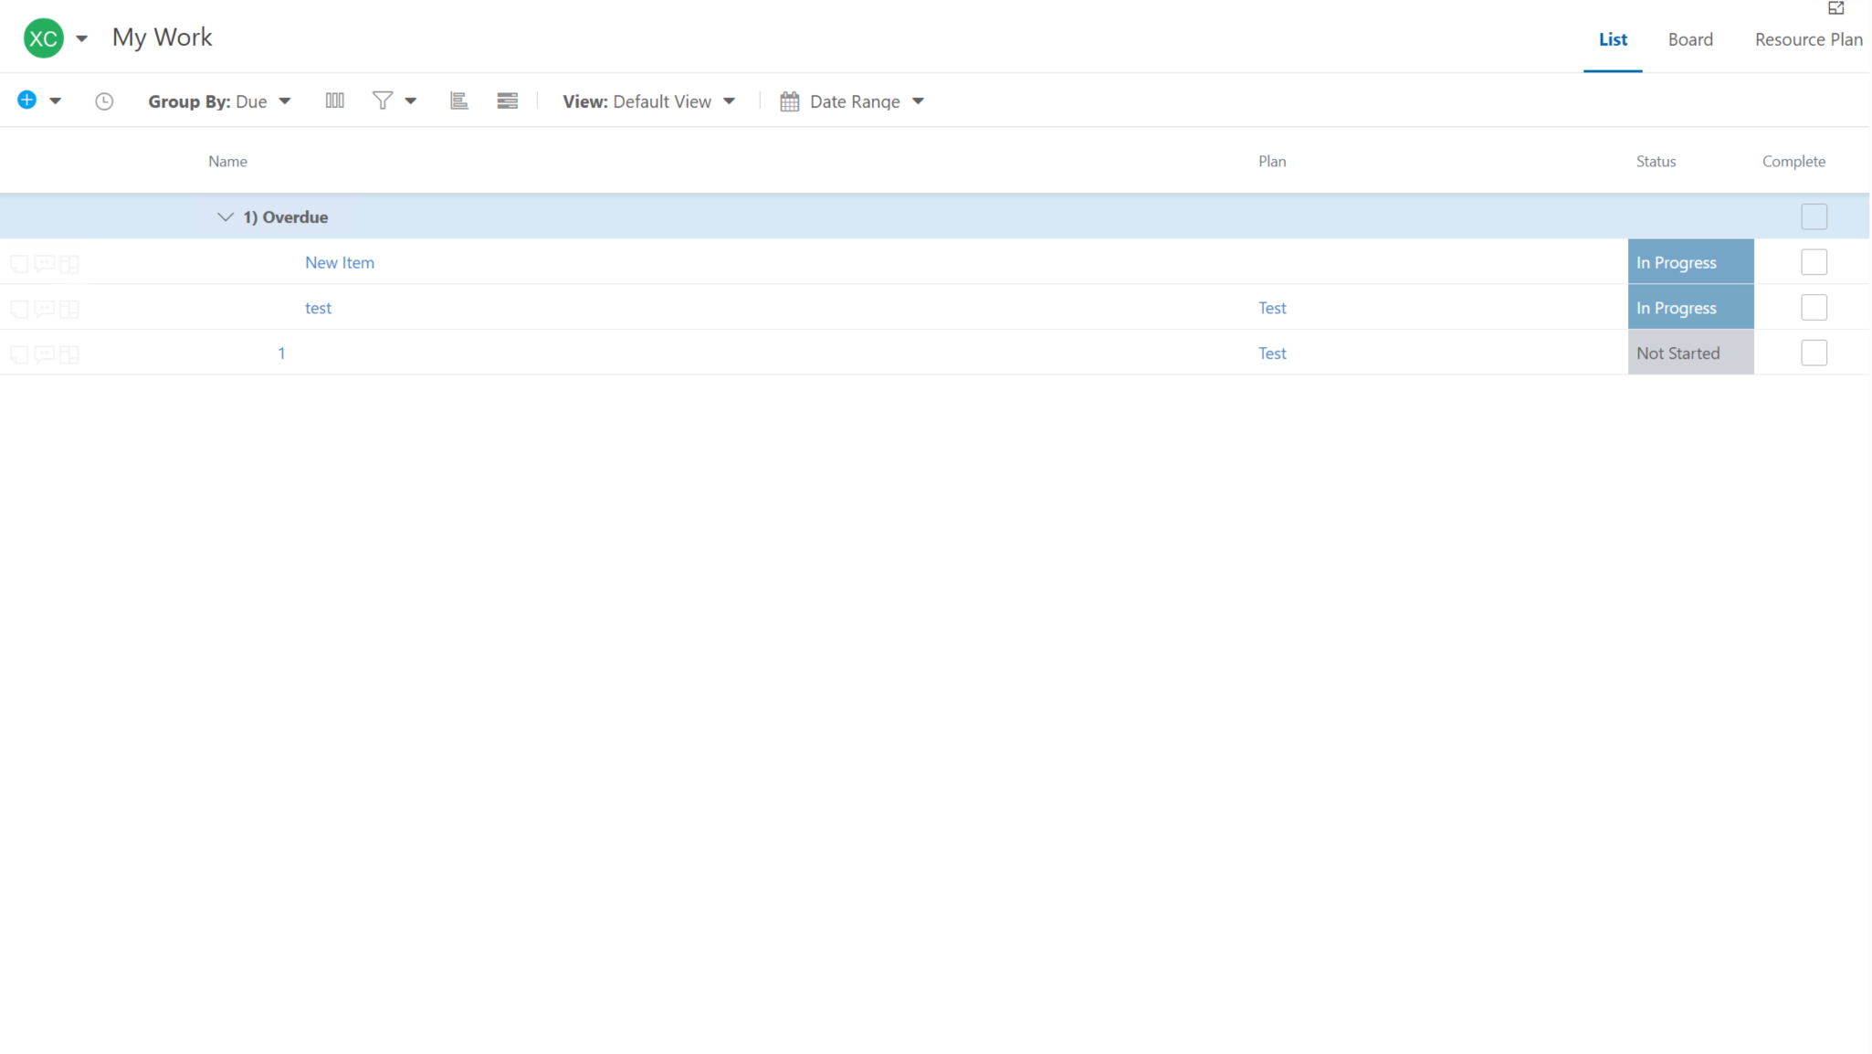
Accessing My Work
Notes:
Replace this screenshot with one from a 312 Group

Slide 35

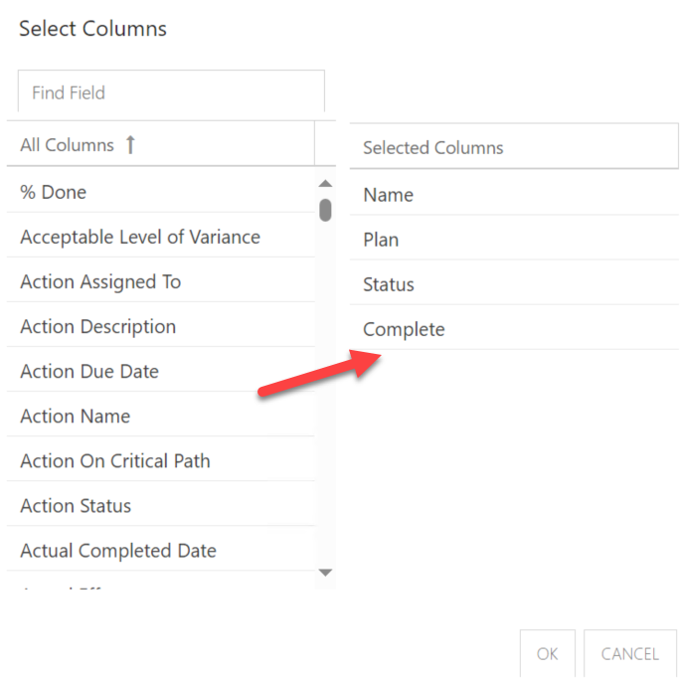
Add Columns in Work Plan
Click Select Columns icon to add fields that you want to show on the page
Drag fields from left to right and select OK to save the changes
Notes:
Perhaps update if they’re not using “Project”

Slide 36
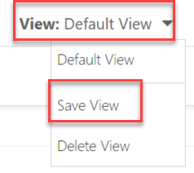
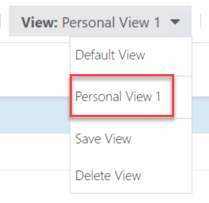
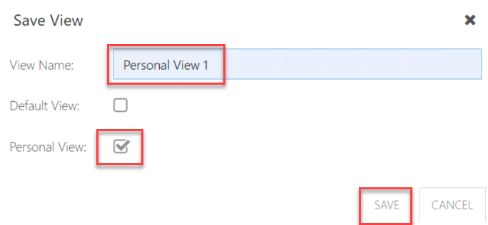
Save Personal View
Click View and select Save View
Remember to select Personal View and Save
Notes:
Perhaps update if they’re not using “Project”

Slide 37

Updating a Task in My Work
In My Work you can update Status and % Done
These updated push back to the schedule, not requiring approval.
It will be up to your project lead if your team uses this feature.
Notes:
Replace this screenshot with one from a 312 Group

Slide 38

Question & Answer

Slide 39
Final Points
Muscle memory will develop. Don’t be hard on yourself as you learn - remember it will take time to get used to where to click!
OnePlan rolls out new updates about every 6 weeks. This means you’ll see improvements all the time, including responses to our enhancement requests.
If you have an idea, share it with us, and we can submit to OnePlan.
The help guide is always available if you need it.

Slide 40

Subscribe to our YouTube Channel
Stay on top of the latest tips and tricks and new features by subscribing to PPM Work’s YouTube Channel. Learn from our latest videos and earn free PDU’s.
https://www.youtube.com/c/ppmworks

