Slide 1


OnePlan Training:
Resource Planning,
Timesheets

Slide 2
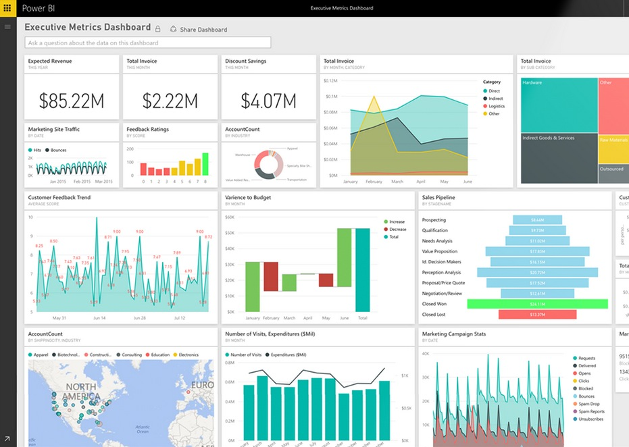


Previously Covered
My Portfolio and Plan Hierarchy
Work Plan
  Schedule/RAID/Lessons Learned
My Work

Slide 3
Today’s Agenda
Resource Planning
Timesheets
Q&A

Slide 4
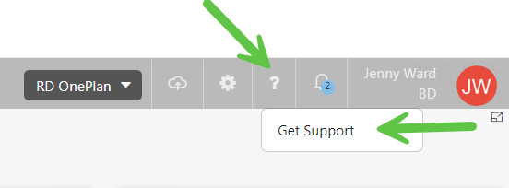
Support site
You can find all the information included in this training on the support site

Slide 5

Resource Plan

Slide 6
Resource Plan
OnePlan allows us to plan the number of resources (by function) we will need on our projects.
This is distinct from Task Assignments in the projects’ schedules.
Resource Plans are designed for estimating resource utilization and capacity.
Resource Plans CAN, however, be imported into Timesheets. This will result in hours on the resource plan being “peanut butter spread” across days of the week on the user’s timesheet.
Notes:
Perhaps update if they’re not using “Project”

Slide 7
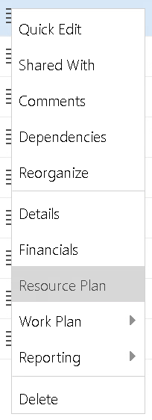
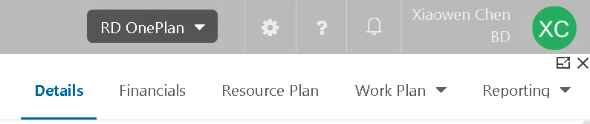
Accessing the Project Resource Plan
Option 1: From My Portfolio, use the “hamburger” menu on the left side of your project in the list, and select “Resource Plan”
Option 2: Get into Project Detail page, and click “Resource Plan” on the top panel
Notes:
Perhaps update if they’re not using “Project”

Slide 8
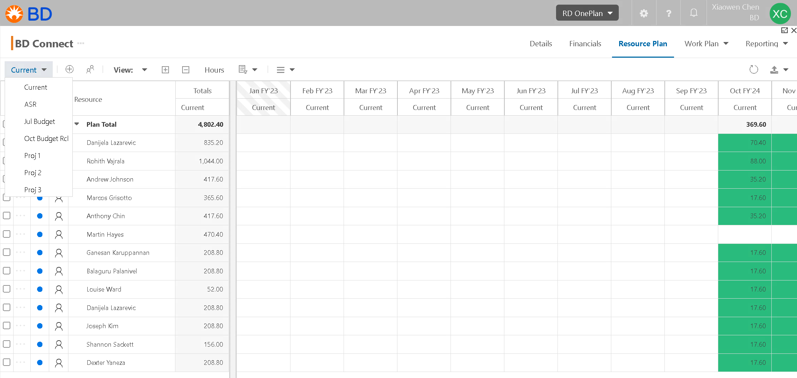
Accessing Resource Plan
When you first get into the Resource Plan page, you are in Current type
This will be where all of your current Resource Plans are established – your “working” copy
Notes:
Perhaps update if they’re not using “Project”

Slide 9
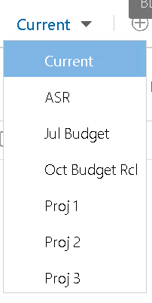
Resource Cost Types
Each BU has 7 Cost Types to be used at various times: Current, ASR, Jul Budget, Oct Budget Rcl, Proj 1, Proj 2, Proj 3
Current will be used for your day-to-day planning
The remainder of Resource Plan types are used to “snapshot” Current at various budget phases
NOTE: Some of BU might not have all the Cost Types. The amount of Cost Types are based on the use of each BU.
Notes:
Perhaps update if they’re not using “Project”

Slide 10
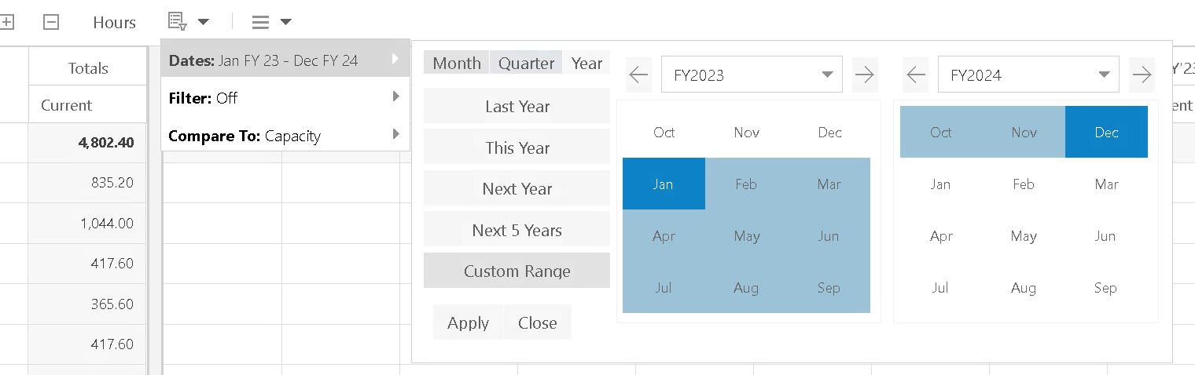
Viewing the Resource Plan by Date Range
Click drop-down icon for Filter to change Dates
Select the time period you want to use
This Year will pertain to this Fiscal year.
Notes:
Perhaps update if they’re not using “Project”

Slide 11
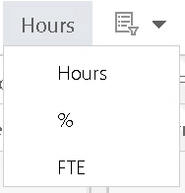
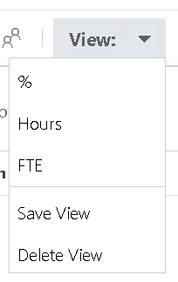
Selecting your Allocation Type
Click icon and select the allocation type you want to use
Click View, you can see there are three allocation types views created already, you can select the one you want
Notes:
Perhaps update if they’re not using “Project”

Slide 12
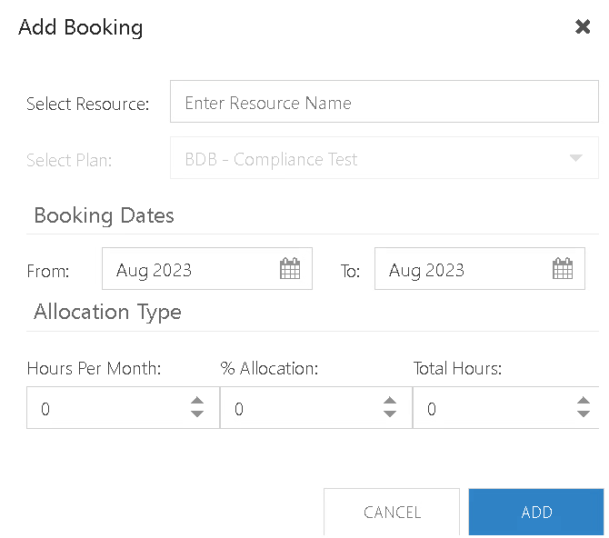
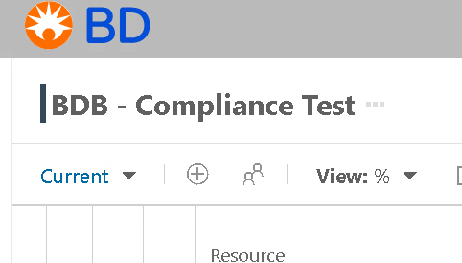
Adding Resources
NOTE: Here you can assign multiple resources at once
Enter Name
Selecting the Add Booking icon will allow you to add individual resources directly by entering the resource’s name
NOTE: These dates are by calendar year only. E.g. for FY24, you need to select From Oct 2023 to Sep 2024
Enter allocation time period
Select one allocation type
Notes:
Perhaps update if they’re not using “Project”

Slide 13
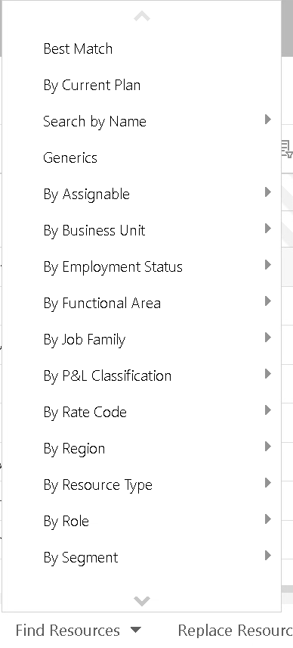
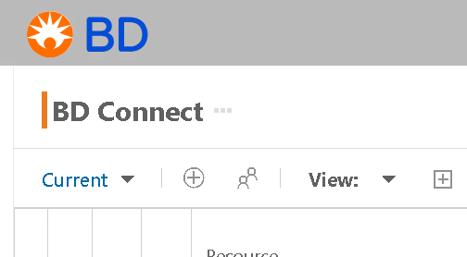
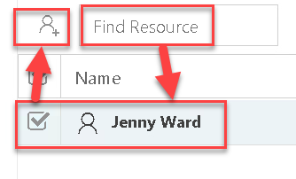
Adding Resources
If you instead select the Candidates List icon, a new section will appear at the bottom half of the screen
From here you can click the Find Resource to find the resources you want, filtered by Business Unit, By Function, by Role, or type in and search directly by Name
Notes:
Perhaps update if they’re not using “Project”

Slide 14
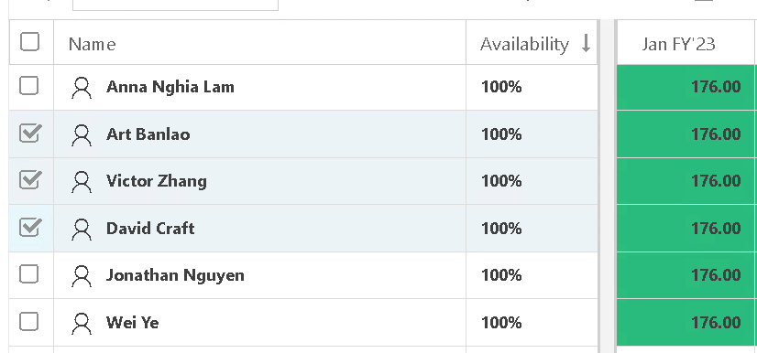
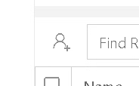
Assign Resources
Select and check the resources you want
Click Add Resources, the resources are added to the Resource Plan for this project on the top half of the screen
Notes:
Perhaps update if they’re not using “Project”

Slide 15
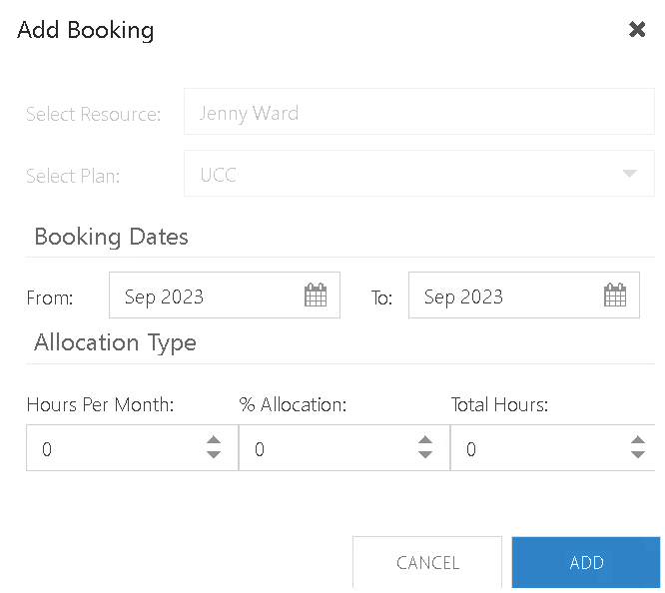
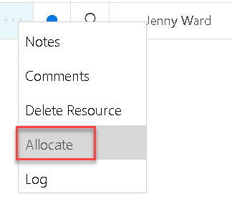
Allocate Resources
Click the ellipsis (three dots) next to the resource, and select Allocate
NOTE: As of right now, the booking dates will default to the current month. We have submitted a request to make this selection more dynamic.
Enter allocation time period
Select one allocation type
Notes:
Perhaps update if they’re not using “Project”

Slide 16
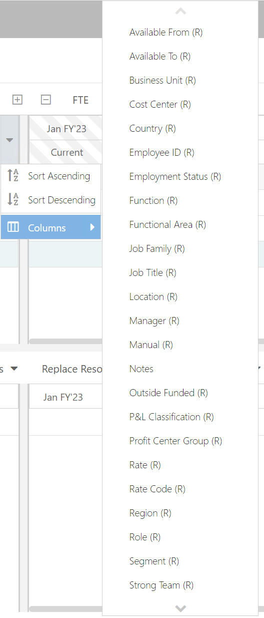
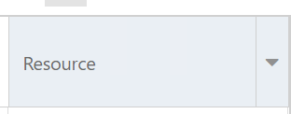
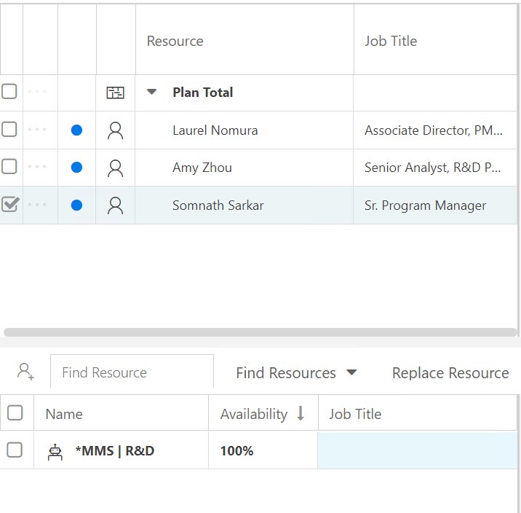
Add Columns in Resource View
You may want to see additional columns in your view for resources. To do this:
Click the drop-down button next to Resource
Click “Columns” and pick any fields of information you want to see for the Resources
Note: The selected columns will show both upper screen and bottom screen (Candidates List)
The columns will disappear when you refresh or second time login into OnePlan
Notes:
Perhaps update if they’re not using “Project”

Slide 17
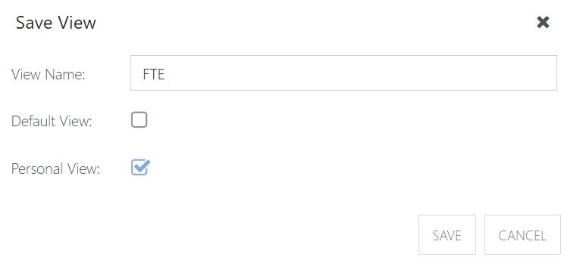
Save Personal View
Click View and select Save View button will allow you to save the columns you want to see.
Next time, if the view change back to default, you can select your personal view to see the information you saved
The view name you want
NOTE: Remember only save as Personal View!
Notes:
Perhaps update if they’re not using “Project”

Slide 18
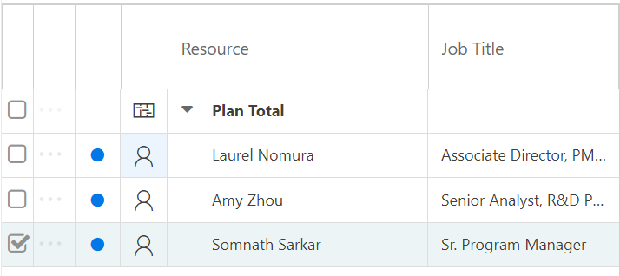
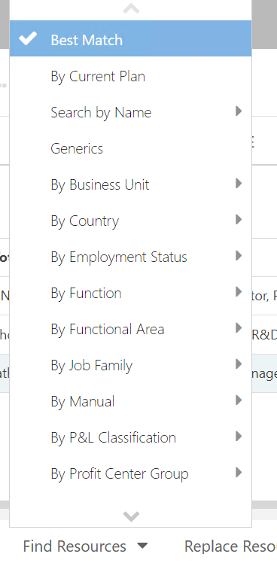
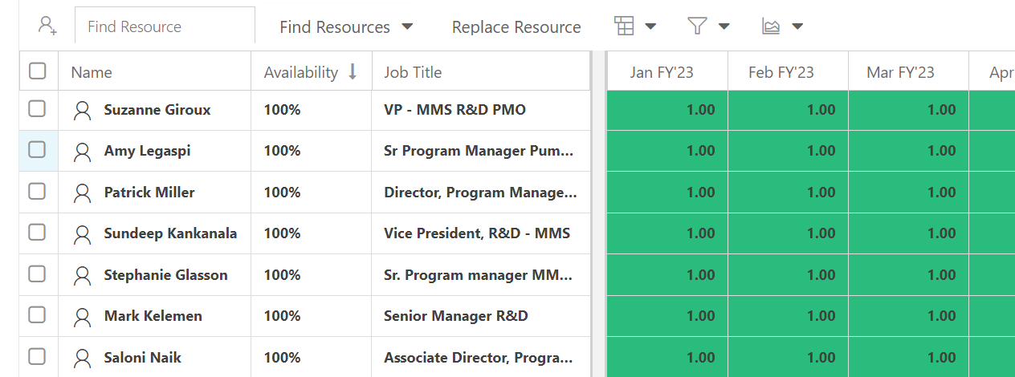
Best Match Resources
In Candidate List feature, you can use Best Match to search for any resources similar to the one you’ve selected, based on Role.
Click the resource, in bottom screen (Candidate List) and select Best Match
Example Shows
Notes:
Perhaps update if they’re not using “Project”

Slide 19
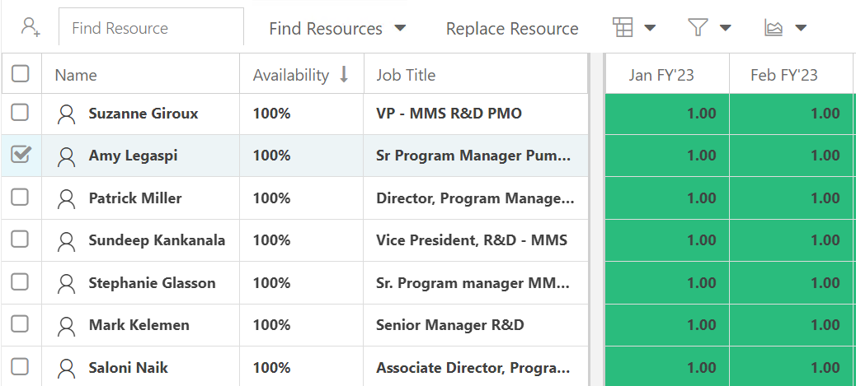
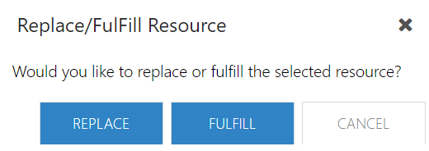
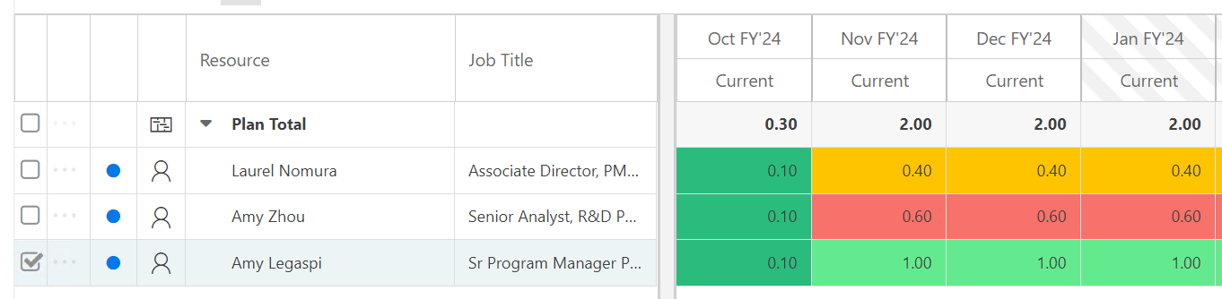
Replace Resources
Select the resources you want to pick in Bottom Screen (Candidate List)
Click Replace Resource
NOTE: The resource will be swapped with the new replacement in the resource plan above. The allocation will stay the same. The status will return to proposed and the row will return to private.
Notes:
Perhaps update if they’re not using “Project”

Slide 20
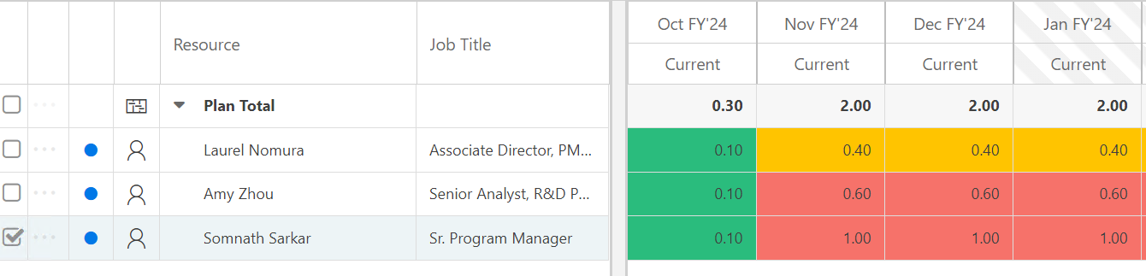
Replace Resources
Notes:
Perhaps update if they’re not using “Project”

Slide 21
Fulfill Resources
Select the resources you want to pick in Bottom Screen (Candidate List)
Click Fulfill Resource
NOTE: The placeholder resource now has named resources assigned to fulfill the resource requirement.
The resource details will show the original resource requirement, and the remaining resources needed to fulfill the requirements (in hours, FTE, or %).
Notes:
Perhaps update if they’re not using “Project”

Slide 22
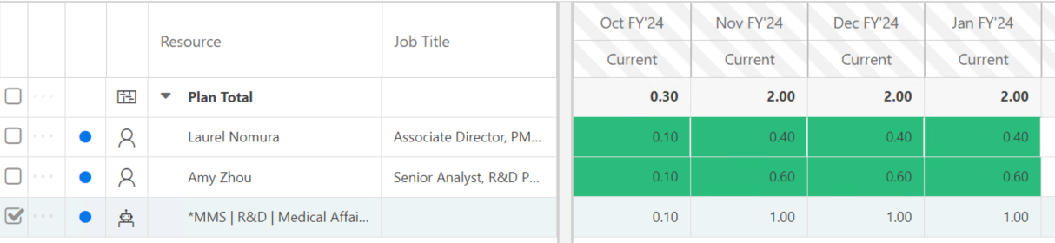
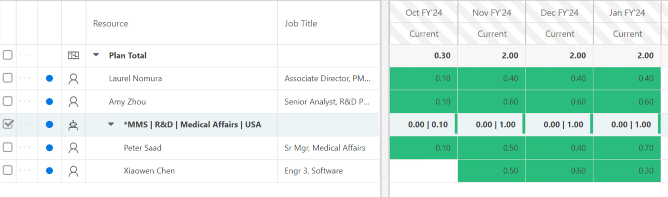
Fulfill Resources
Notes:
Perhaps update if they’re not using “Project”

Slide 23
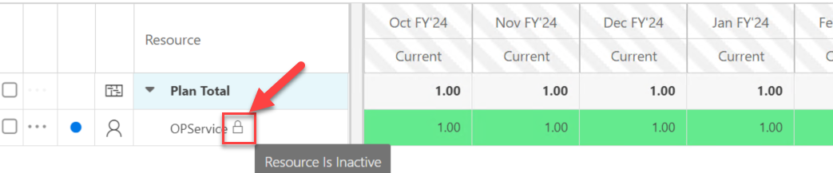
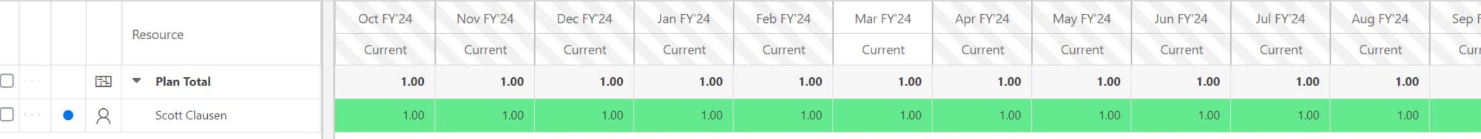
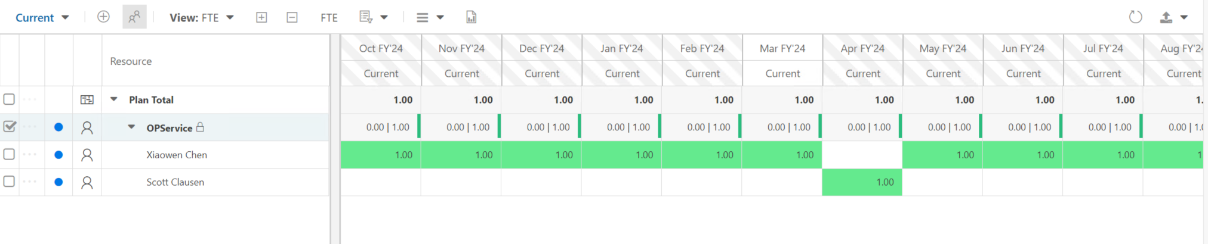
Good Solutions to Replace Inactive Resources
NOTE: If a resource become inactive, you cannot allocate the time anymore, the only way is to delete the resource or transfer the time to other resources.
Replace – replace the inactive resources entirely with another resources
Fulfill – assign the inactive resource's time to other resources
Warning: If you use Replace/Fulfill feature, the history of the allocation for the inactive user will get removed too.

Slide 24
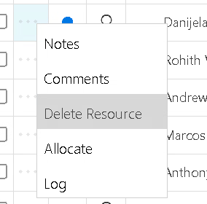
Delete Resources
Click the three dots next to the resource, and select Delete Resource
Note this will only delete this resource from your project, not OnePlan!
Notes:
Perhaps update if they’re not using “Project”

Slide 25
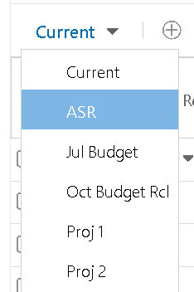
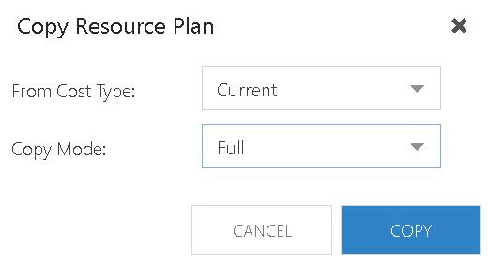
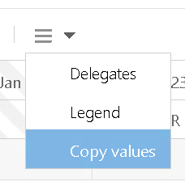
Copy Resource Plan from Current to ASR
Click Current drop-down list and select ASR
When ASR page open, click the drop-down list for the “hamburger”, select Copy values
Notes:
Check with Palak if she will speak to the process of when ASR, July, Oct etc are copied from Current.

Slide 26

Timesheets

Slide 27

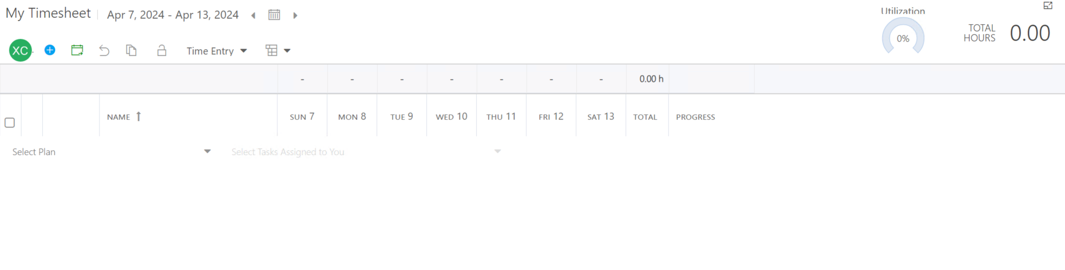
Accessing Timesheets
Notes:
Replace this screenshot with one from a 312 Group

Slide 28
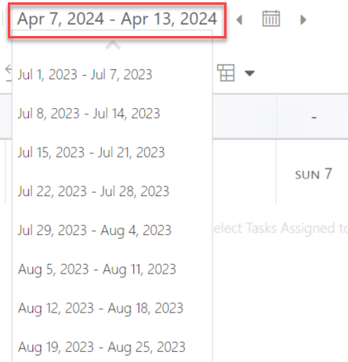

Change Timesheet Periods
Click on the period dates. A drop down will show all open/unlocked timesheet periods. If the admin has locked a period, you can no longer navigate to it.
Use the period navigation icons to quickly move to the previous period, the current/"today" period, or the next period.
Notes:
Perhaps update if they’re not using “Project”

Slide 29

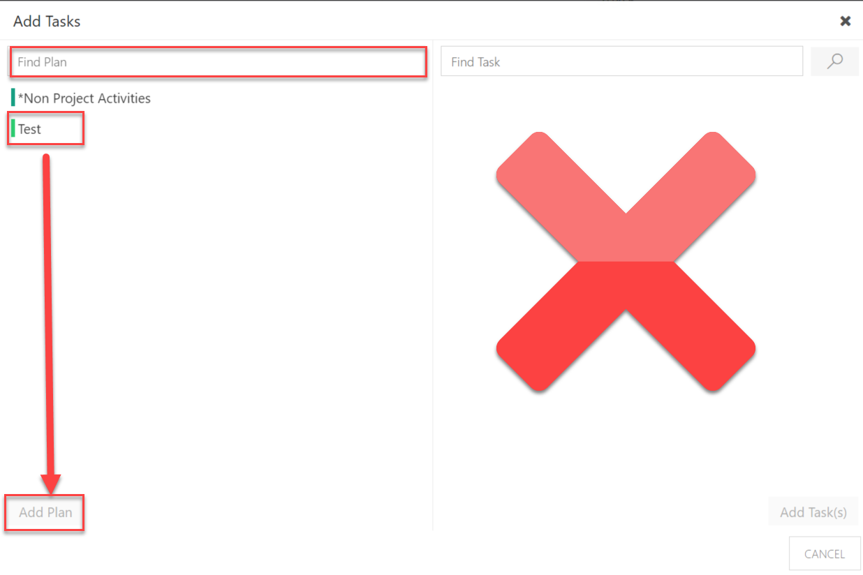
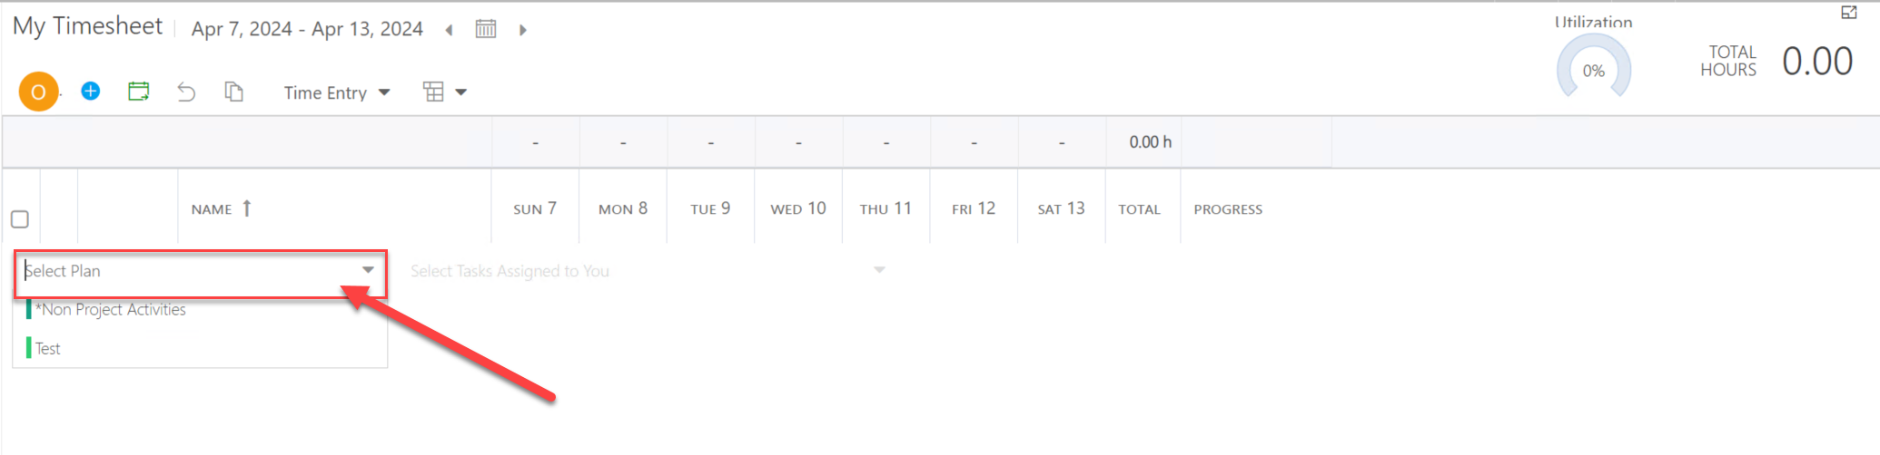
Add Work Items to Your Timesheet
Option 1: Click the Add Item icon. The Add Tasks window will open. Search for and select the desired project. Either type in the plan name into the Find Plan field, or select a project from the list of projects. Click Add Plan.
Option 2: Search for or select the desired project. Either type in the project name into the Select Plan field or open the drop-down menu and select a project from the list of projects. Click directly to the project, the project will add to your timesheet.
Notes:
Perhaps update if they’re not using “Project”

Slide 30
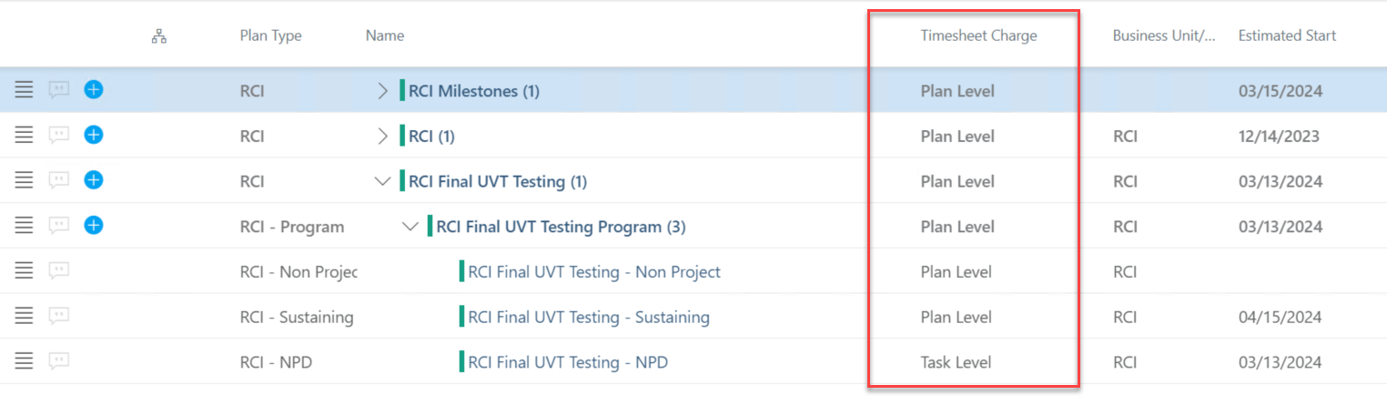
Plan-level or Task-level ?
If you select "Plan Level" -> Timesheet can import from Resource Plan
If you select "Task Level" -> Timesheet can import from Work Plan > Schedule
If you select "Task Level" & allocate resources in Resource Plan -> Resource Plan allocations will not import to Timesheet
If you select "Plan level" & assign resources to tasks -> Task Assignment will not import to Timesheet, but you can still charge time at a Plan level.
Key Takeaway: The ONLY time you should select Task Level is if you want users to charge time on their timesheets to specific tasks in your project schedules.
Notes:
Perhaps update if they’re not using “Project”

Slide 31
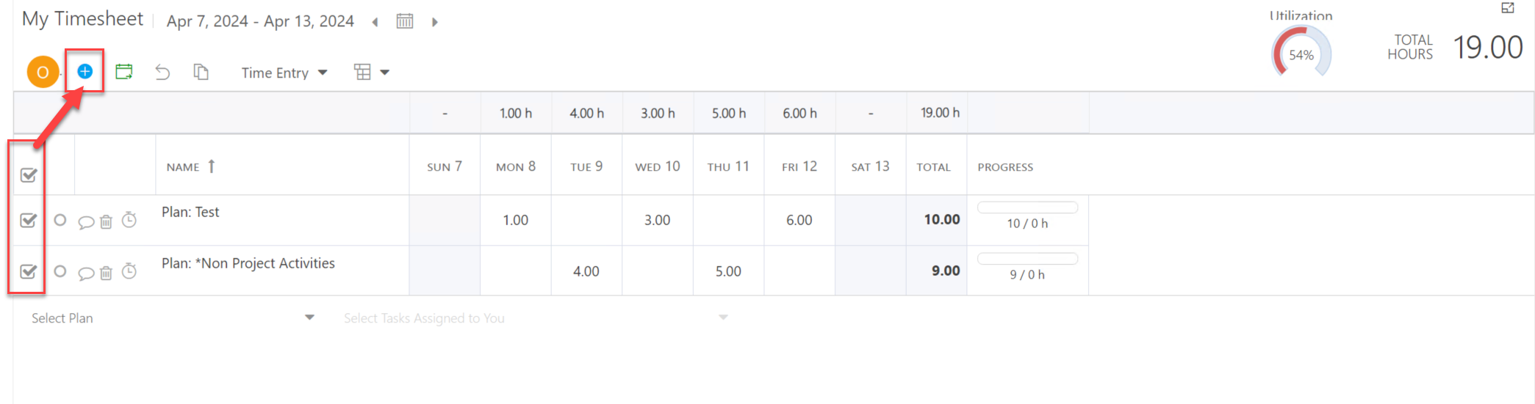
Submit Your Timesheet
Check the check box next to the timesheet rows you would like to submit for review.
Click the Submit icon in the timesheet header. The selected timesheet rows will be sent off to your timesheet manager for review and approval.
Notes:
Perhaps update if they’re not using “Project”

Slide 32
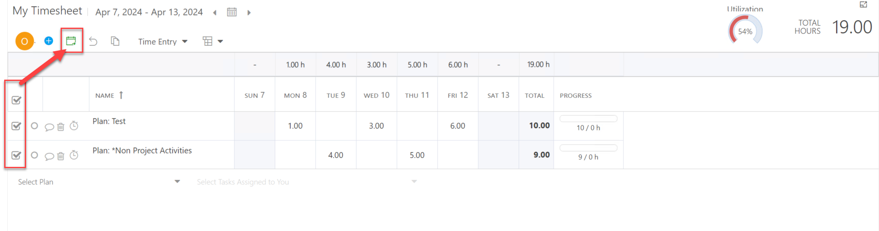
Recall Your Timesheet
Check the check box next to the timesheet rows you would like to make changes.
Click the Recall icon in the timesheet header. The selected timesheet rows will be recalled and become editable.
Notes:
Perhaps update if they’re not using “Project”

Slide 33
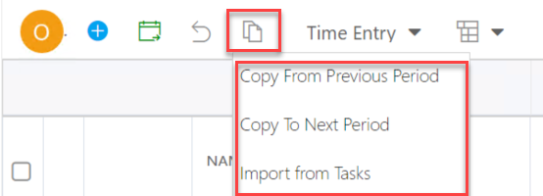
Copy Timesheet Items
Click Copy Timesheet icon.
Copy From Previous Period: Select to copy items from the previous timesheet period into the current timesheet period. This will overwrite any existing entries for this period.
Copy To Next Period: Select to copy items from the current timesheet period to the next timesheet period. This will overwrite any existing entries for that period.
Import from Tasks: Select to import any tasks to your timesheet you are currently assigned to for the current period.
Notes:
Perhaps update if they’re not using “Project”

Slide 34
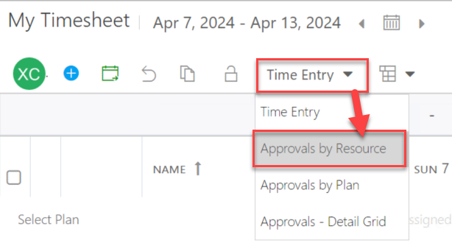
Approve Timesheet for your Team Members
Click on the Timesheets icon in the navigation. You will begin in the "Time Entry" mode.
To switch to Approval mode, select the desired approval view.
Note: The Timesheet Approver is automatically the Manager listed in the Resource Center
Notes:
Perhaps update if they’re not using “Project”

Slide 35
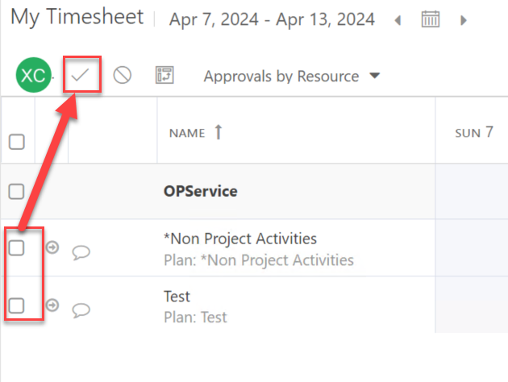
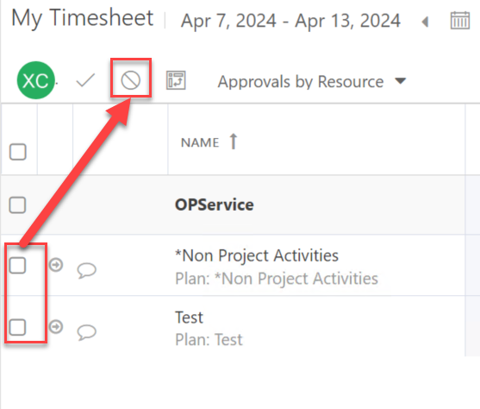
Select Items to Approve or Reject
Select one or multiple items to approve or reject. A comments window will open.
Approve
Reject
Notes:
Perhaps update if they’re not using “Project”

Slide 36
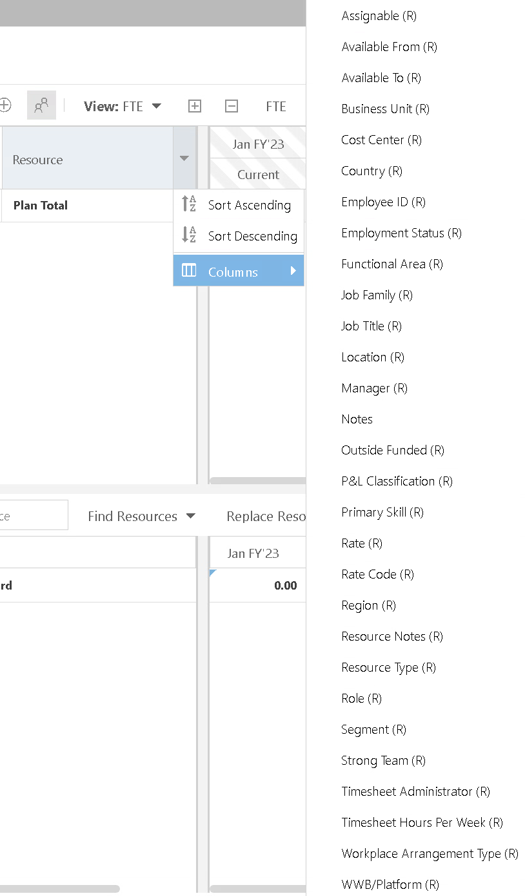
Add Columns
Click the drop-down button next to “Resource”
Click “Columns” and select the field you want to see for Resources
NOTE: The columns will disappear when you refresh or second time login into OnePlan
Notes:
Perhaps update if they’re not using “Project”

Slide 37
Support site
You will find all the information included in this training on the support site

Slide 38

Question & Answer

Slide 39
Final Points
Muscle memory will develop. Don’t be hard on yourself as you learn - remember it will take time to get used to where to click!
OnePlan rolls out new updates about every 6 weeks. This means you’ll see improvements all the time, including responses to our enhancement requests.
If you have an idea, share it with us, and we can submit to OnePlan.
The help guide is always available if you need it.

Slide 40

Subscribe to our YouTube Channel
Stay on top of the latest tips and tricks and new features by subscribing to PPM Work’s YouTube Channel. Learn from our latest videos and earn free PDU’s.
https://www.youtube.com/c/ppmworks

