Slide 1


OnePlan Training:
Financial Planning

Slide 2
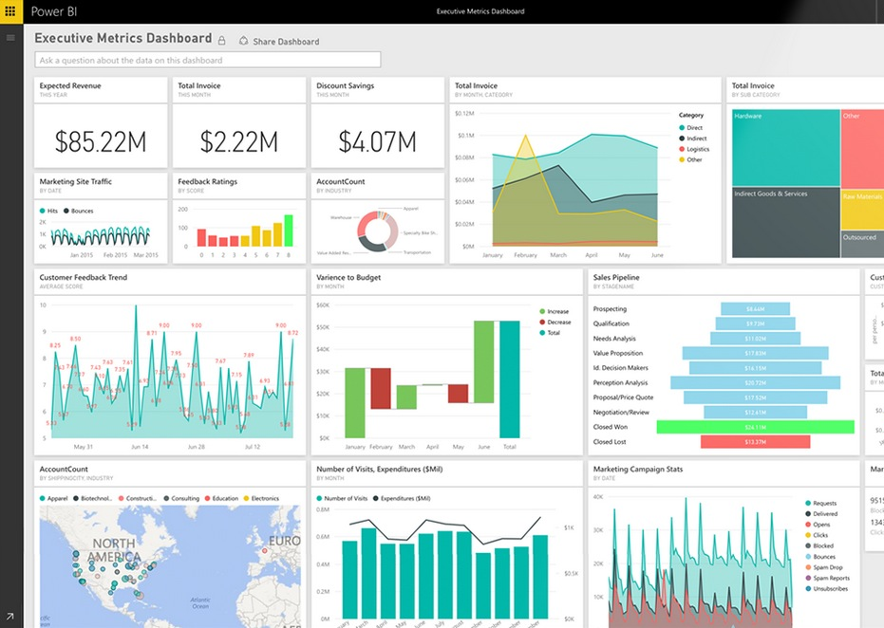


Previously Covered
Portfolio Overview
Schedule, RAID, Lessons Learned
Resource Plan
Timesheets

Slide 3
Today’s Agenda
Financial Planning
Q&A

Slide 4
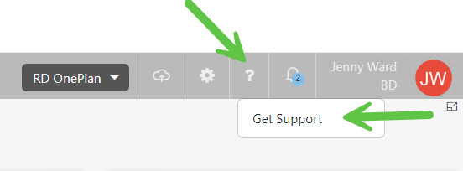
Support site
You can find all the information include in this training in support site

Slide 5

Financial Plan
Now that we’ve input our Resource Plan, we can shift to adding these Labor costs to the Financial Plan, along with OpEx (Non Labor) costs, as well.

Slide 6
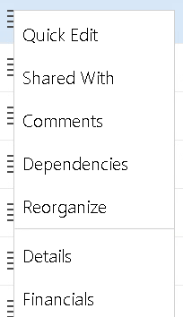
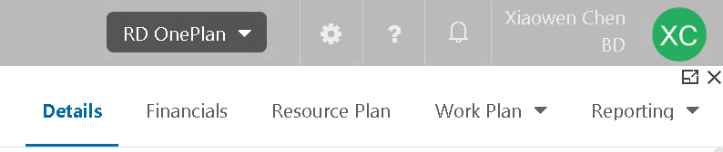
Accessing the Financial Plan
Option 1: From My Portfolio, use the “hamburger” menu on the left side of your project in the list, and select “Financials”
Option 2: Get into Project Detail page, and click “Financials” on the top banal
Notes:
Perhaps update if they’re not using “Project”

Slide 7
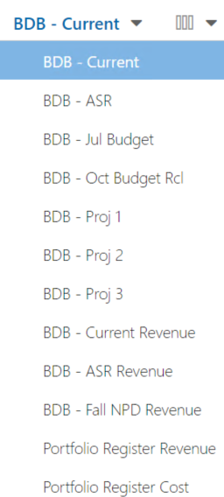
Financial Plan Cost Types
As with Resource Planning, each BU has few Cost Types to be used at various times in the Financial Plan (include cost and revenue)
Current will be used for your day-to-day budget/cost and revenue planning
The remainder are used to capture current at various budget phases, and once the phase ends, and they can be locked manually by a OnePlan Administrator
Portfolio Register Revenue and Cost are required by Corporate,
even if you enter these values into another Cost Type
Notes:
Perhaps update if they’re not using “Project”

Slide 8
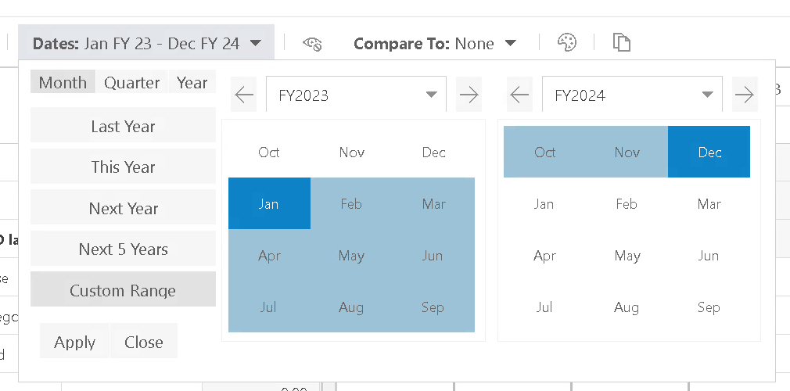
Accessing Financial Plan
Click the drop-down icon of Dates to change Dates
Select the time period you want to use
Notes:
Perhaps update if they’re not using “Project”

Slide 9
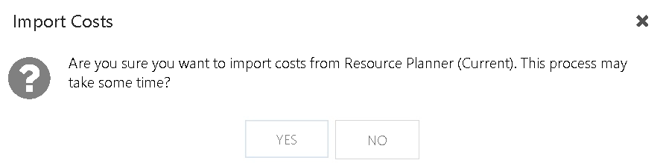
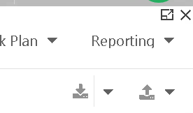
Import Financial Plan from Resource Plan
Click Import Cost icon, to import resource data (Current) into Financial Plan (Current)
For resources that have Rate Codes, the Financial cost is calculated automatically in Financials based on the allocation in Resource Plan
For resources without Rate Codes in OnePlan, the Excel file will need to be used to calculate those costs (see next slides)
Notes:
Perhaps update if they’re not using “Project”

Slide 10
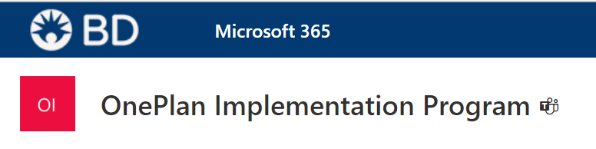
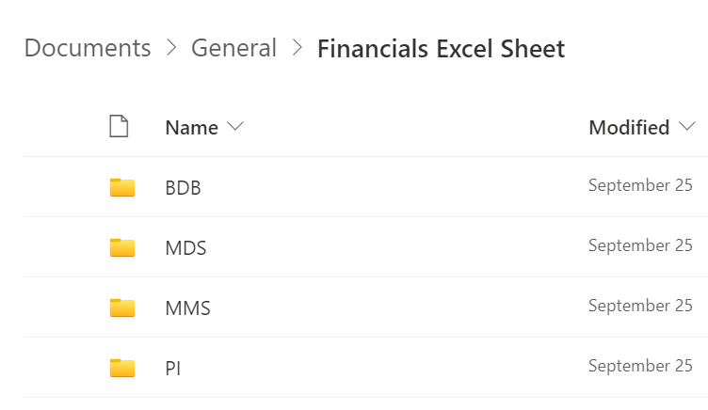
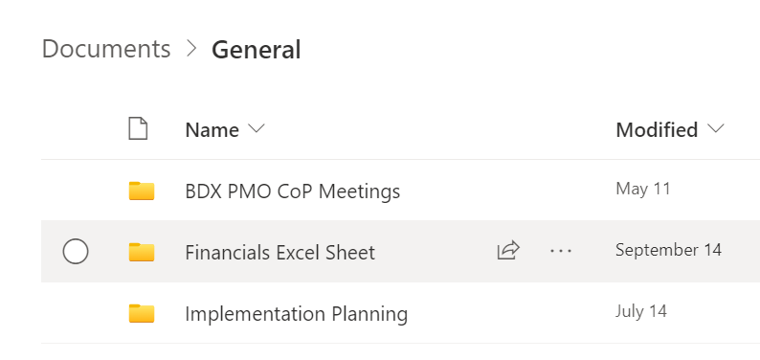
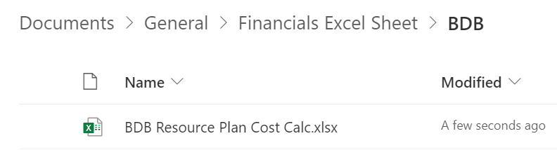
Financials –Excel sheet – FYI only
For some Bus, contingent workers’ rates and calculations are done via an external Excel sheet.
BDB Resource Plan Cost Calc.xlsx
Notes:
May need some updates on this slide to make more clear.

Slide 11
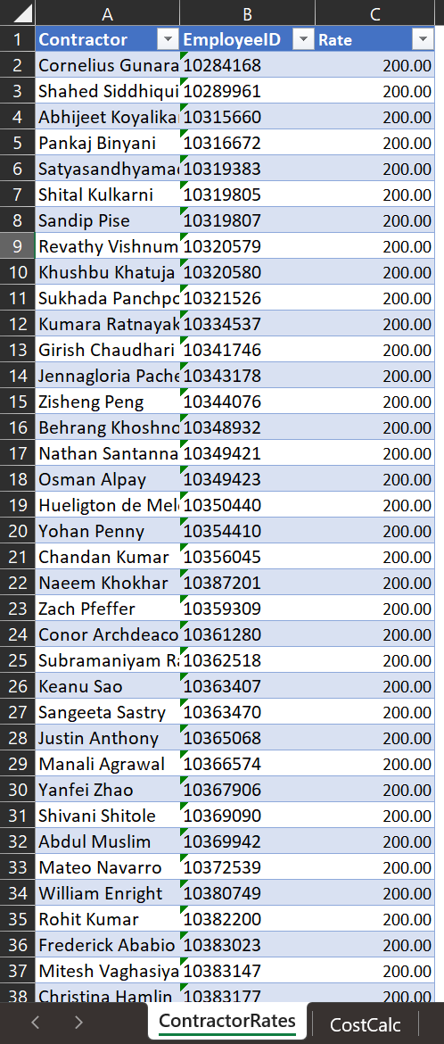
Financials - Excel sheet
These groups can input Contractor rates into a ContractorRates tab
The Rates now in the sheet are for example only
NOTE: We will re-review this technique with teams who need to use this for R2 contractor and/or internal labor rates
Notes:
May need some updates on this slide to make more clear.

Slide 12
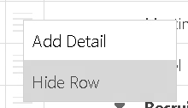
Financial Plan – Hide Row
Since there are MANY detail rows in the Financial plan, you may want to hide rows you don’t need.
Click the “Hamburger” icon and chose Hide Row
NOTE: OnePlan only allow to Hide Row one by one, we cannot yet hide multiple rows at once; An enhancement request has been submitted to auto collapse rows as you can in the Portfolio View
Notes:
Perhaps update if they’re not using “Project”

Slide 13
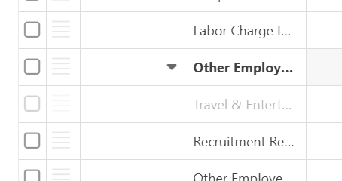
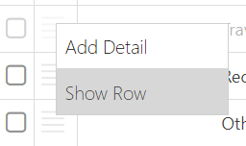
Financial Plan – Unhide Row
If you want all the hidden detail rows to show in the page later, click Show Hidden Categories icon
NOTE: The hidden row show in Grey color
Click the “Hamburger” icon and chose Show Row
Notes:
Perhaps update if they’re not using “Project”

Slide 14
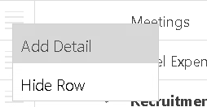
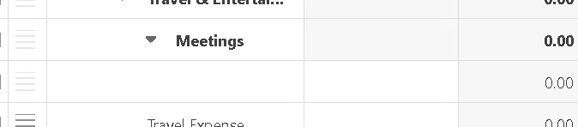
Financial Plan – Add Detail Row
If you want to add more details for each categories for cost in Financial Plan, click the “Hamburger” icon and chose Add Detail
Notes:
Perhaps update if they’re not using “Project”

Slide 15
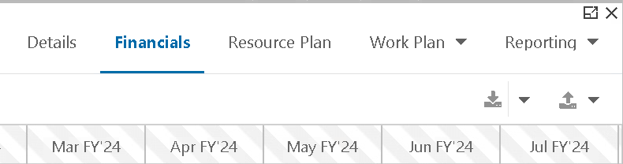
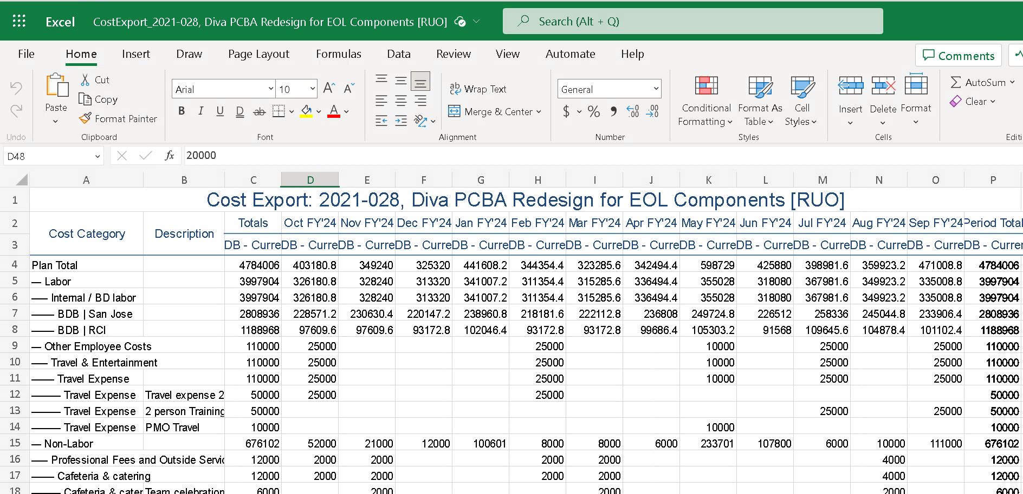
Financial Plan – Export to Excel
If you want to Export the Financials to Excel sheet, click Export
Notes:
Perhaps update if they’re not using “Project”

Slide 16
Copying To ASR from Current
Now that we’ve input our Financial Plans, it will come time to copy those values into ASR.

Slide 17
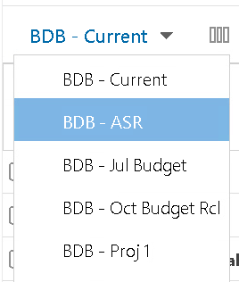
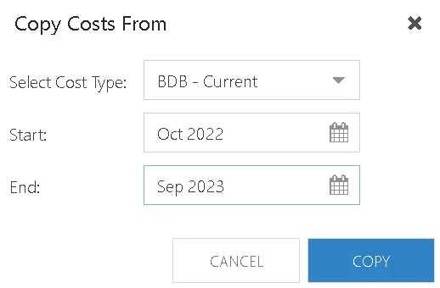

Copy Financial Plan to ASR from Current
Click Current drop-down list and select ASR
When ASR page open, click Copy Values
Notes:
Perhaps update if they’re not using “Project”

Slide 18
Support site
You can find all the information include in this training in support site

Slide 19

Question & Answer

Slide 20
Final Points
Muscle memory will develop. Don’t be hard on yourself as you learn - remember it will take time to get used to where to click!
OnePlan rolls out new updates about every 6 weeks. This means you’ll see improvements all the time, including responses to our enhancement requests.
If you have an idea, share it with us, and we can submit to OnePlan.
The help guide is always available if you need it.

Slide 21
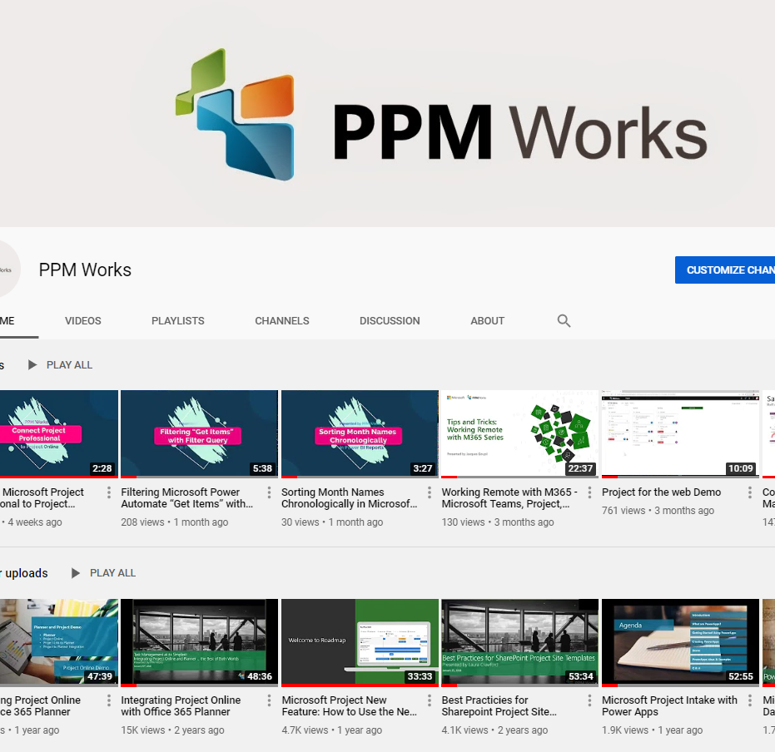
Subscribe to our YouTube Channel
Stay on top of the latest tips and tricks and new features by subscribing to PPM Work’s YouTube Channel. Learn from our latest videos and earn free PDU’s.
https://www.youtube.com/c/ppmworks

