Slide 1


OnePlan
General Training

Slide 2
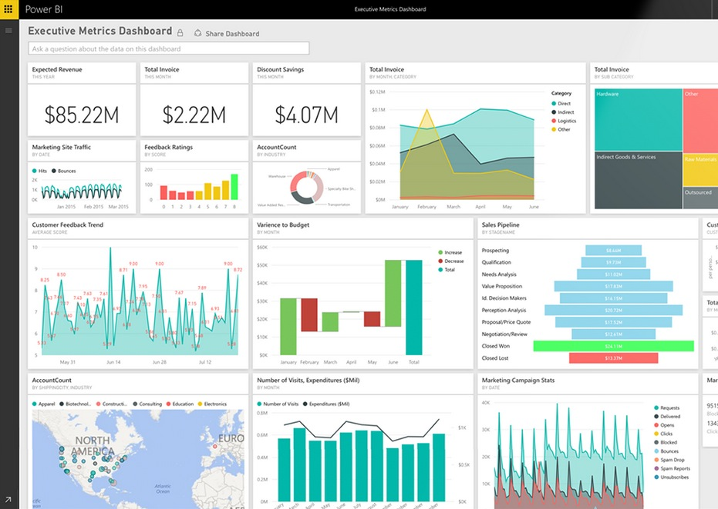


Today’s Agenda
Navigating OnePlan
My Portfolio
Project Creation
Next Steps

Slide 3
Training Etiquette
Please turn off video and mute microphones for recording quality
Send questions in chat so we can collect them and address recurring theme questions
Remaining questions will be answered/addressed in a follow-up email
Because of the large attendee list, we will see if we have time for question and answer session will take place on this call
Reminder: The terms “Project” and “Plan” will be synonymous here. There are places in OnePlan (because of the name in the tool) where links and menus will use “Plan”. For BD’s purposes, this equates to a Project record – a Project, a Program, a Platform, etc.

Slide 4
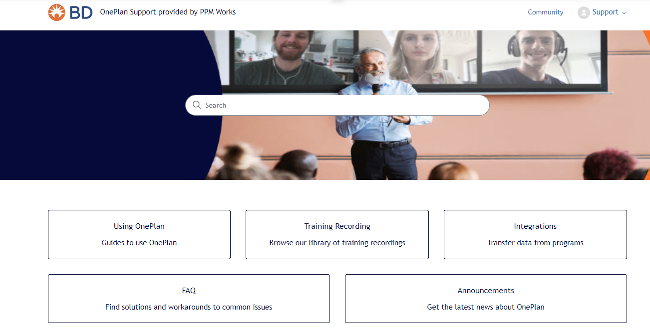
Support site – bd.ppmworks.com
You will find the recording for this training and this PPT here!

Slide 5
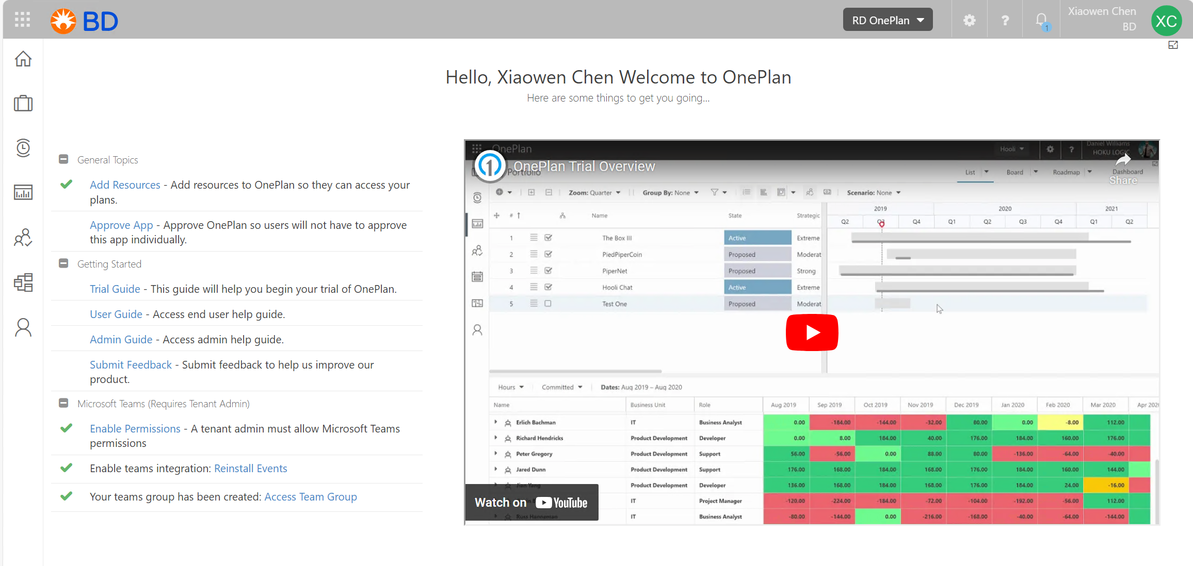
Navigating to OnePlan
To access OnePlan, simply navigate your browser to my.oneplan.ai. OnePlan will use your organizational credentials.
From there, you will be brought to the OnePlan home screen, or whatever was the last OnePlan page you visited.
Notes:
Replace screenshot to include Timesheet icon, and just dim text if it’s not included in their environment, or explain there may be elements they don’t use

Slide 6
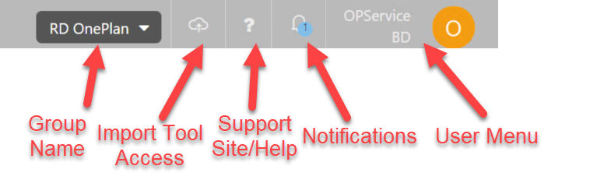
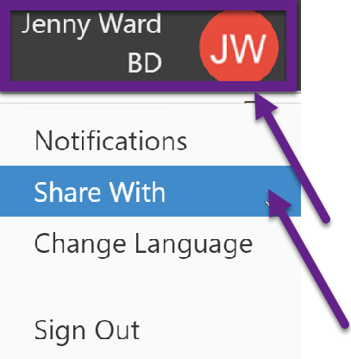
Navigating the OnePlan Top Menu
Share With from your user drop down menu will provide a direct link to a plan. It will NOT grant permission automatically.

Slide 7

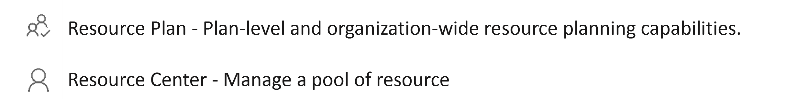
Navigating the OnePlan Quick Launch Menu
Home – Overall View
My Work – Where you can see your assigned projects and submit status updates
Timesheets- Timesheets Entry features as a Team Member, tracking time on plans
NOTE: This will only show if your BU is using Timesheets to enter time
My Portfolio – Central location for all Portfolios, Programs, and Projects
Those with Manager or Admin level permissions will also see the Resource Plan and Resource Center links.
Notes:
Replace screenshot to include Timesheet icon, and just dim text if it’s not included in their environment, or explain there may be elements they don’t use

Slide 8
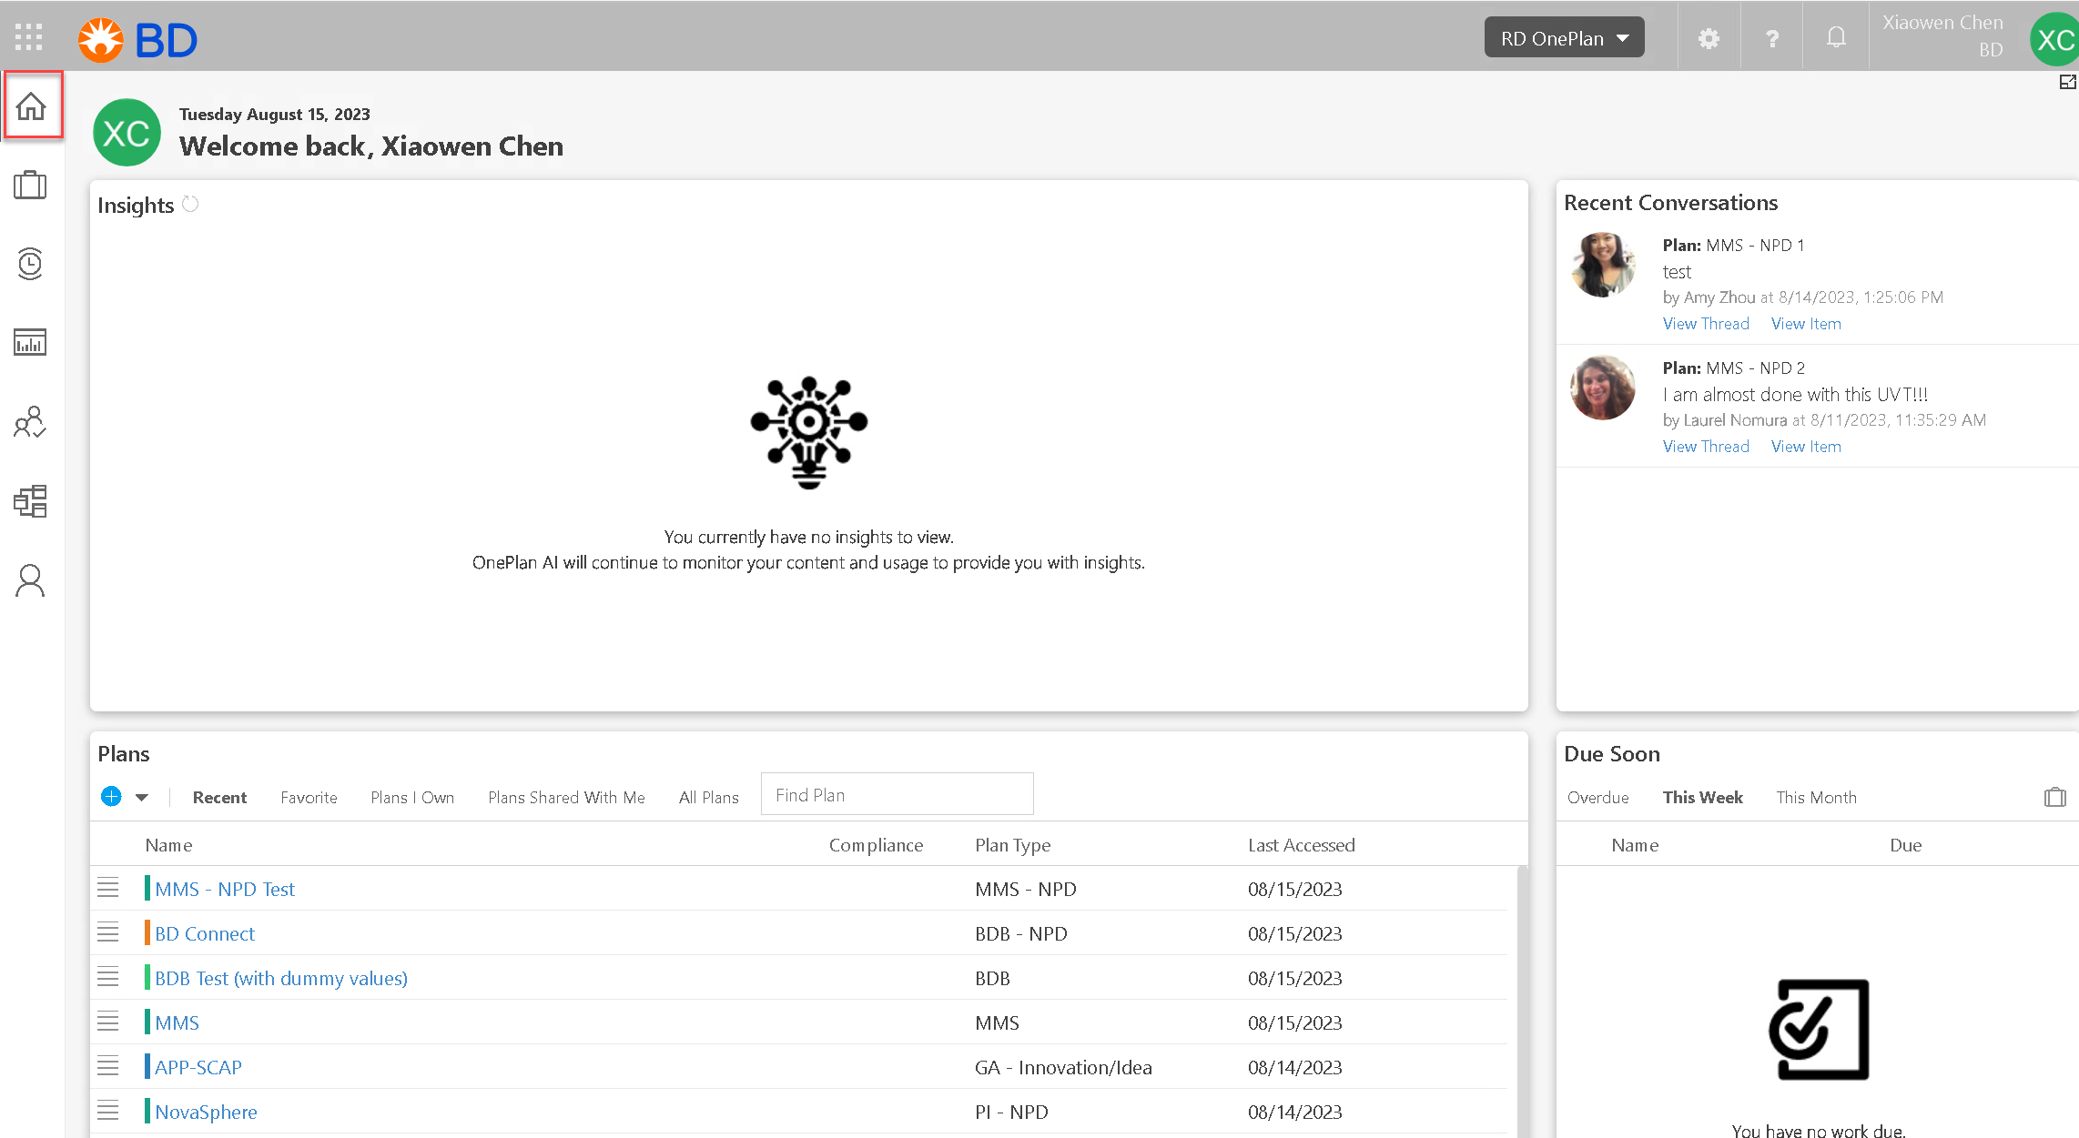
Home – your home base to access recent plans
You can see the comments left by your team members
You can see the Plans to which you have access, categorized by Recent, Favorites, Plans you Own, and Plans Shared with you.
Notes:
Replace this screenshot with one from a 312 Group

Slide 9
Home
Recent : Projects you recently view and access
Favorite: Projects you save as favorite for faster access
Plans | Own: Projects you as owner
Plans Shared With Me: Owners have shared with you
You can search the project you want by typing in name of the project in “Find Plan”
NOTE: the difference between these two is Permission Level
Notes:
Replace this screenshot with one from a 312 Group

Slide 10
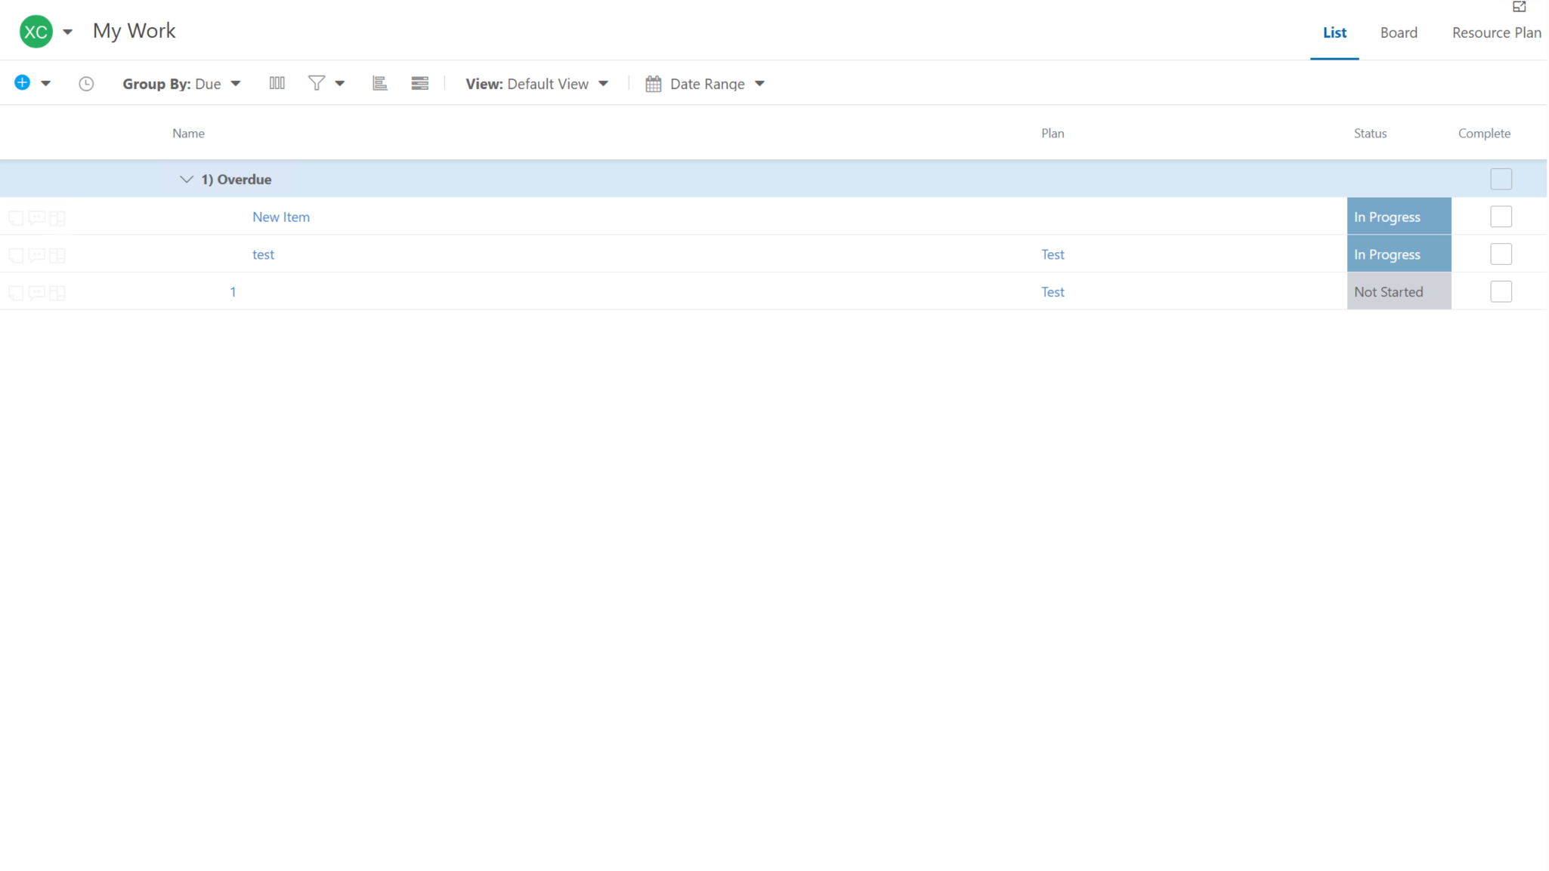
My Work
NOTE: We will talk about this area in more detail during Work Plan session
Notes:
Replace this screenshot with one from a 312 Group

Slide 11
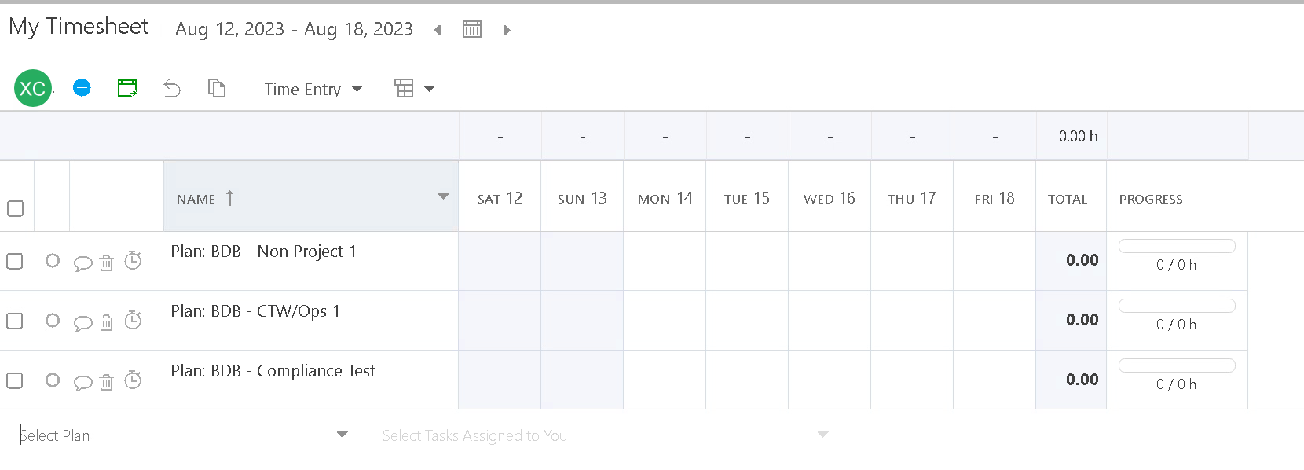
Timesheets
NOTE: We will talk about this area in more detail during Resource Plan session

Slide 12
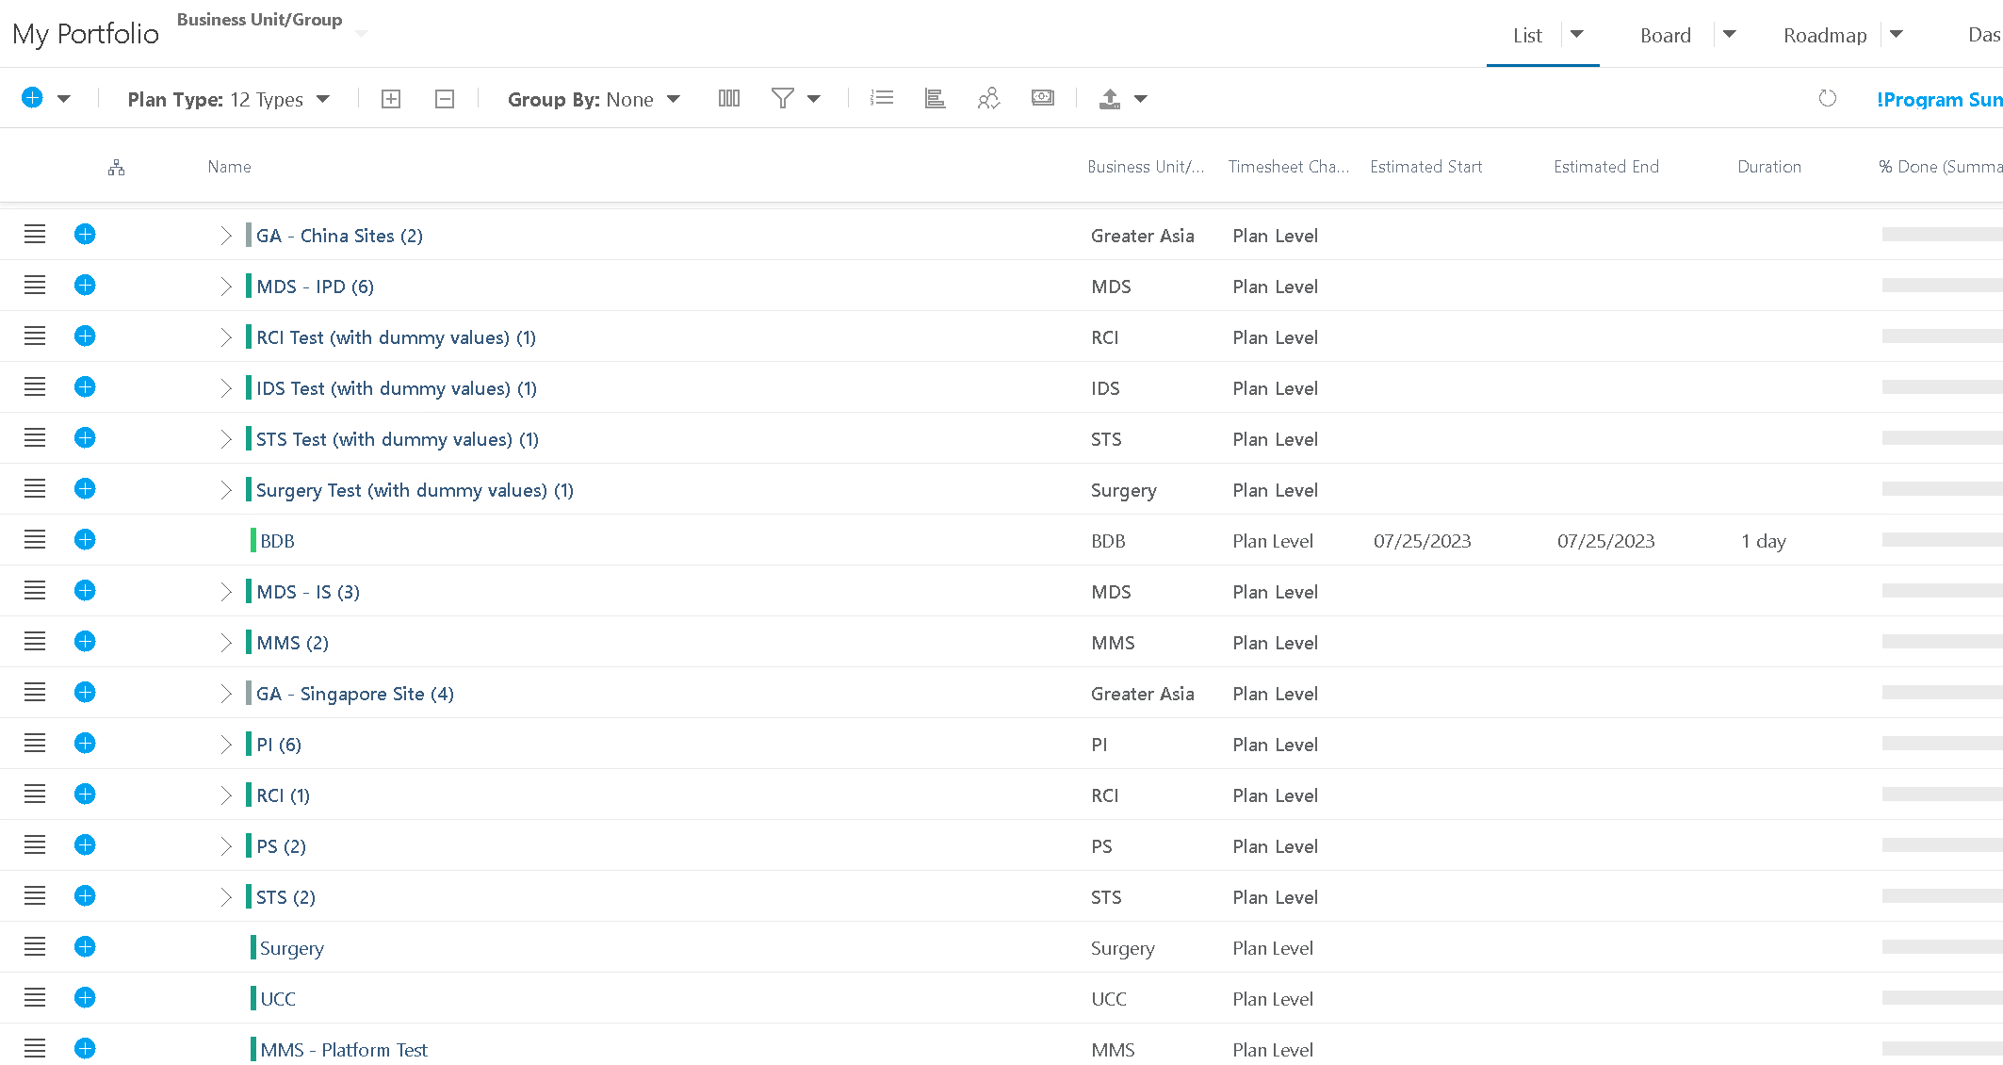
My Portfolio – view of all plans from your own BU
Notes:
Replace this screenshot with one from a 312 Group

Slide 13
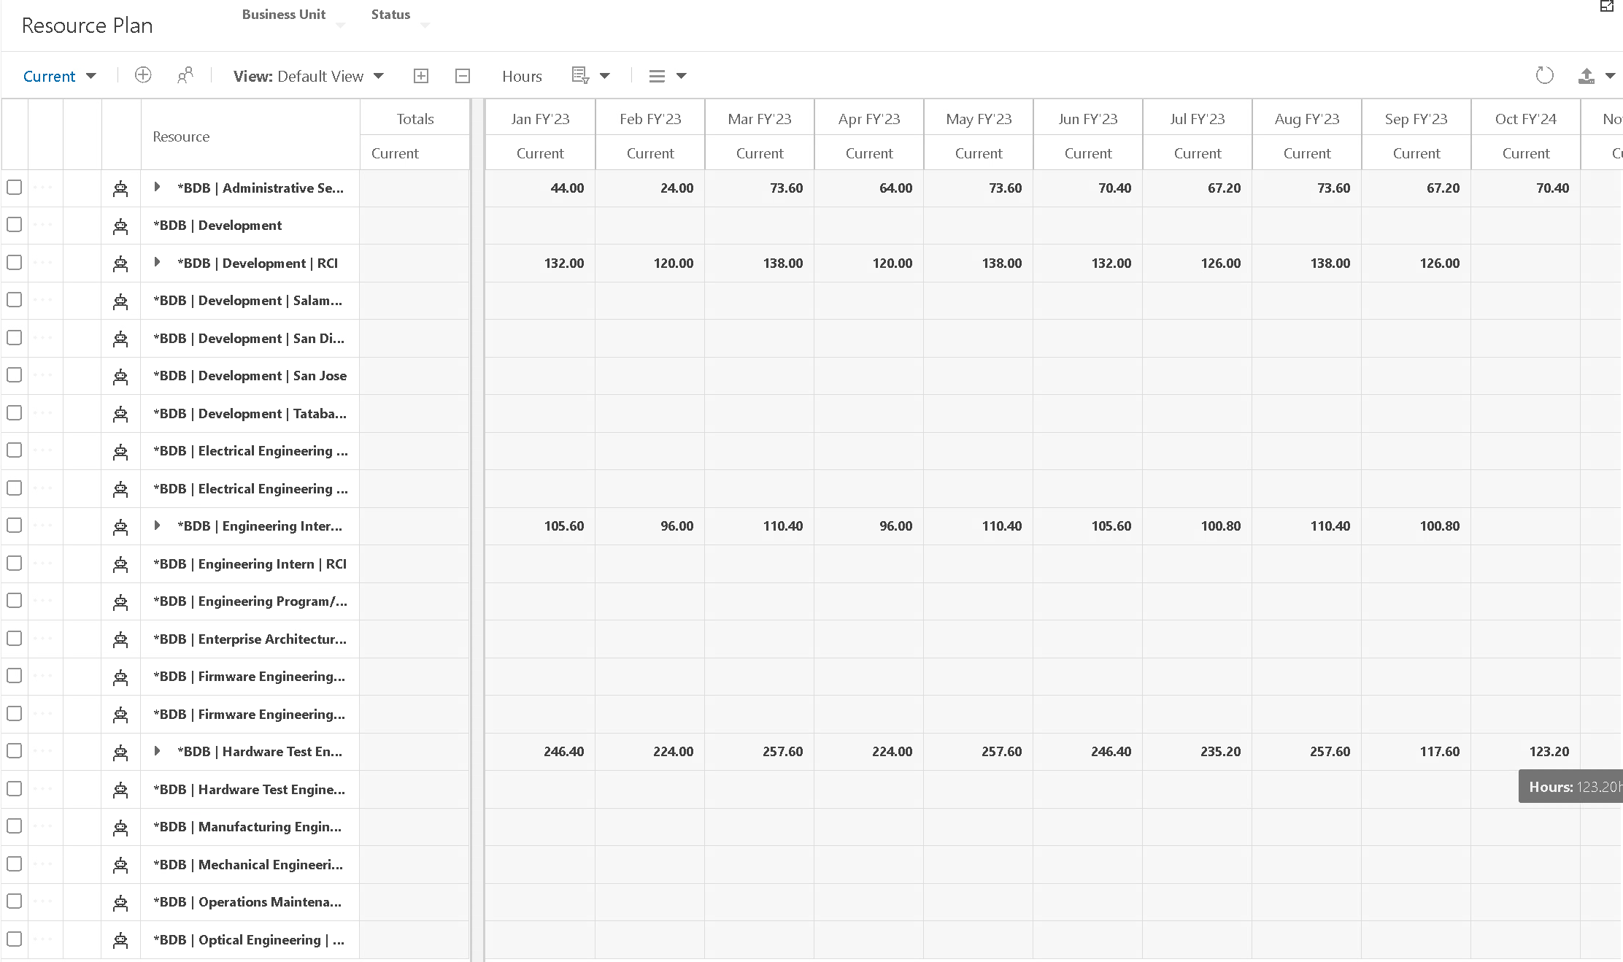
Resource Plan
Notes:
Replace this screenshot with one from a 312 Group

Slide 14
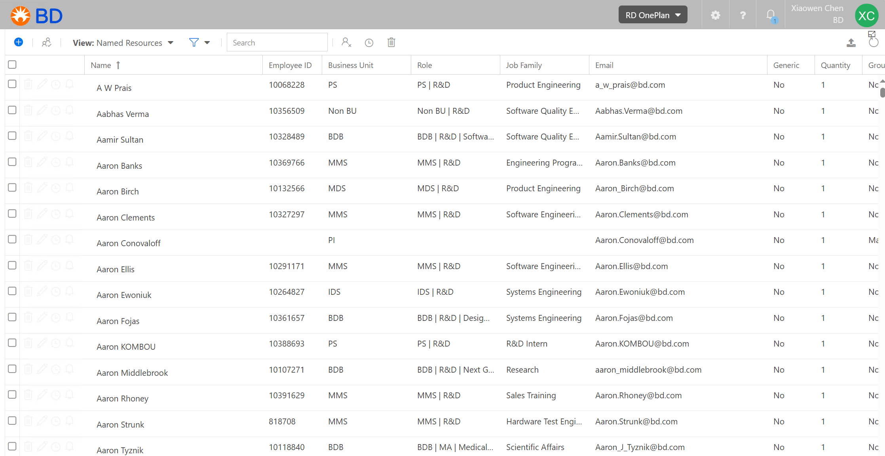
Resource Center
Notes:
Replace this screenshot with one from a 312 Group

Slide 15

My Portfolio

Slide 16
Navigate to My Portfolio – You will only see your own BU’s Projects
Notes:
Replace this screenshot with one from a 312 Group

Slide 17
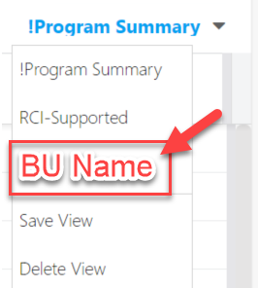
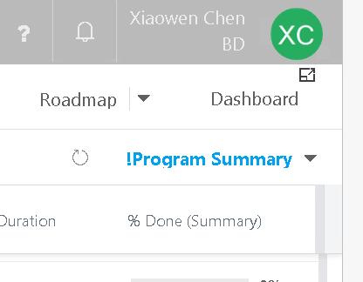
My Portfolio View – BU Specific View
If it’s your first time accessing the Portfolio Area, your view will default to the !Program Summary view
Click on the drop down near this view name to select your BU’s view.
Once you do this, when you
return to this page, your BU
view will remain as your
selection
Notes:
Perhaps update if they’re not using “Project”

Slide 18



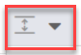

My Portfolio View – Header Menus
Expand and Collapse Plans
Click the Group By icon to select a field to group the plans by in the Portfolio grid.
Click the Filters icon to select and apply filters to the Portfolio. You can select multiple filters.
Click the Row Height icon to select the height of the rows in the Portfolio grid. Options include Small, Medium, and Large.
Click the Export icon to export project lists to Excel with fields that show in the page.
Notes:
Perhaps update if they’re not using “Project”

Slide 19
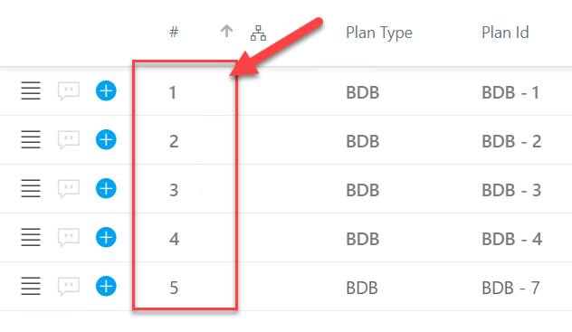
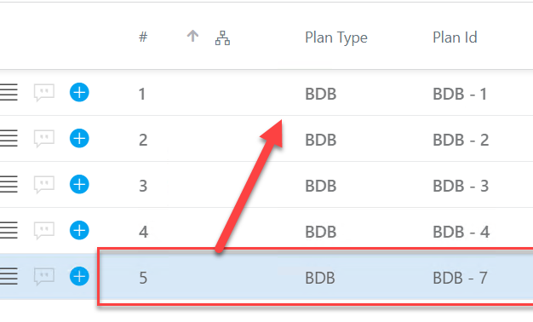
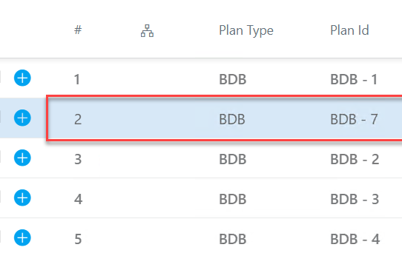
My Portfolio View – Header Menus
The Reorder function will allow you to drag and drop to reorganize the currently selected top-level plan types in the Portfolio.
Notes:
Perhaps update if they’re not using “Project”

Slide 20
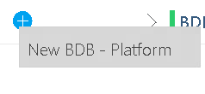

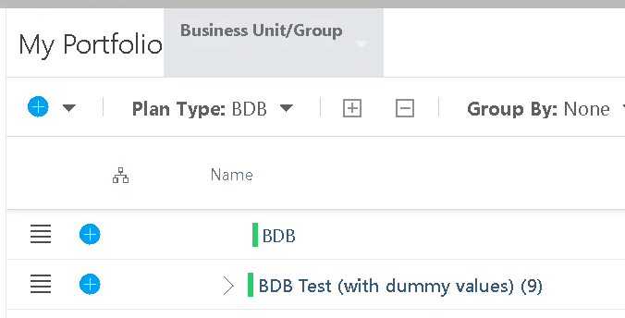
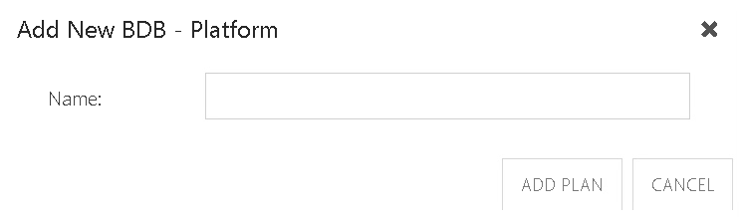
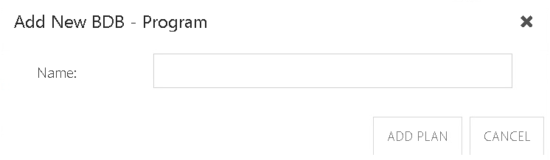
Create a New Platform / Program
From My Portfolio, ensure you are on your own BU’s Plan Type view.
Select the project record under which you will want to add the new item, click on the plus sign on the left side of its row, then select “New Platform” or “New Program” or new (specific project type) name
Notes:
Perhaps update if they’re not using “Project”

Slide 21
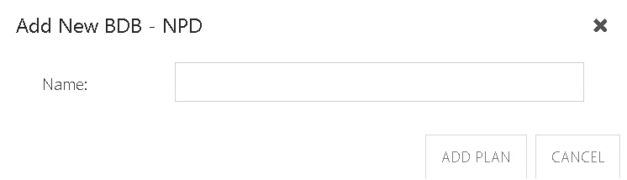
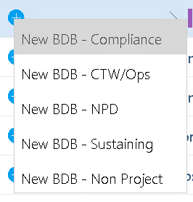
Create a New Plan
Under the Platform / Program level, click on the plus sign and select the type of project you want to create. Each BU has own types of projects
Type the name of your new project and click ADD PLAN

Slide 22
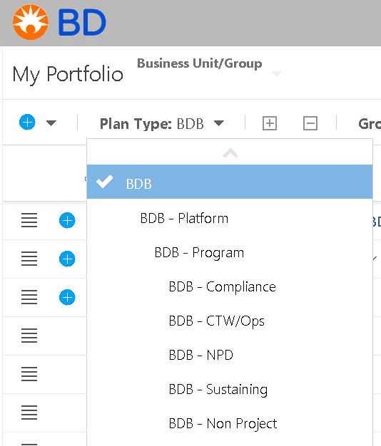
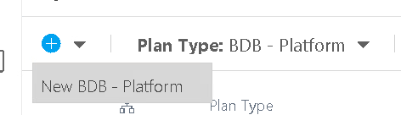
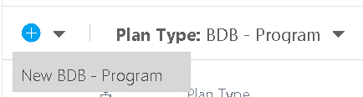
Create a New Platform / Program (Not Recommended)
From My Portfolio, ensure you are on your BU Plan Type view.
Under the Plan Type icon, click the drop-down menu, select the level you want that you can create directly
NOTE: If using this way to create projects, the projects will not show in the front BU page, since the project create here does not have a Platform or Program.
Notes:
Perhaps update if they’re not using “Project”

Slide 23
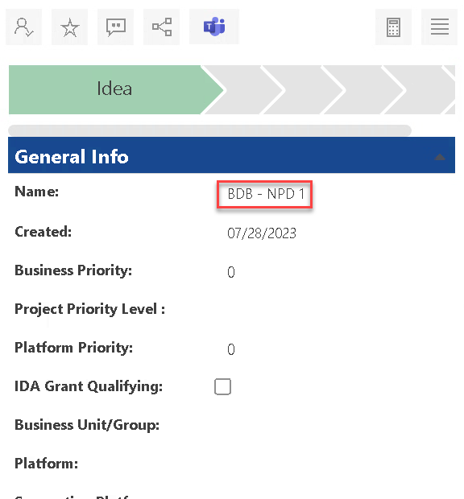

Accessing your Plan
When you first create the plan the Details panel will popup on the right-hand side of the screen. If you wish, you can instead close out of the panel, and go directly into the plan to edit its details. Not that a Page Refresh may be required before your new item appears in the list.
“Business Unit/Group” field is required to fill in by using the drop-down list. Populating this field ensures all your plans appear in your view.

Slide 24
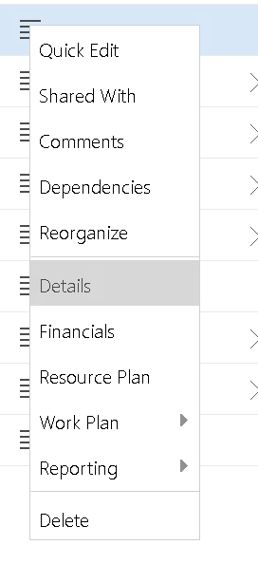
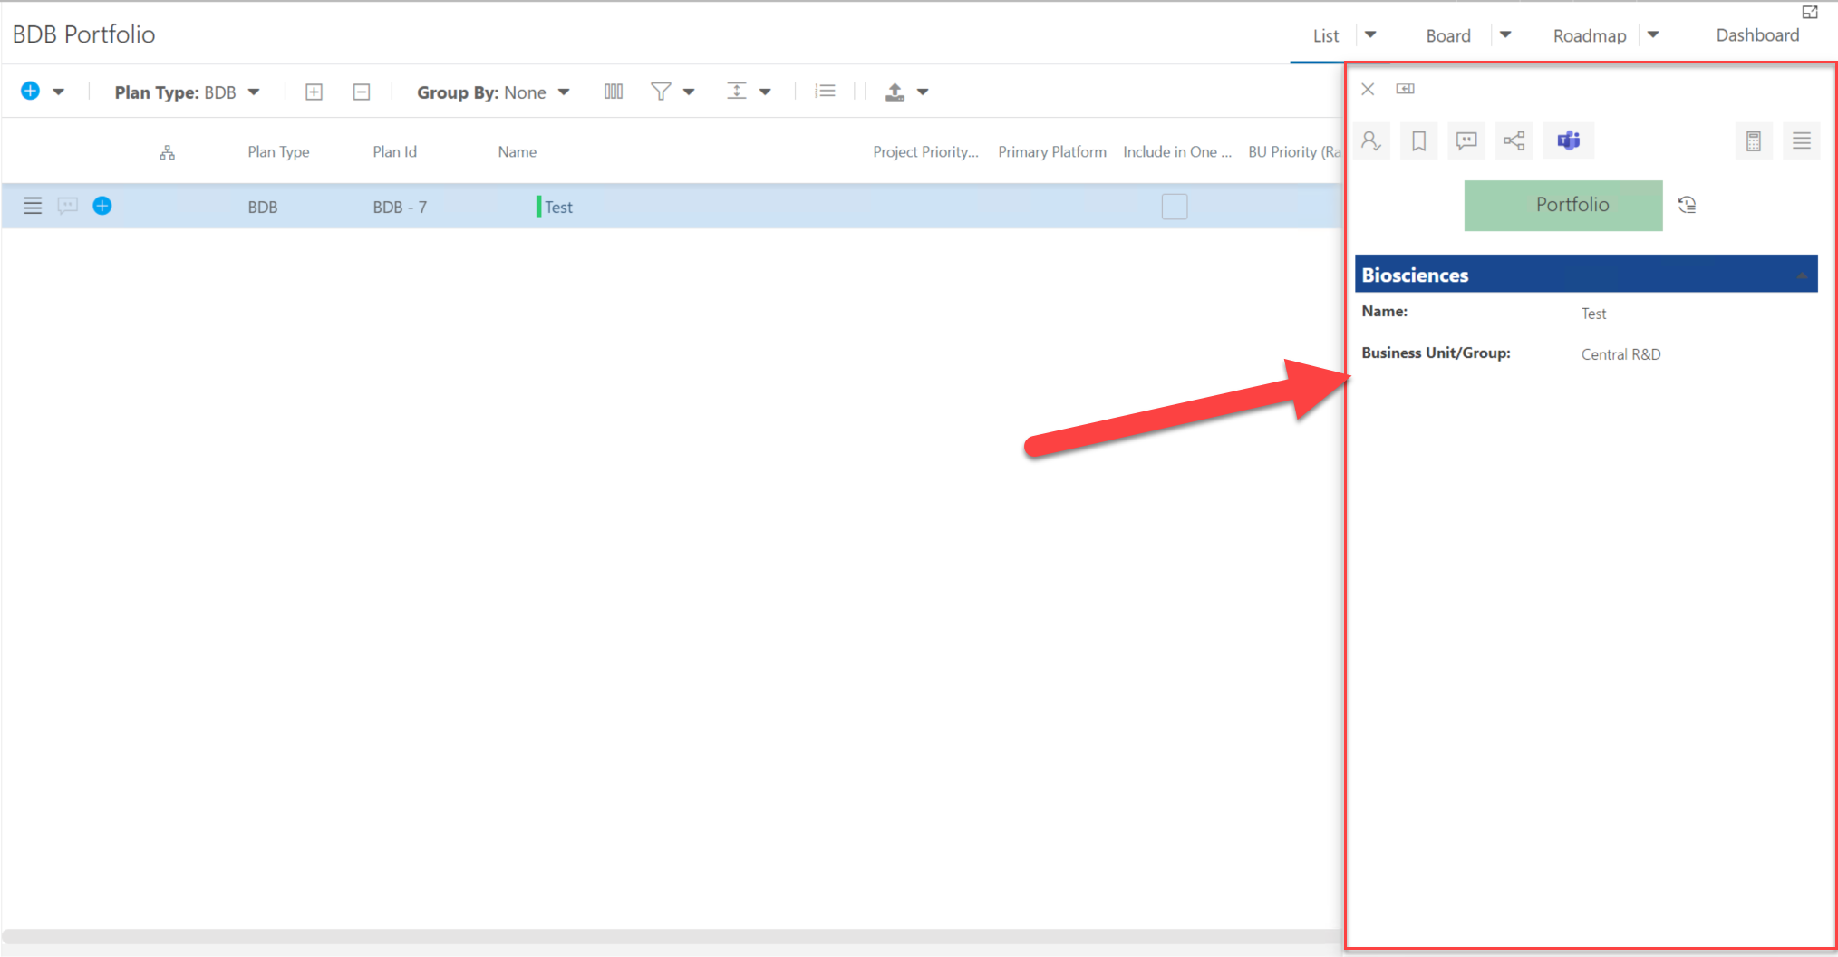
Accessing your Plan
To get a quick view of the Plan, use the “hamburger” menu on the left side of your plan in the list
Select Quick Edit
Notes:
Talk about quick edit?

Slide 25
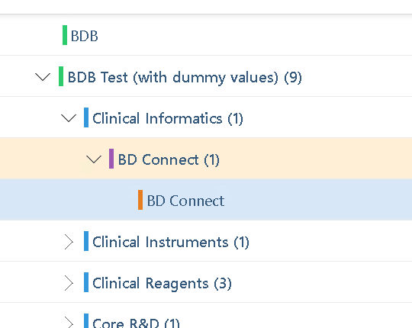
Accessing your Plan
To get to Details in full screen mode, use the “hamburger” menu on the left side of your plan in the list
Clicking on the title of the Plan will bring you to whatever the last visited page was
Notes:
Talk about quick edit?

Slide 26
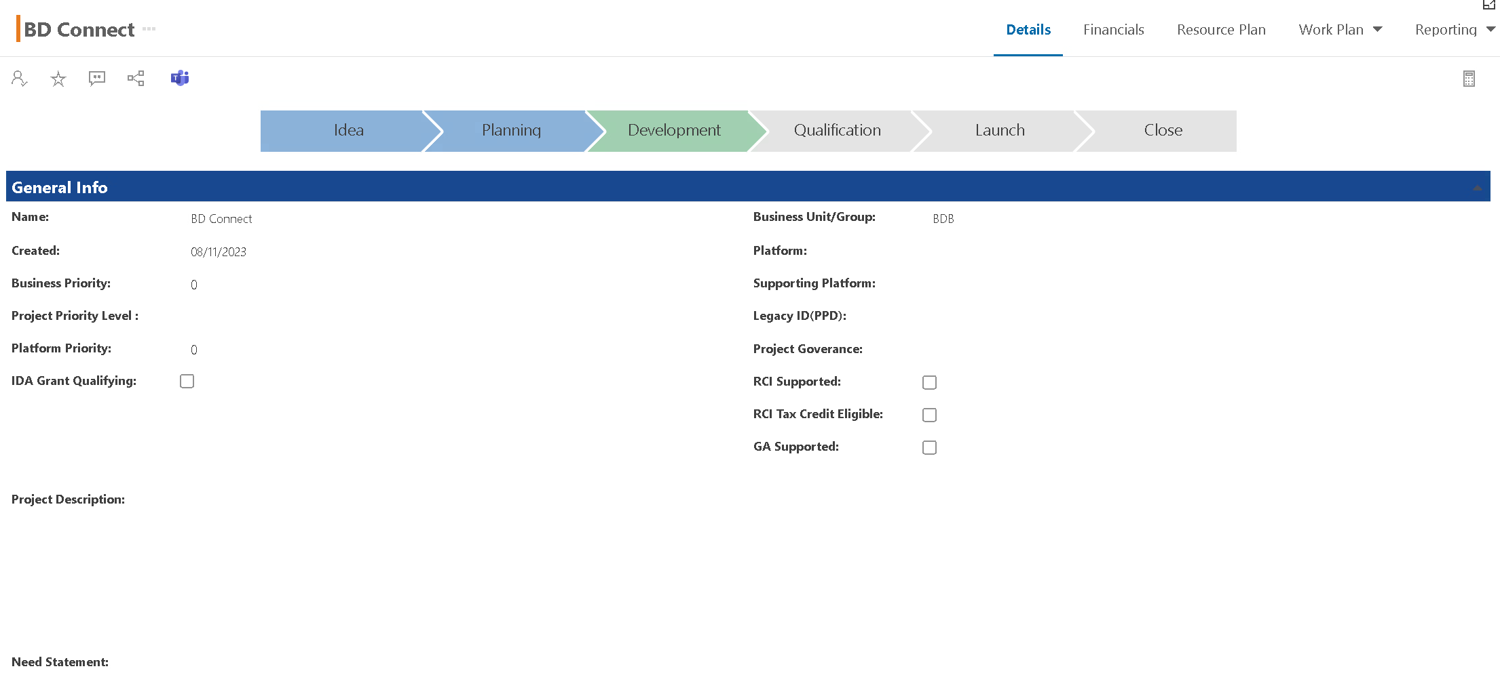
Plan Detail View
Once you are in your plan, you can access the different views from the top menu. The Details page will include all your top-level plan fields
Notes:
Add client’s screenshot

Slide 27
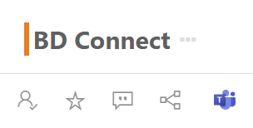



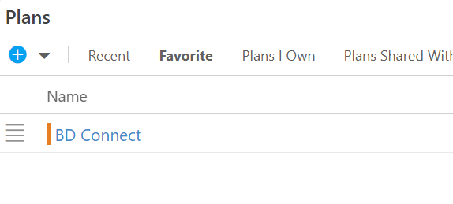
Plan Detail View Icons
This is Option 1. We will also show other options for sharing the project.
Shared With: Share the project with others
Add Favorite: The project will show in Home page as favorite
Comments: Add comments for the project
Notes:
Add client’s screenshot

Slide 28

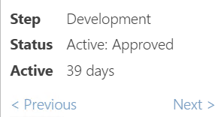
Plan Detail View – Process Phases
Click Previous or Next to move the project process to next phase
Phases information will be collected in Process History
Notes:
Add client’s screenshot

Slide 29
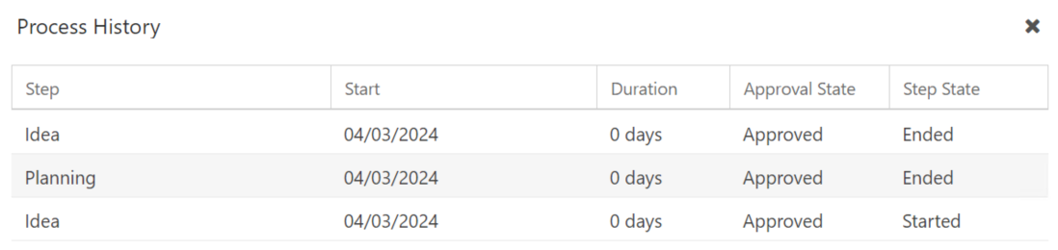
Plan Detail View – Process Phases History
Phases information will be collected in Process History
  Click on the Process History icon to access a record of the project’s progress through the various process step phases.
Notes:
Add client’s screenshot

Slide 30
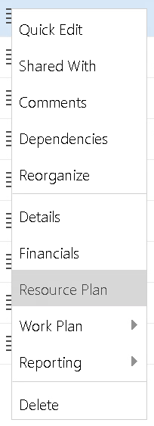
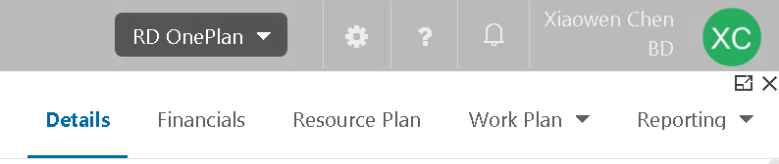
Accessing Resource Plan
From My Portfolio, use the “hamburger” menu on the left side of your project in the list, and select “Resource Plan”
Get into Project Detail page, and click “Resource Plan” on the top banal
NOTE: Our Resource Plan session will take place on Wednesday!
Notes:
Perhaps update if they’re not using “Project”

Slide 31
Accessing Financial Plan
From My Portfolio, use the “hamburger” menu on the left side of your project in the list, and select “Financials”
Get into Project Detail page, and click “Financials” on the top panel
NOTE: Our Financial Plan session will take place on Thursday!
Notes:
Perhaps update if they’re not using “Project”

Slide 32
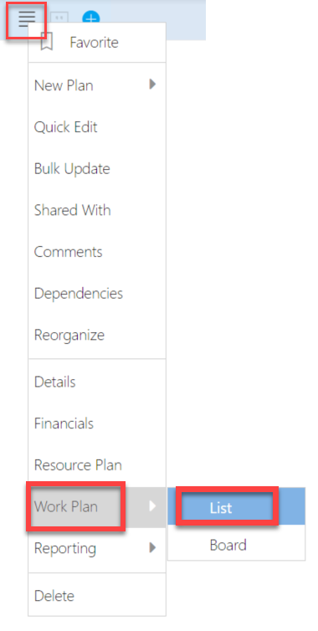
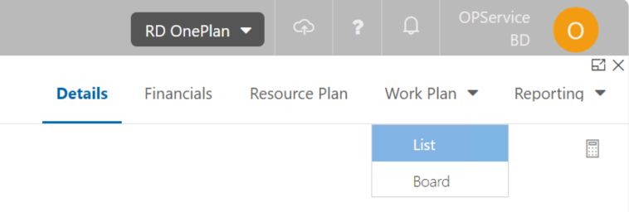
Accessing Work Plan
Option 1: From My Portfolio, use the “hamburger” menu on the left side of your project in the list, and select “Work Plan” –> ”List”
Option 2: Once you’re in the plan, click “Work Plan” on the top panel, and select “List”
NOTE: Our Schedule and Timesheet session will take place on Tuesday!
Notes:
Perhaps update if they’re not using “Project”

Slide 33
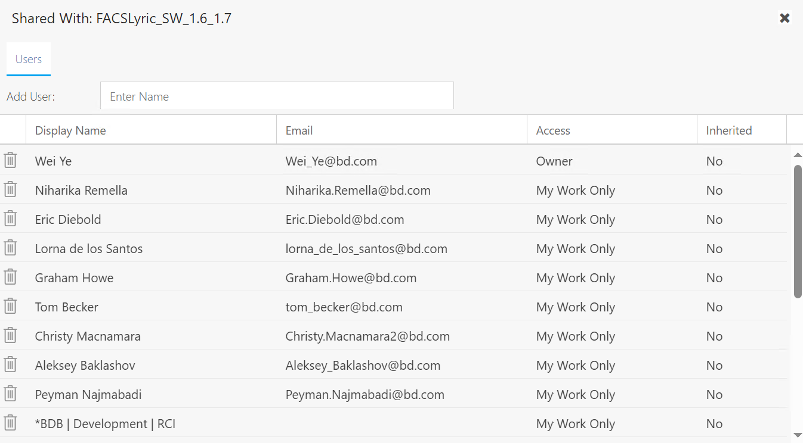
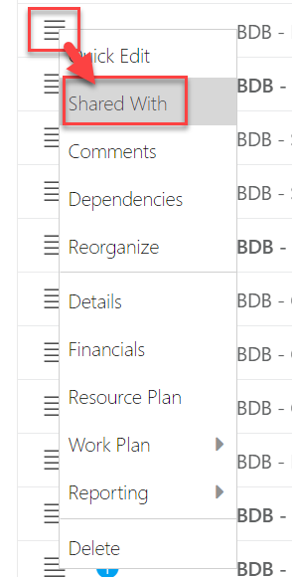
Share Projects - Option 2
NOTE: You will only be able to share projects if you are an Owner or Contributor on those projects.
To share the project, use the “hamburger” menu on the left side of your project in the list
Click “Shared With”, you can share the projects with other team members
Sharing Project Name
Enter the name for users you are going to share the project in

Slide 34
Share Projects
You can check the permission level of the users for this project
Here are all the users who can see the project

Slide 35
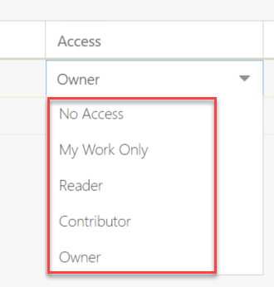
Share Projects – Permission Settings
No Access: The user will not have access to the plan, and will not see assigned work items in My Work. The user can be assigned to tasks by the Plan Manager.
My Work Only: The user will not have access to view the plan, but the user will see all assigned work items in their My Work area.
Reader: The user has read-only access to the plan. The user will see all assigned work items in their My Work area and can see Plan details and schedule.
Contributor: The user has edit access to the plan, but the user cannot delete or archive the plan.
Owner: The user has full edit rights to the plan. The user can delete or archive the plan.

Slide 36
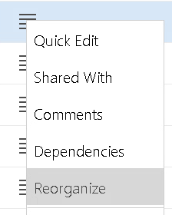
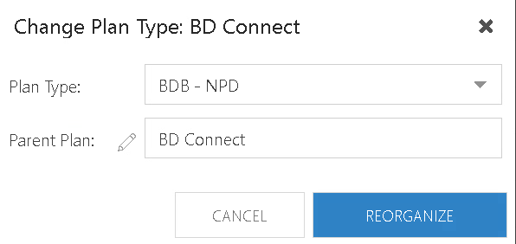
Move Projects to other Programs
To move the project under other program or platform, use the “hamburger” menu on the left side of your project in the list
Click “Reorganize” to change the project’s Plan Type (if applicable) and Parent Plan (the Program or Platform under which you want to move it
Note: If you change Plan Type for your Project, the fields that are not in the other plan type will disappear, but the original data are still stored in the system.

Slide 37
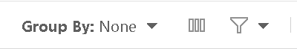
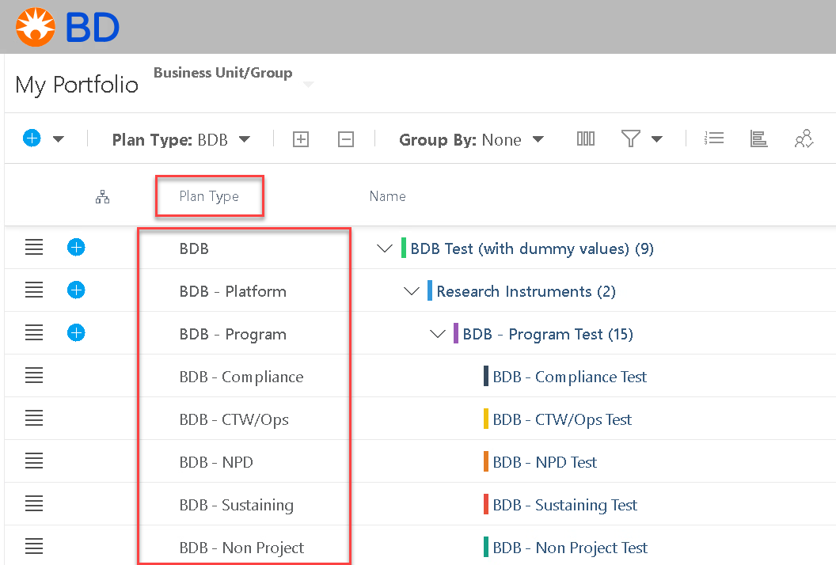
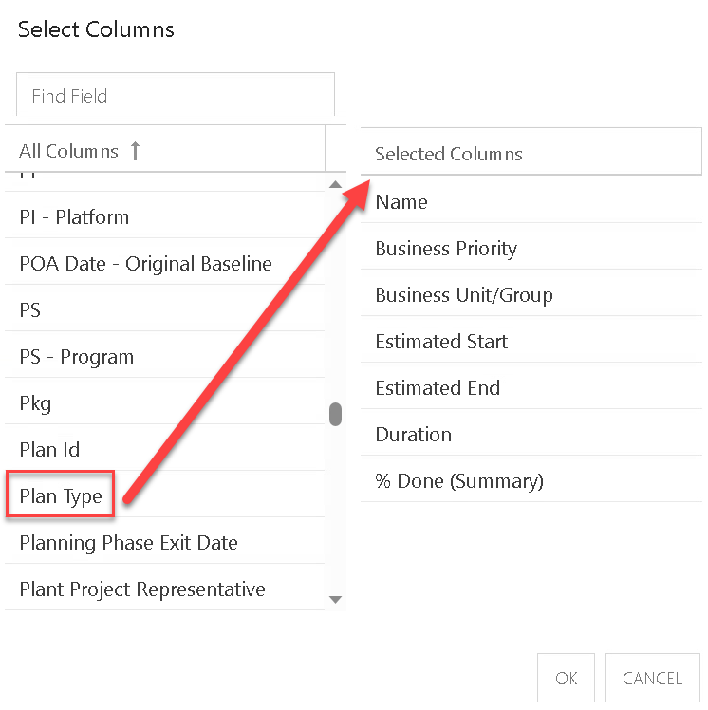
My Portfolio View – Create a Personal View
From My Portfolio, click Select Columns
Drag the fields you want to view on the My Portfolio page
Notes:
Perhaps update if they’re not using “Project”

Slide 38
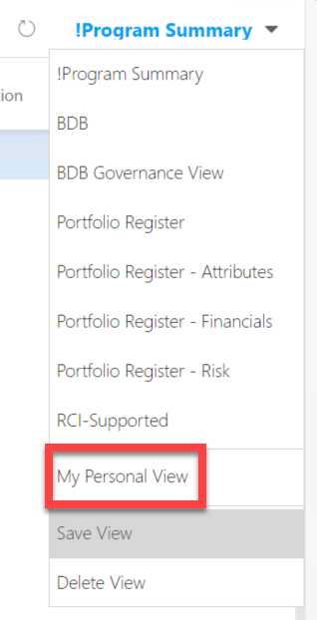
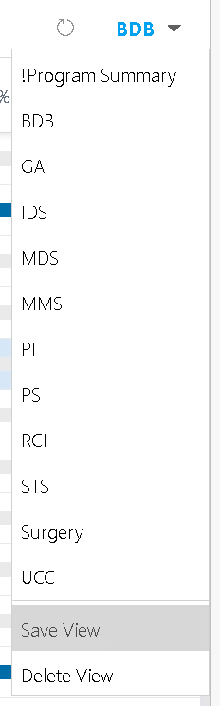

Save your own My Portfolio view
Save the view as Personal view
Type in the Name you want for your own personal view

Slide 39
Next Steps
Depending on your group, you will begin your R2 use of OnePlan
Practice right away… enter details on projects
Work with your team leads on your responsibilities in OnePlan
Further training will be given by your BU for BU-specific processes; Check with your Team Leader for details

Slide 40

Support site
You can find all the information included in this training on our support site

Slide 41
Muscle memory will develop. Don’t be hard on yourself as you learn - remember it will take time to get used to where to click!
OnePlan rolls out new updates about every 6 weeks. This means you’ll see improvements all the time!
The help guide and Support link is always available if you need it.
Final Points

Slide 42

Subscribe to our YouTube Channel
Stay on top of the latest tips and tricks and new features by subscribing to PPM Work’s YouTube Channel. Learn from our latest videos and earn free PDU’s.
https://www.youtube.com/c/ppmworks

